Slide 1
Supplementary Fig 1
Frequencies of FOXJ1 positive cells
Supplementary Fig. 1. Frequencies of FOXJ1-positive cells
Box-and-whisker plots showing the percentage of FOXJ1-positive epithelial cells in eutopic endometrium (EM) and fallopian tube (FT) from women without endometriosis (w/o EMS; EM n = 10, FT n = 10) and with endometriosis (with EMS; EM n = 7, FT n = 7). NS indicates no significant difference between groups (unpaired Student’s t-test). EM, endometrium; FT, fallopian tube; FOXJ1, Forkhead box J1; NS, not significant.

Slide 2
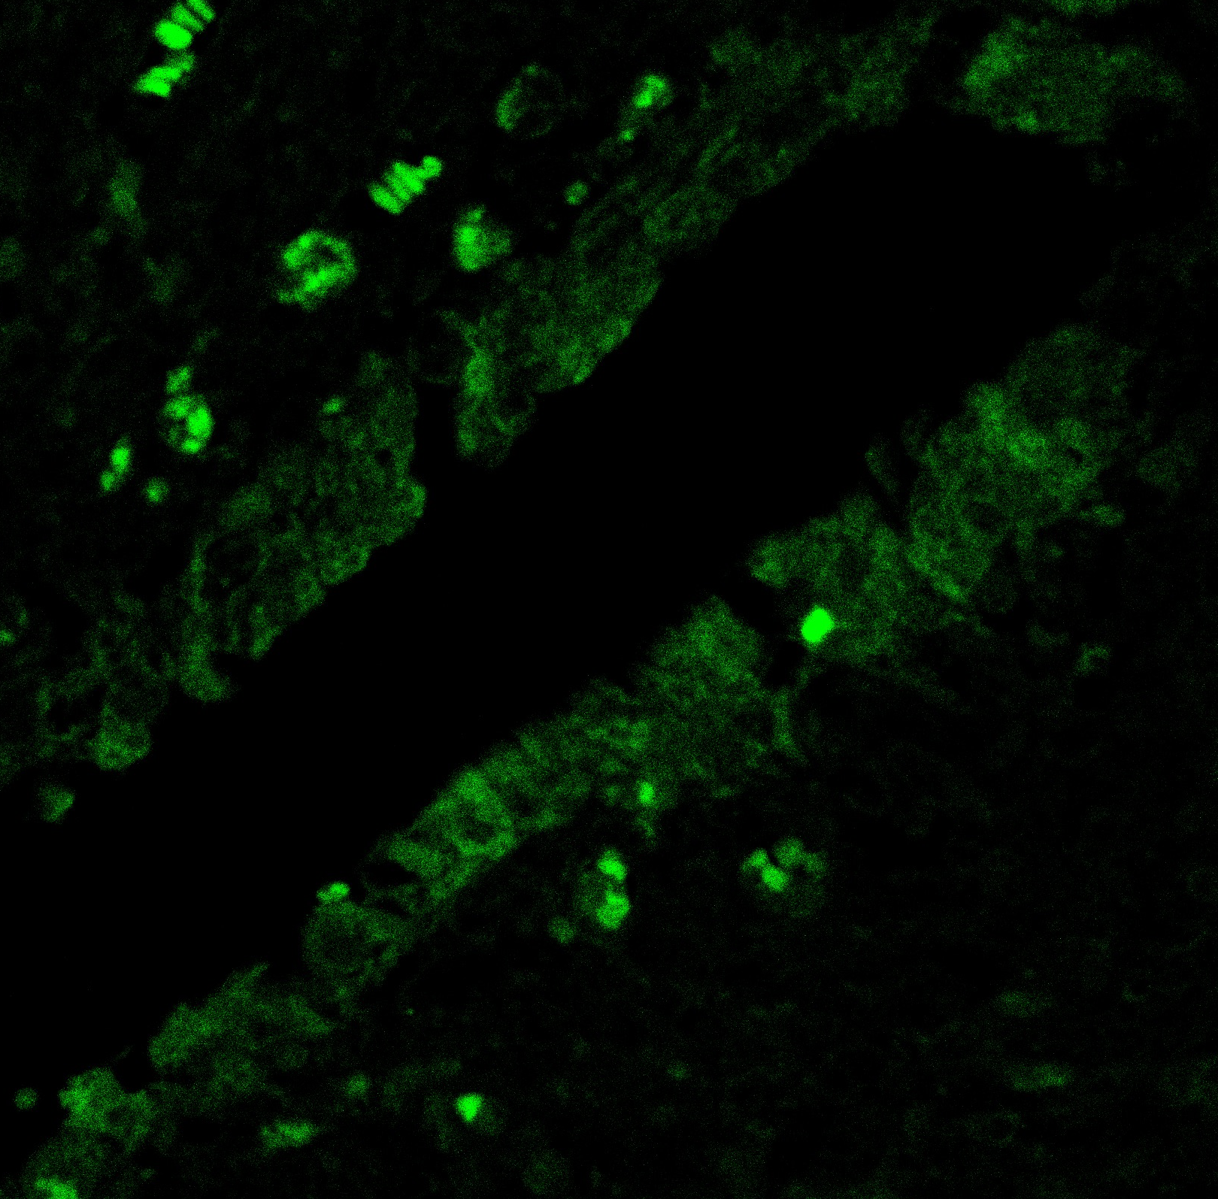
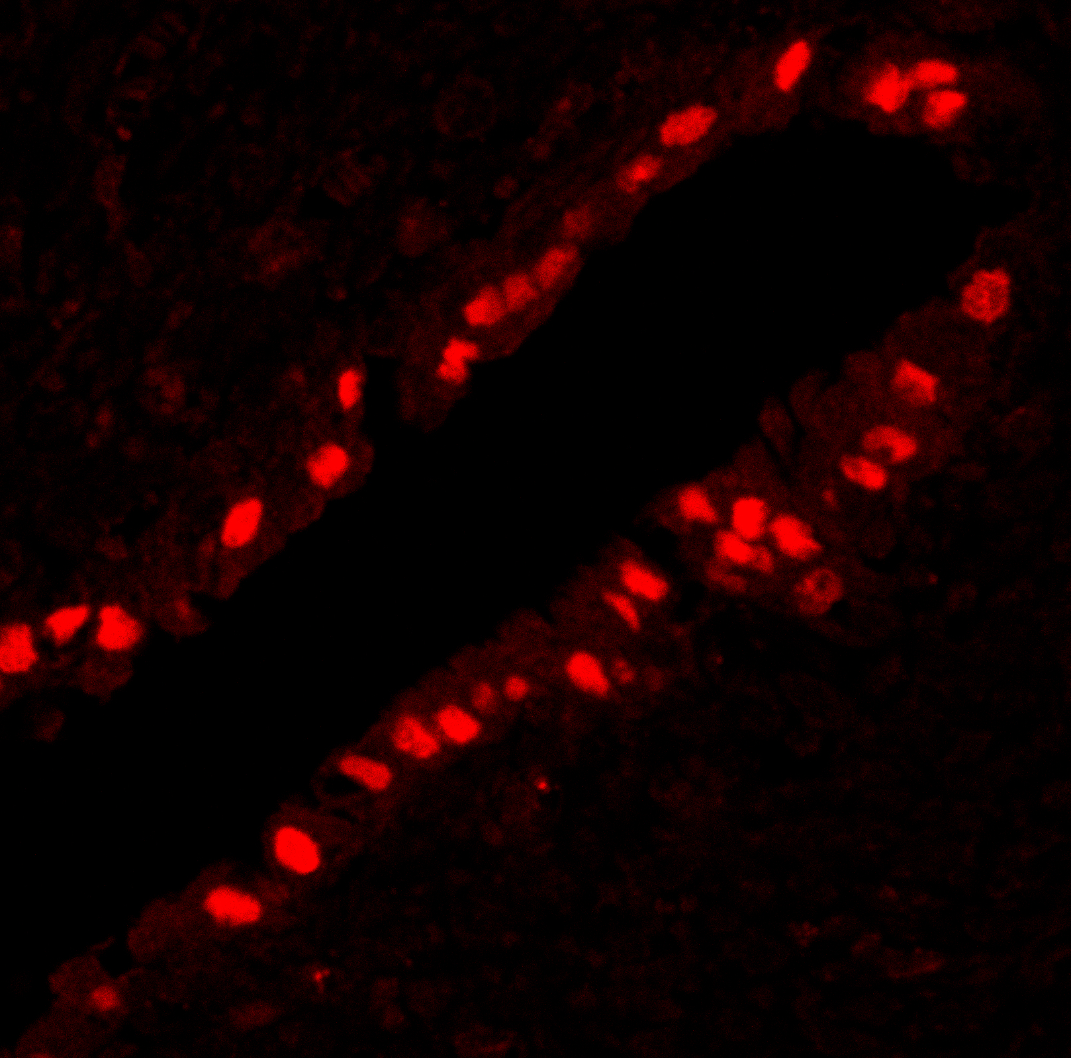
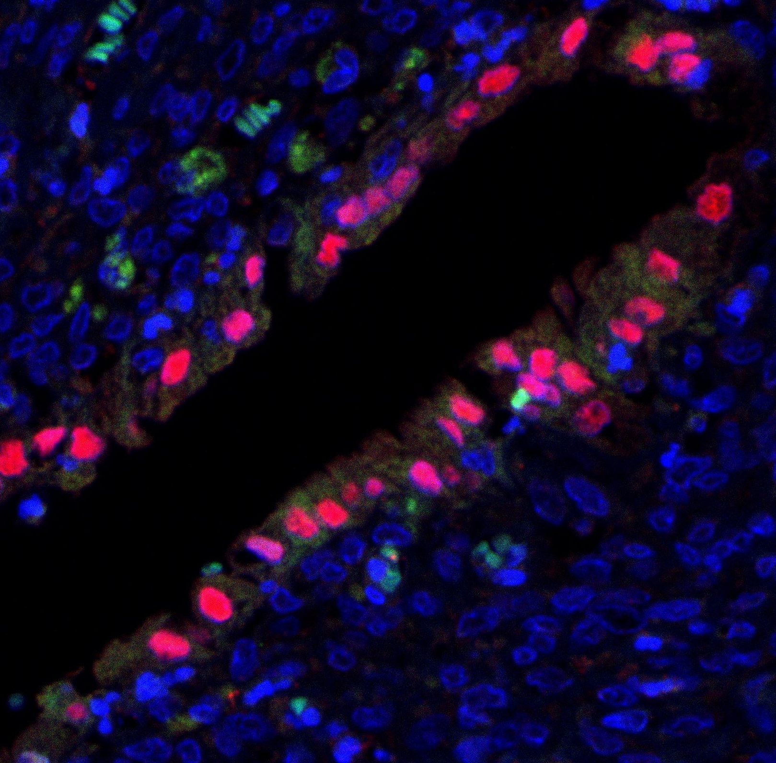
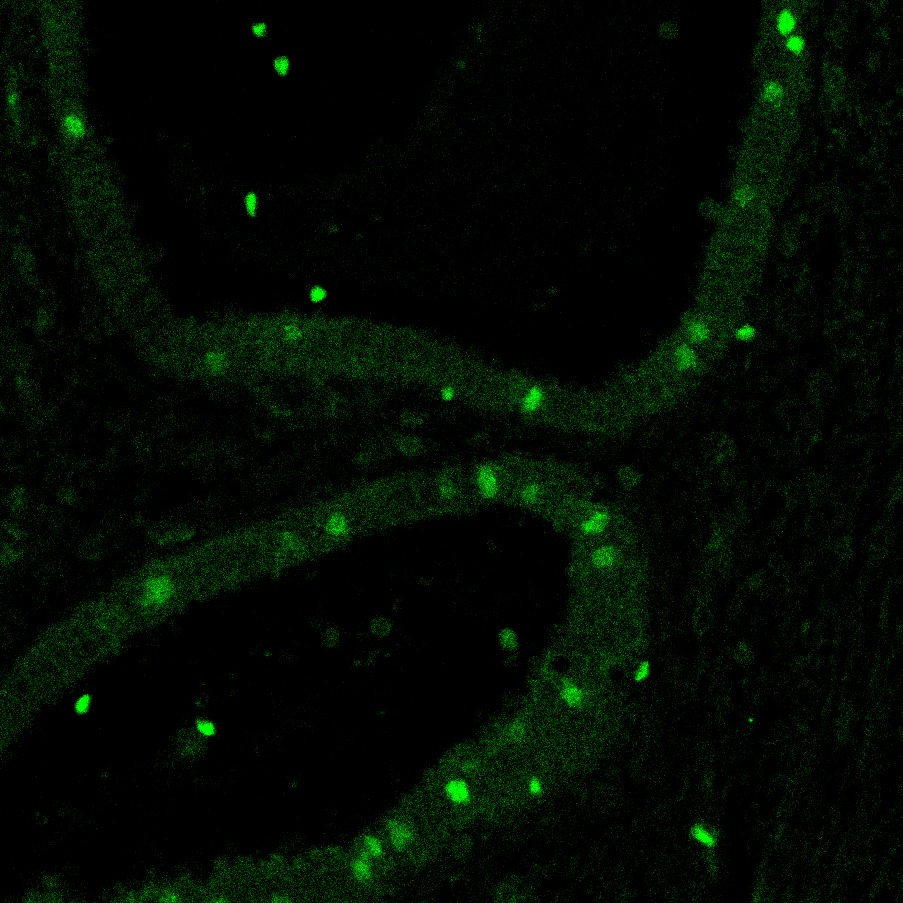
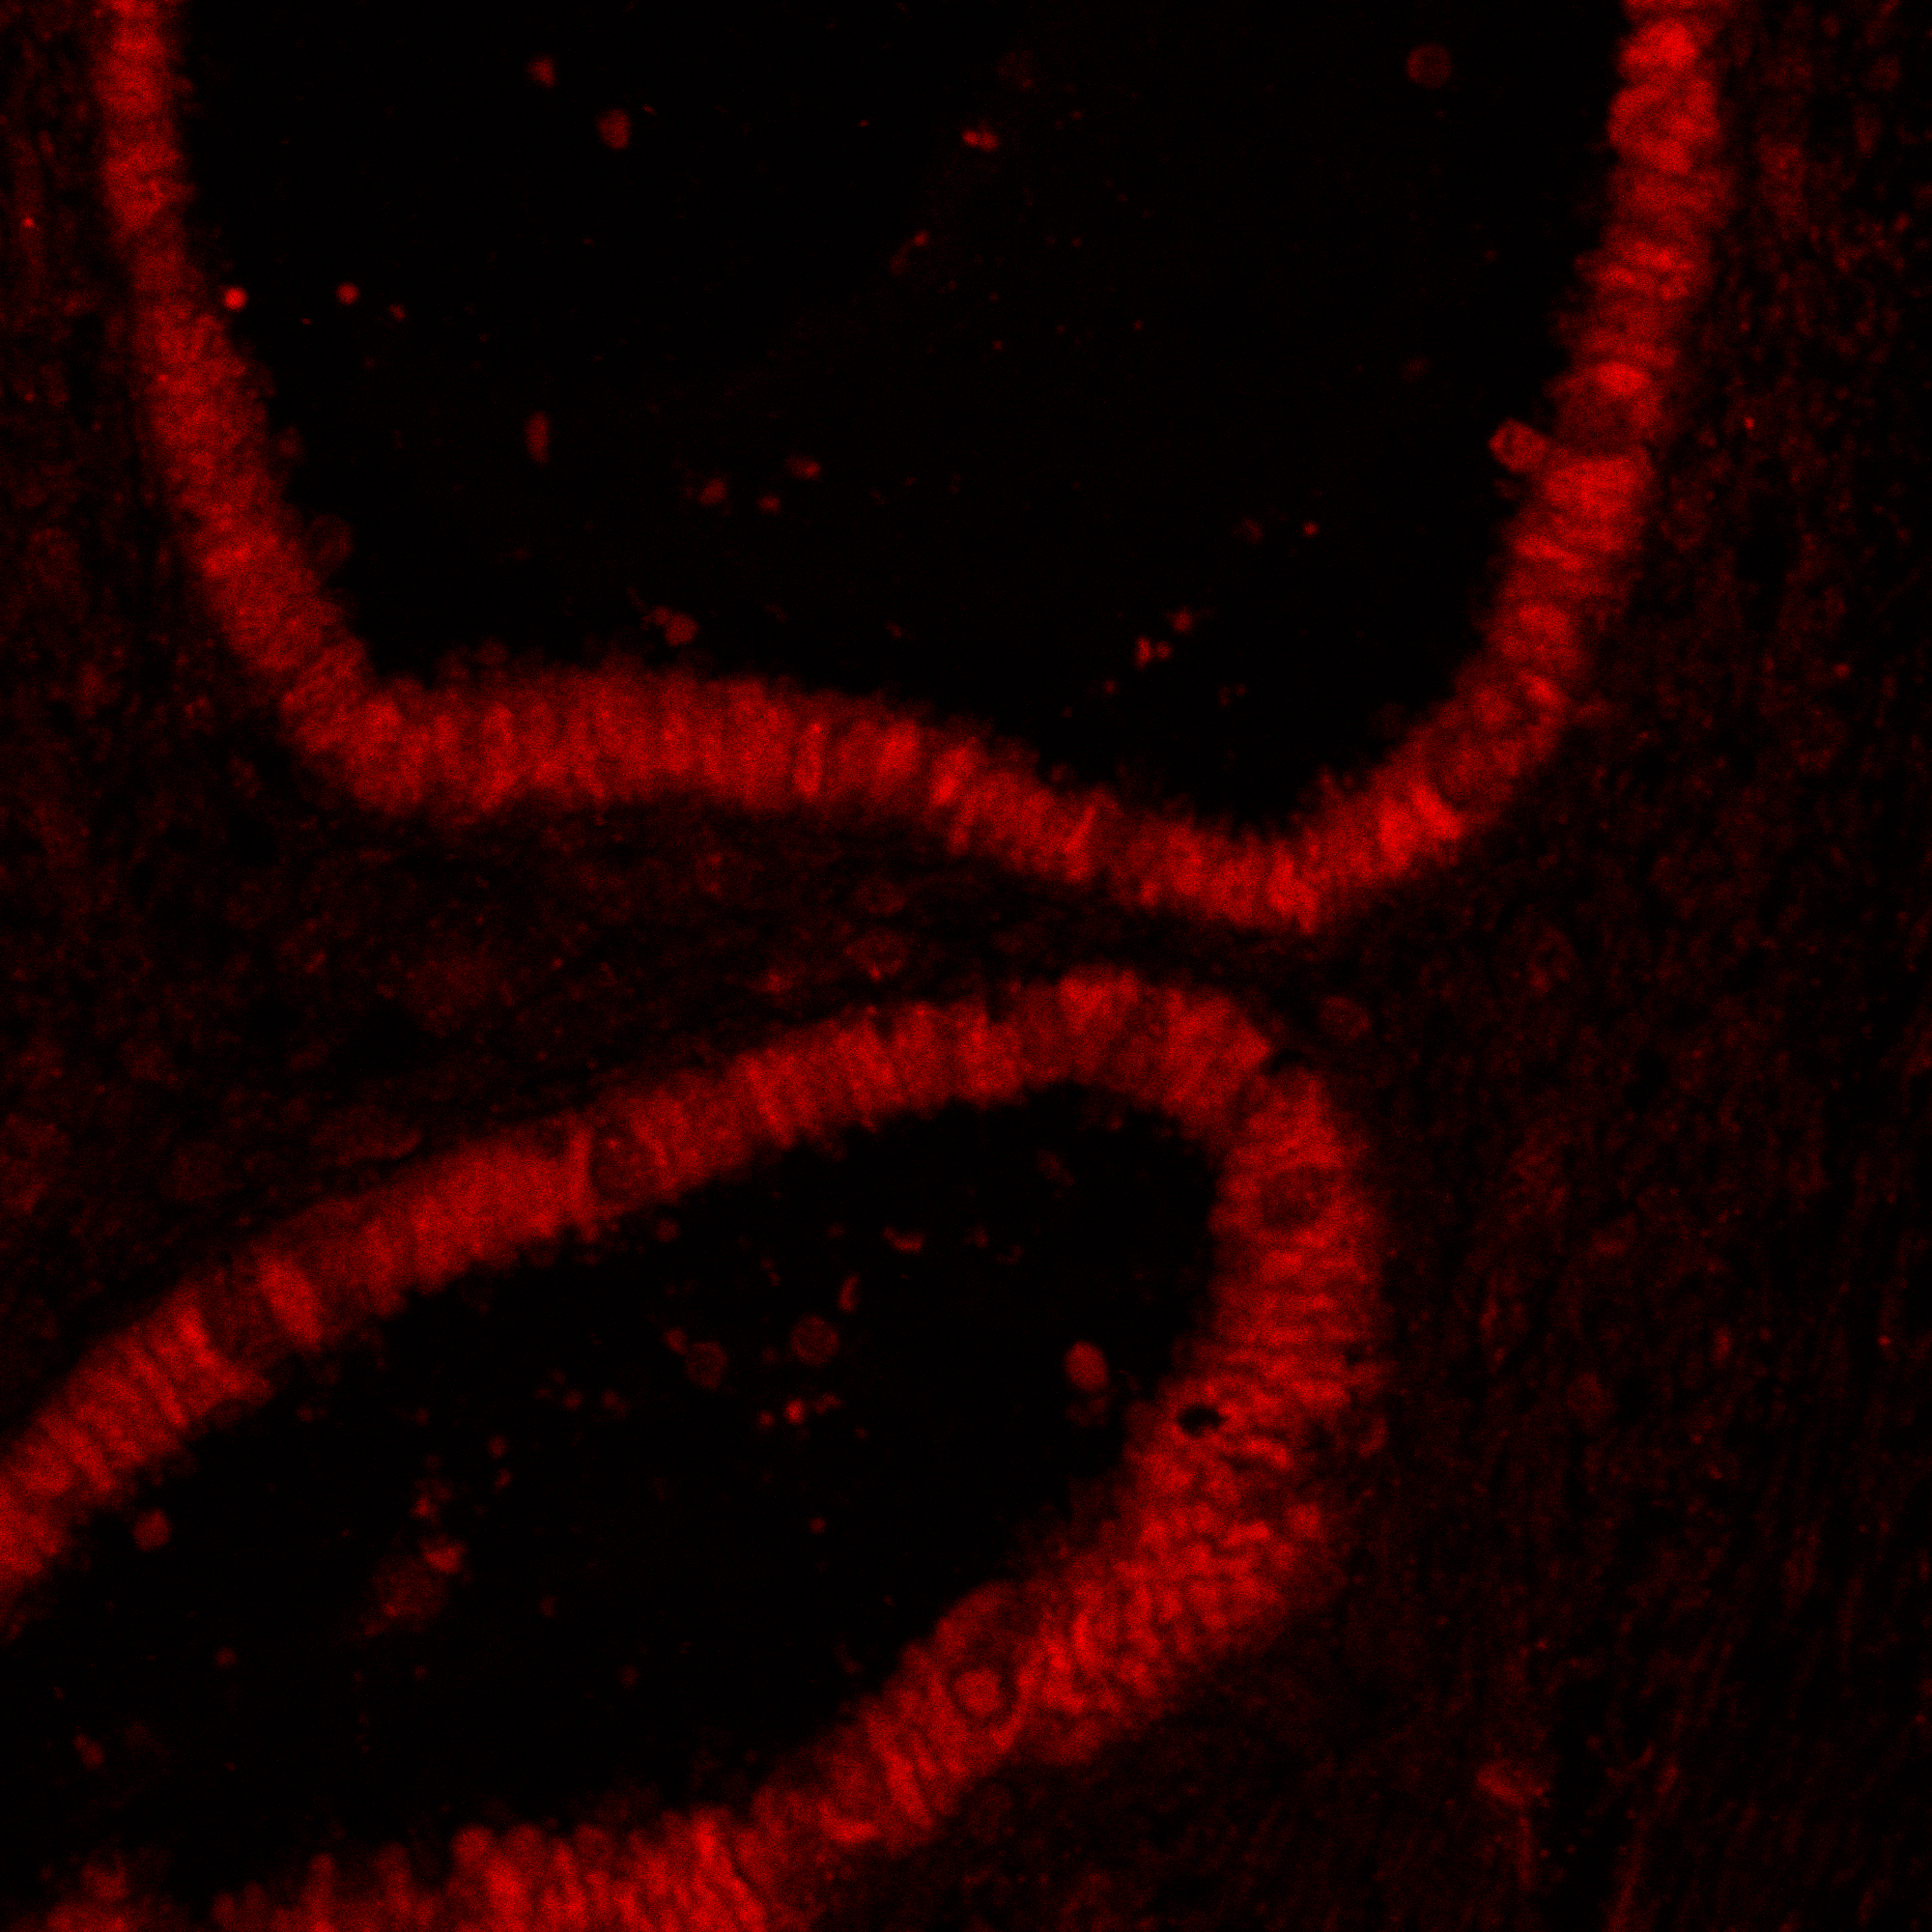
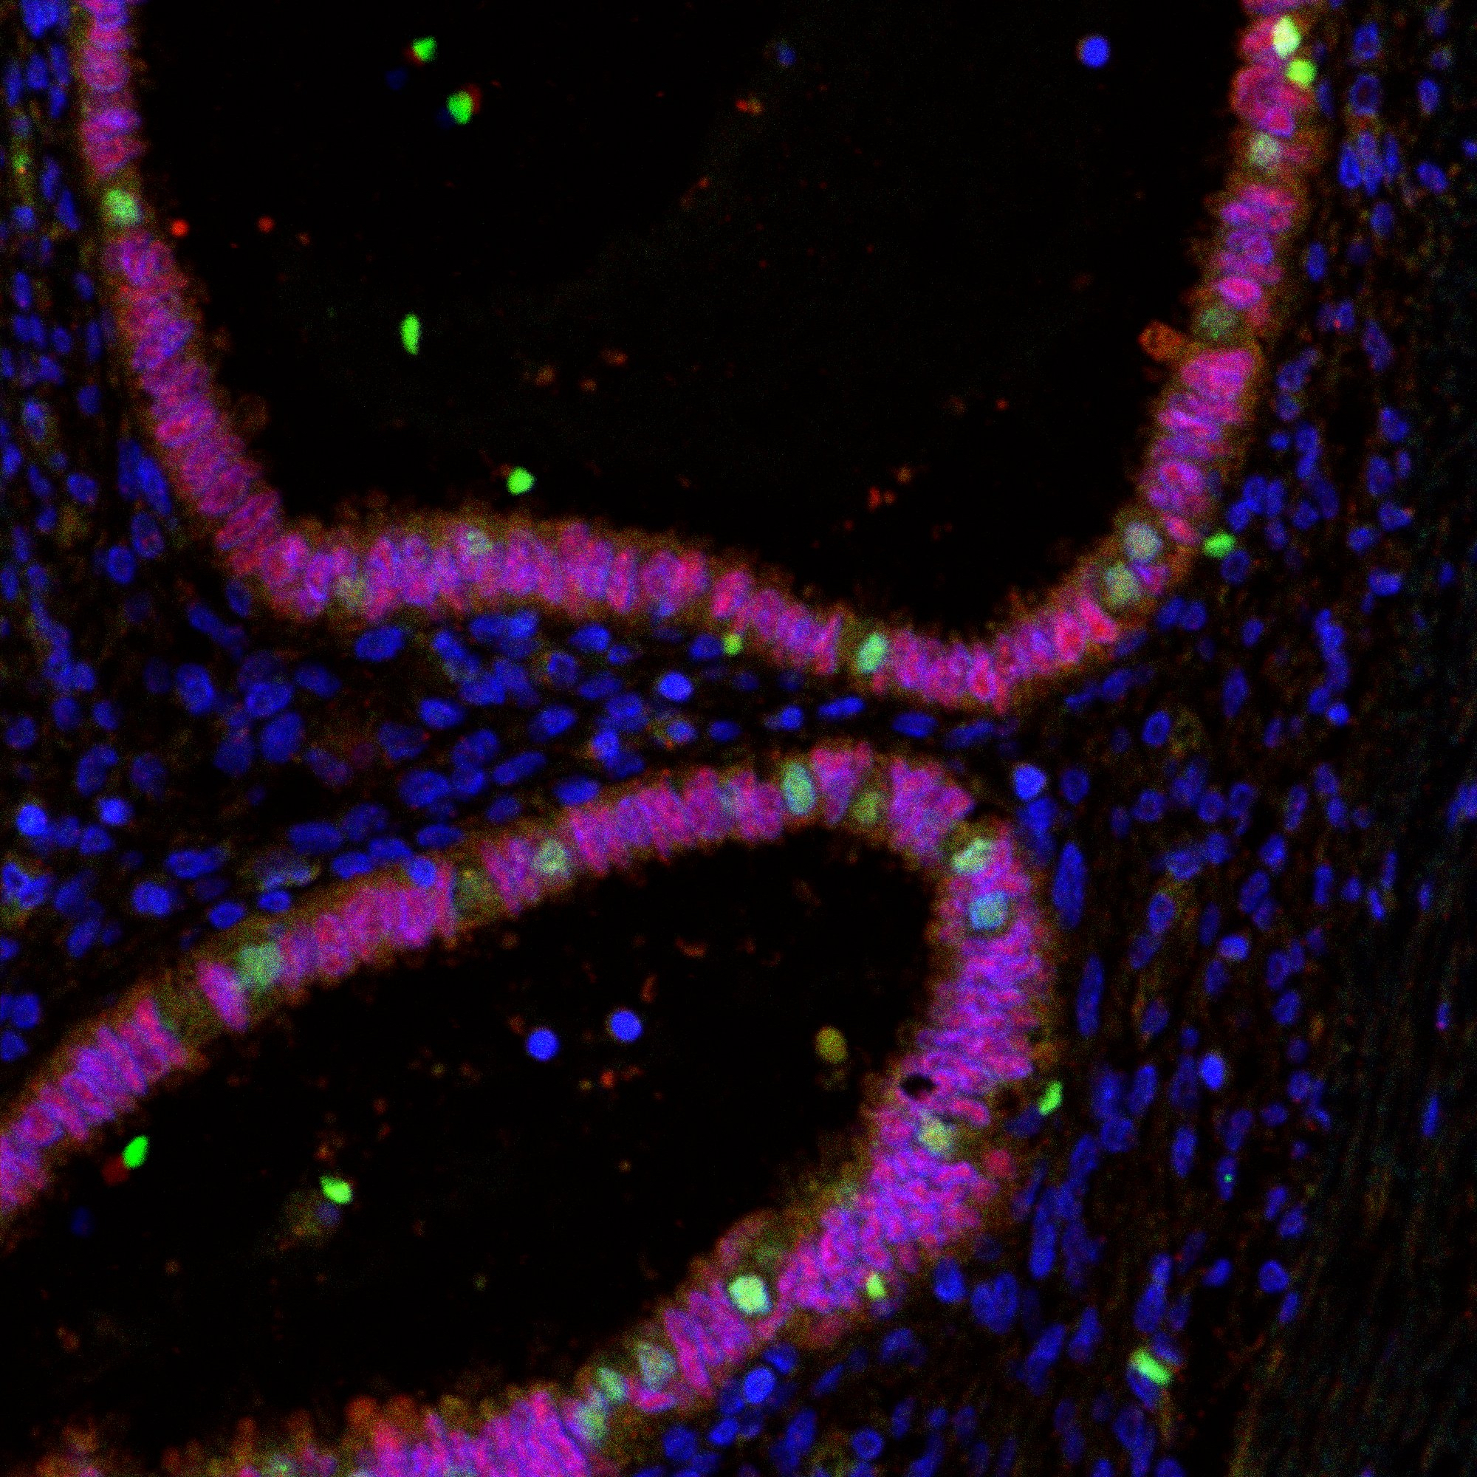
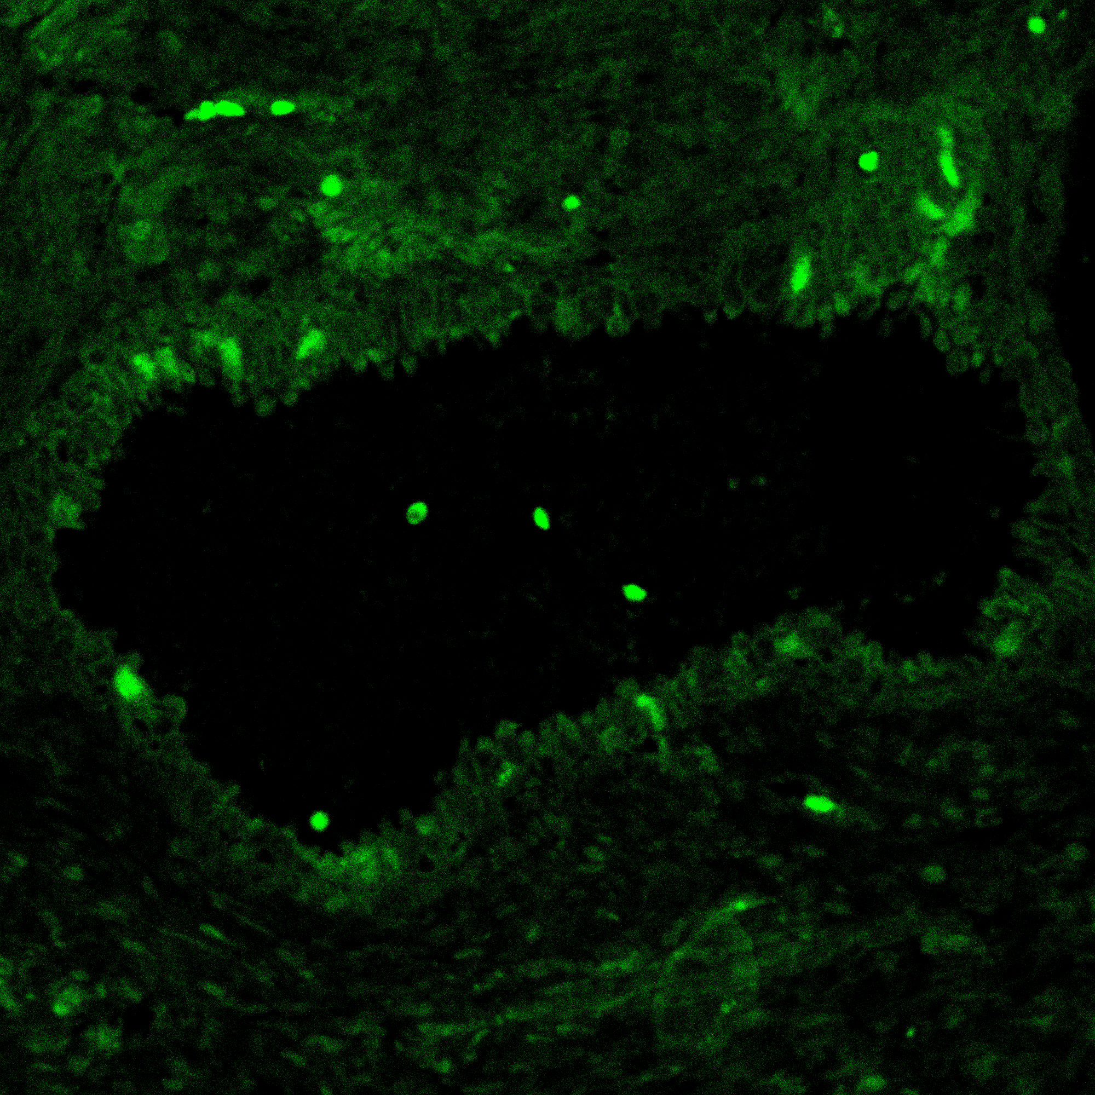
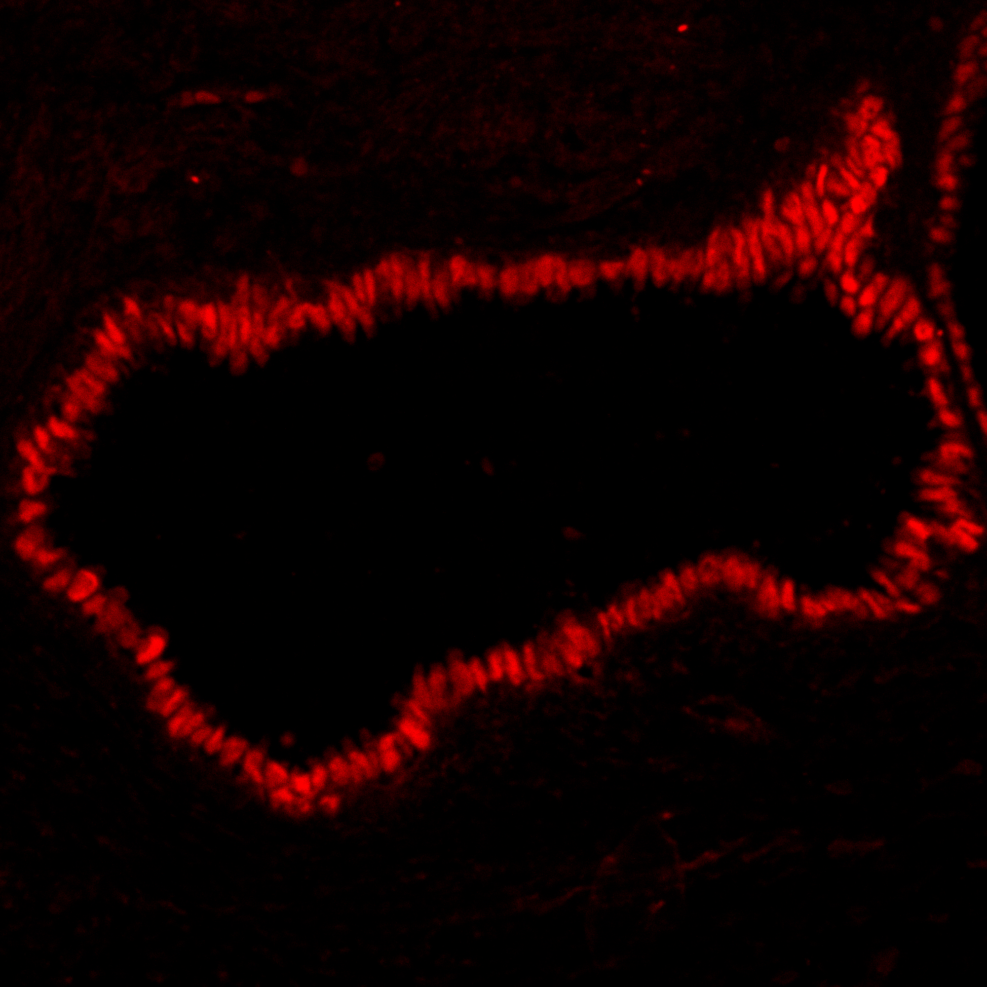
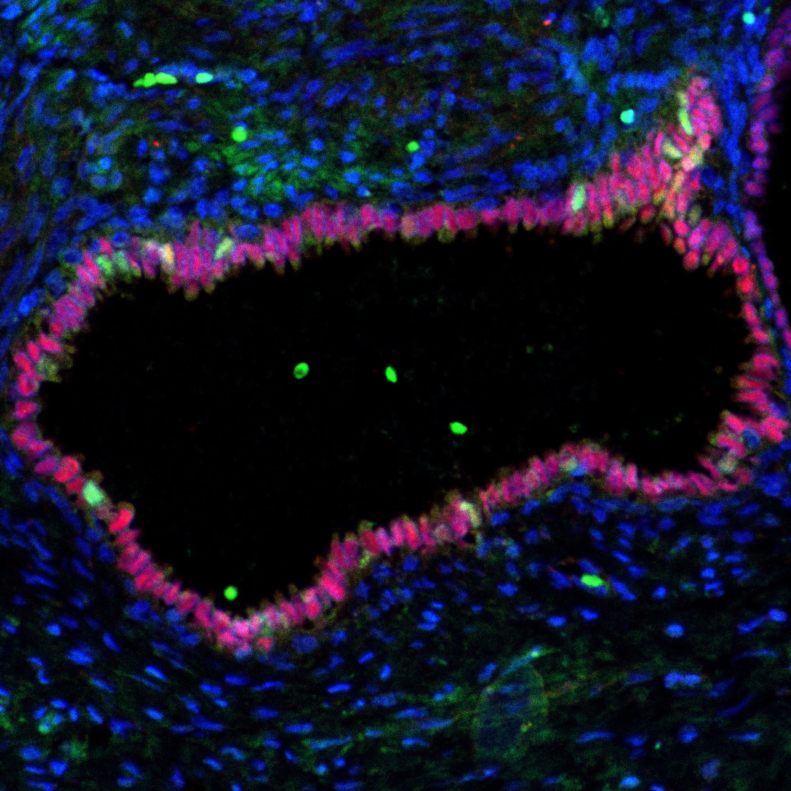
Supplementary Fig 2
A
B
C
Type
1
Ov
EMS
FOXJ1
100μm
PAX8
Merge
D
E
F
DE
FOXJ1
PAX8
Merge
G
H
I
PE
FOXJ1
PAX8
Merge

Slide 3
Supplementary Fig. 2. Co-localization of FOXJ1 and PAX8 in type 1 ovarian endometrioma, deep endometriosis, and peritoneal endometriosis
Representative double immunofluorescence images of FOXJ1 (green) and PAX8 (red); merged images include DAPI nuclear counterstaining (blue). (A–C) Type 1 ovarian endometrioma (Ov EMS), (D–F) deep endometriosis (DE), and (G–I) peritoneal endometriosis (PE). Arrowheads indicate FOXJ1-positive ciliated cells; in DE and PE, white arrowheads denote FOXJ1-positive cells without PAX8 signal, whereas yellow arrowheads denote FOXJ1-positive cells with strong nuclear PAX8 co-expression. Scale bar: 100 μm. FOXJ1, Forkhead box J1; PAX8, paired box gene 8; Ov EMS, ovarian endometrioma; DE, deep endometriosis; PE, peritoneal endometriosis.

