Slide 1
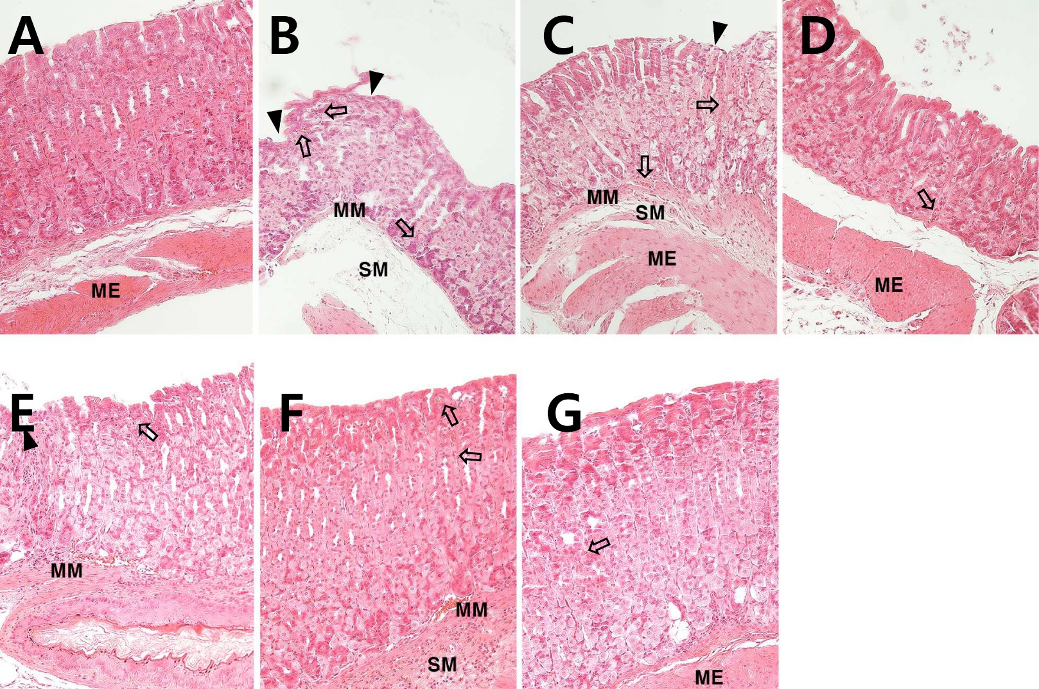
Suppl. 1. Hematoxylin & eosin staining of gastric tissue
A; Wild-type mice
B; DW
C; Zo,
D: Pg,
E; PZ 1:3,
F; PZ 1:1,
G; PZ 3:1
ME; muscularis externa,
SM; submucosa,
MM; muscularis mucosa,
Arrow; hemorrhage, arrow head; epithelial disruption. (x200).
(n-2 in each group)

Slide 2
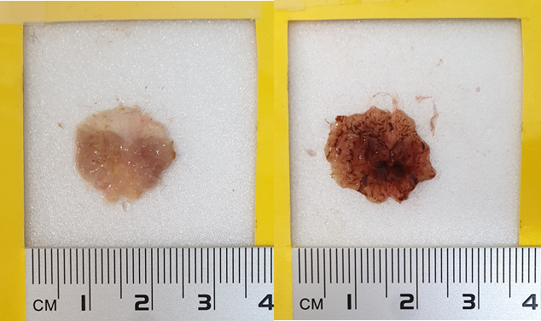
Suppl. 2. Photographs of the inside of the stomach of normal mice and mice subjected to water immersion stress.
Normal condition
Water immersion

Slide 3
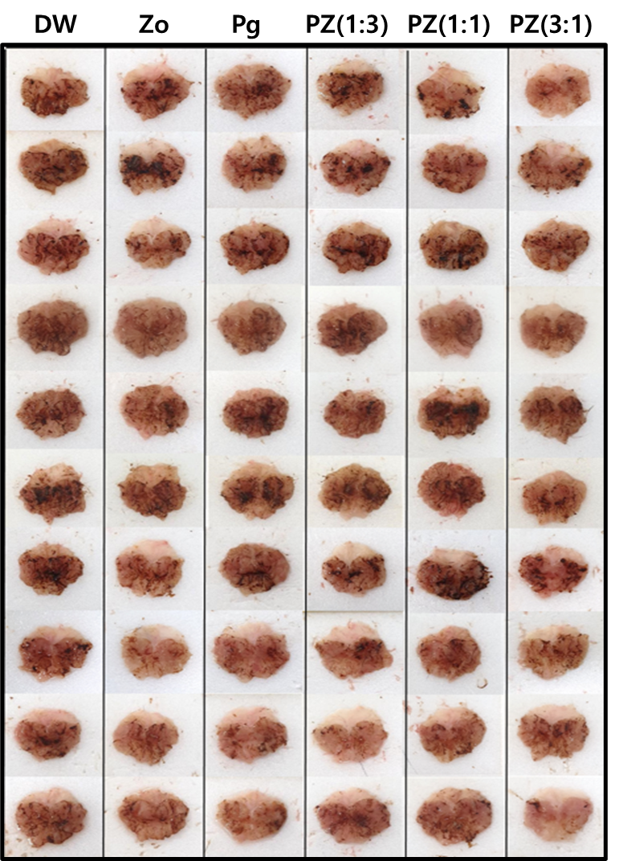
Suppl. 3. WIRS-induced gastrointestinal bleeding

