Slide 1
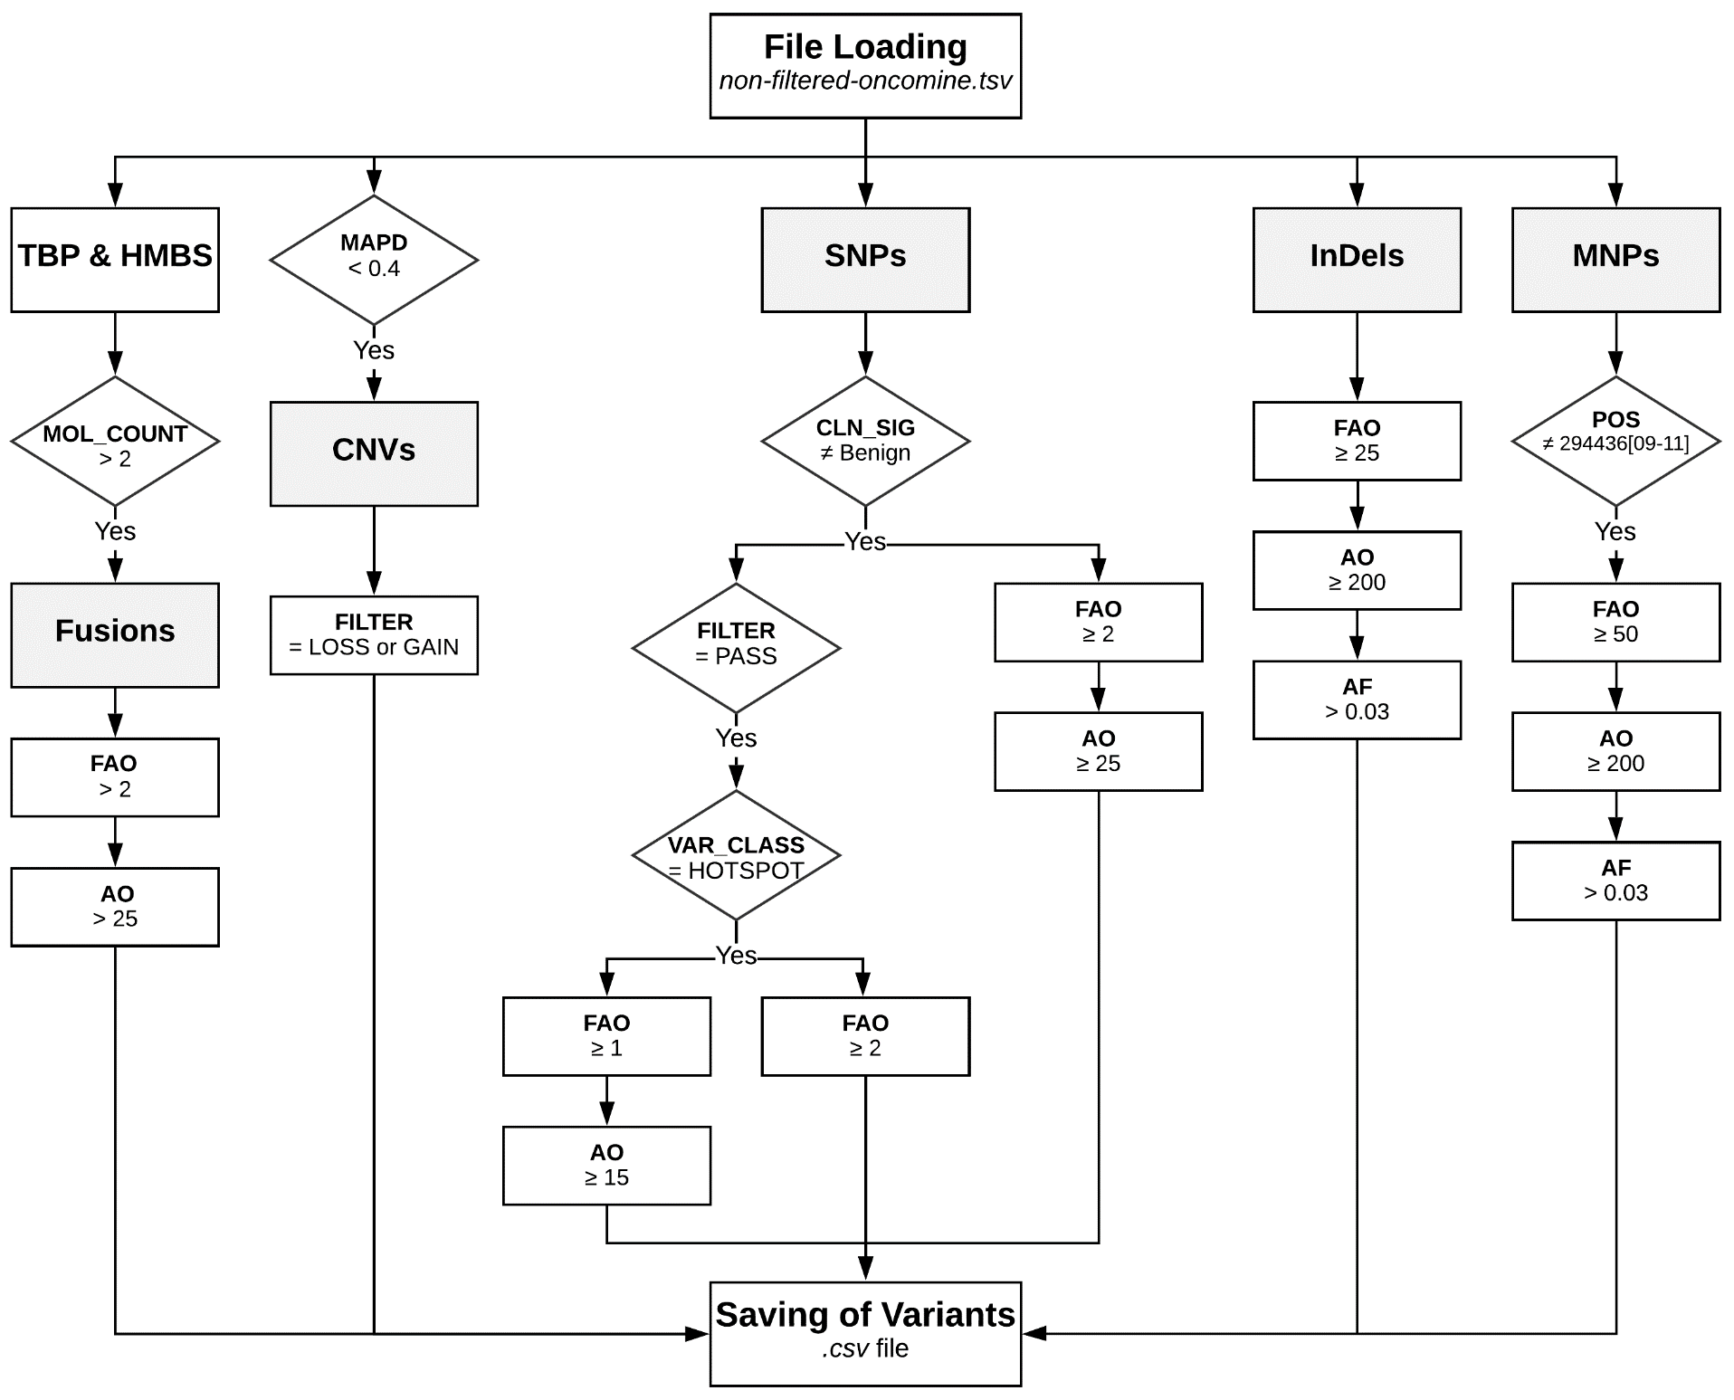
Figure S1. Flowchart of the bioinformatic pipeline optimized for the processing and assessment of variants at the ALK gene locus. FAO, molecular coverage; AO, read coverage; MAPD, median of the absolute values of all pairwise differences; FILTER: Ion Reporter™ internal filter (Oncomine™ Variants v5.12); CLN_SIG, clinical significance; VAR_CLASS: Oncomine™ Variant Class; POS: variant position; AF, allele frequency.

