Slide 1
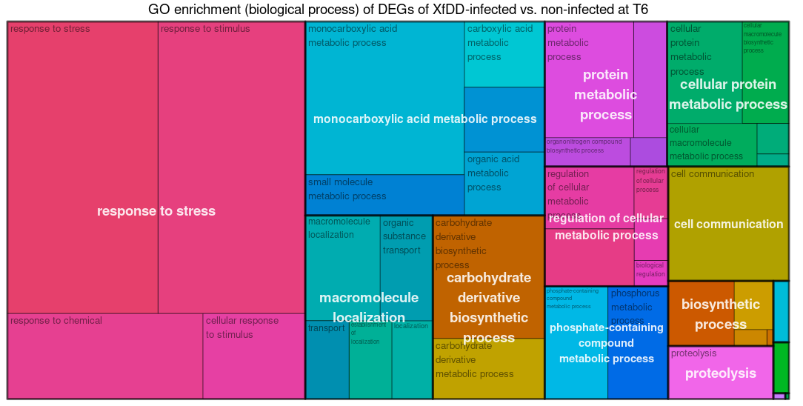
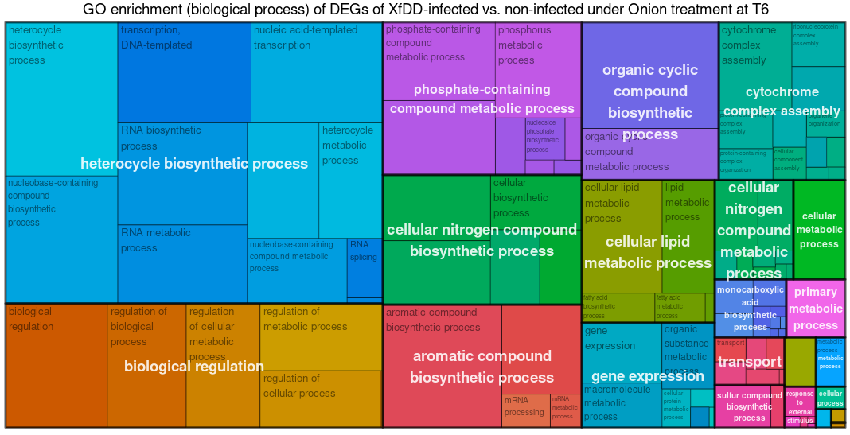
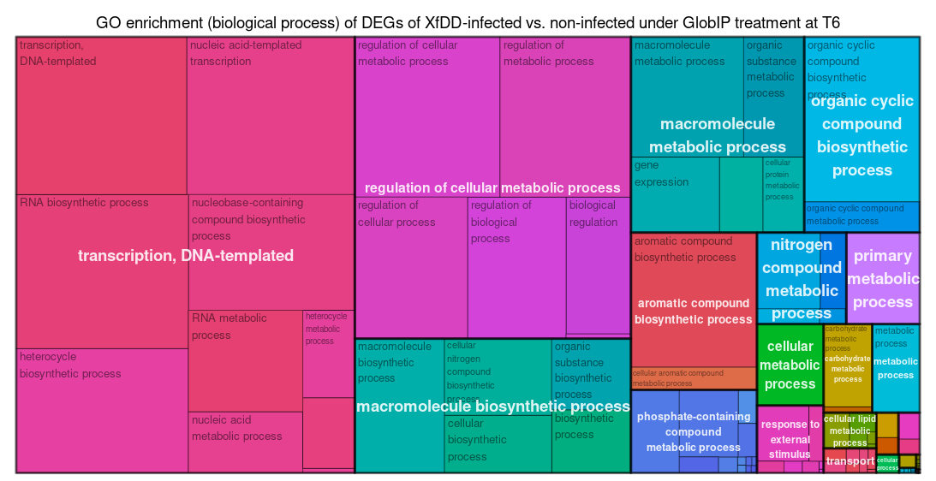
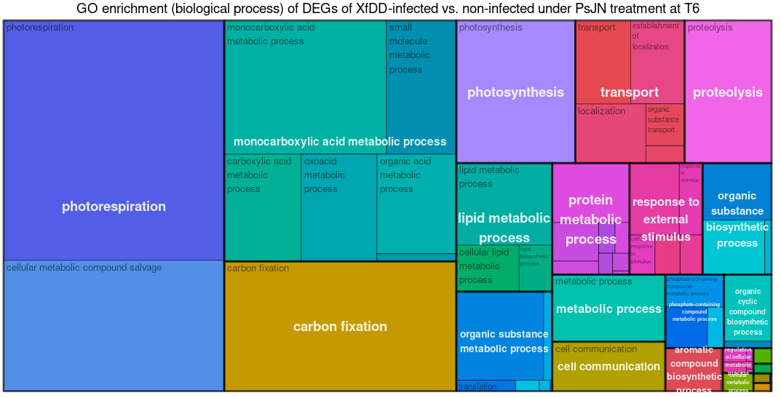
Additional file 3: Fig. S3.: GO enrichment (BP) of DEGs of XfDD-infected vs. non-infected at T6
Control
Onion treatment
Sankari© treatment
PsJN treatment
Notes:
Additional file 3: Fig. S3. Treemap visualization of the GO enrichment analysis of DEG sets of XfDD infected samples compared to non-infected samples without any treatment or within each treatment group at T6 by the rrvgo package.

