Slide 1
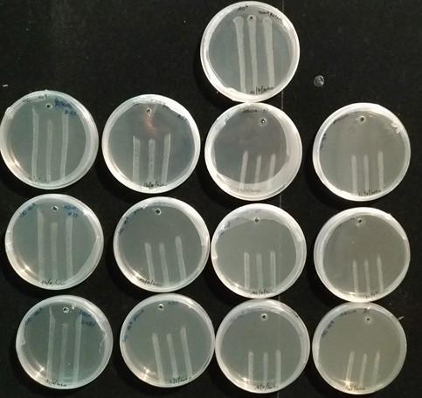
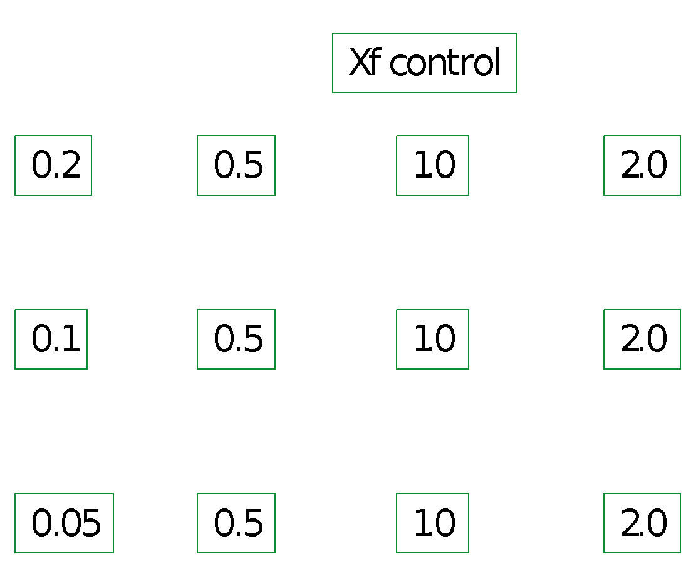
Additional file 1: Fig. S1
a)
b)
Notes:
Additional file 1: Fig. S1.Evaluation of in vitro antagonistic activity of Paraburkholderia phytofirmans strain PsJN against XfDD (a) and Onion extract (b). PsJN was inoculated on the top of the agar in a single point while XfDD was placed as suspension drop. Different concentrations of Onion extract were pipetted in a well as indicated in the right scheme of (b).

