Slide 1
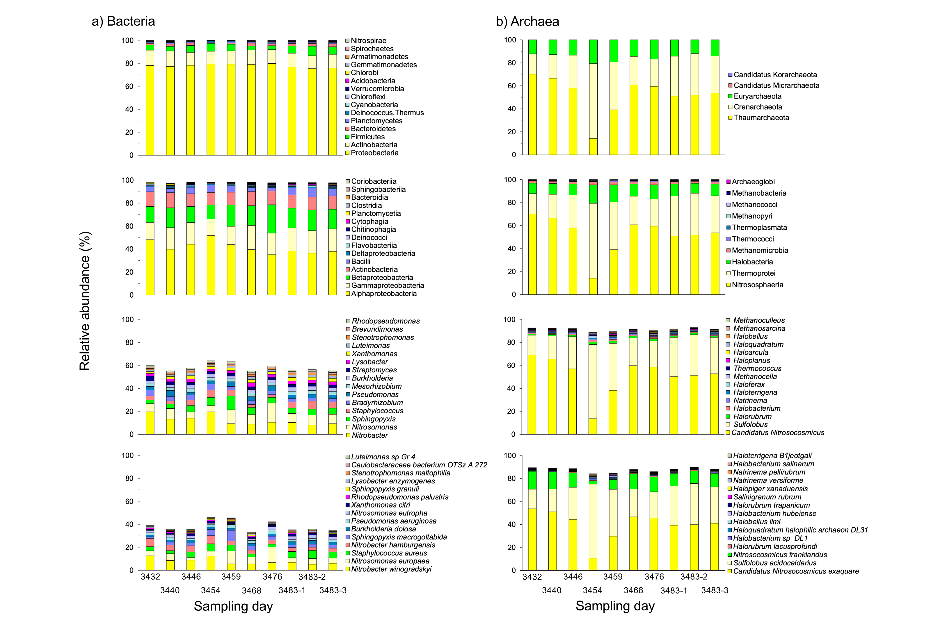
Mass flow controller
Medium
Effluent
Settled biomass
Liquid waste
Bioreactor > 9 years

