Slide 1
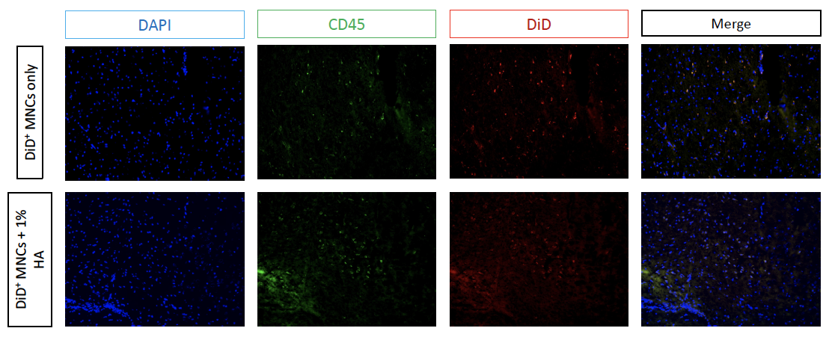
Supplement data
Fig. S1 HA facilitates the retention of MNCs at the infarction site on post-stroke day 3.

Slide 2
Fig. S2 Microglia polarization from M1 to M2 (P4: M2; P5: M1) after combine treatment. Data was presented as the mean ± SEM. n=2 per group.

Slide 3
Fig. S3 Levels of IL-10, TNF-alpha, and IL-1beta at post-stroke day 3. Cytokine levels were detected using ELISA. Data was analyzed with ordinary one-way ANOVA with post hoc Tukey’s test and presented as the mean ± SEM. n=3 per group. *P < 0.05.

