Slide 1
Table 1: Spatial and temporal changes in myelin proteins after juvenile MeV infection
Brain Region: | Hippocampus |  | SVZ |  | Cerebellum |  | Cortex
Day post-infection: | 9 | 90 | 9 | 90 | 9 | 90 | 9 | 90
PLP - HMW isoform | - | ↓ | - | ↓ | ↑ | - | ↓ | ↑
PLP - LMW isoform | - | - | - | ↓↓ | ↑ | - | - | -
PLP – all isoforms | - | ↓ | - | ↓ | ↑ | - | ↓ | ↑
MBP - HMW isoform | - | - | ↓↓ | - | - | - | ↓ | ↑
MBP - MMW isoform | - | - | - | - | - | - | - | -
MBP - LMW isoform | - | ↓ | - | - | ↑ | - | - | -
MBP – all isoforms | - | ↓ | ↓ | - | - | ↓ | - | -
MOG | - | - | - | ↓ | - | - | - | -
MAG | - | ↓ | - | ↓ | - | - | - | -
MBP: myelin basic protein, PLP: myelin proteolipid protein, MAG: myelin associated glycoprotein, MOG: Myelin oligodendrocyte protein, HMW: high molecular weight, MMW: mid molecular weight, LMW: low molecular weight
↓↓ : >25% decrease compared to PBS-injected control
↓ or ↑ : <±25% change compared to PBS-injected control
Grey arrows (↓/↑ ) : trend towards significance (p=0.05-0.07)
- : no significant change

Slide 2
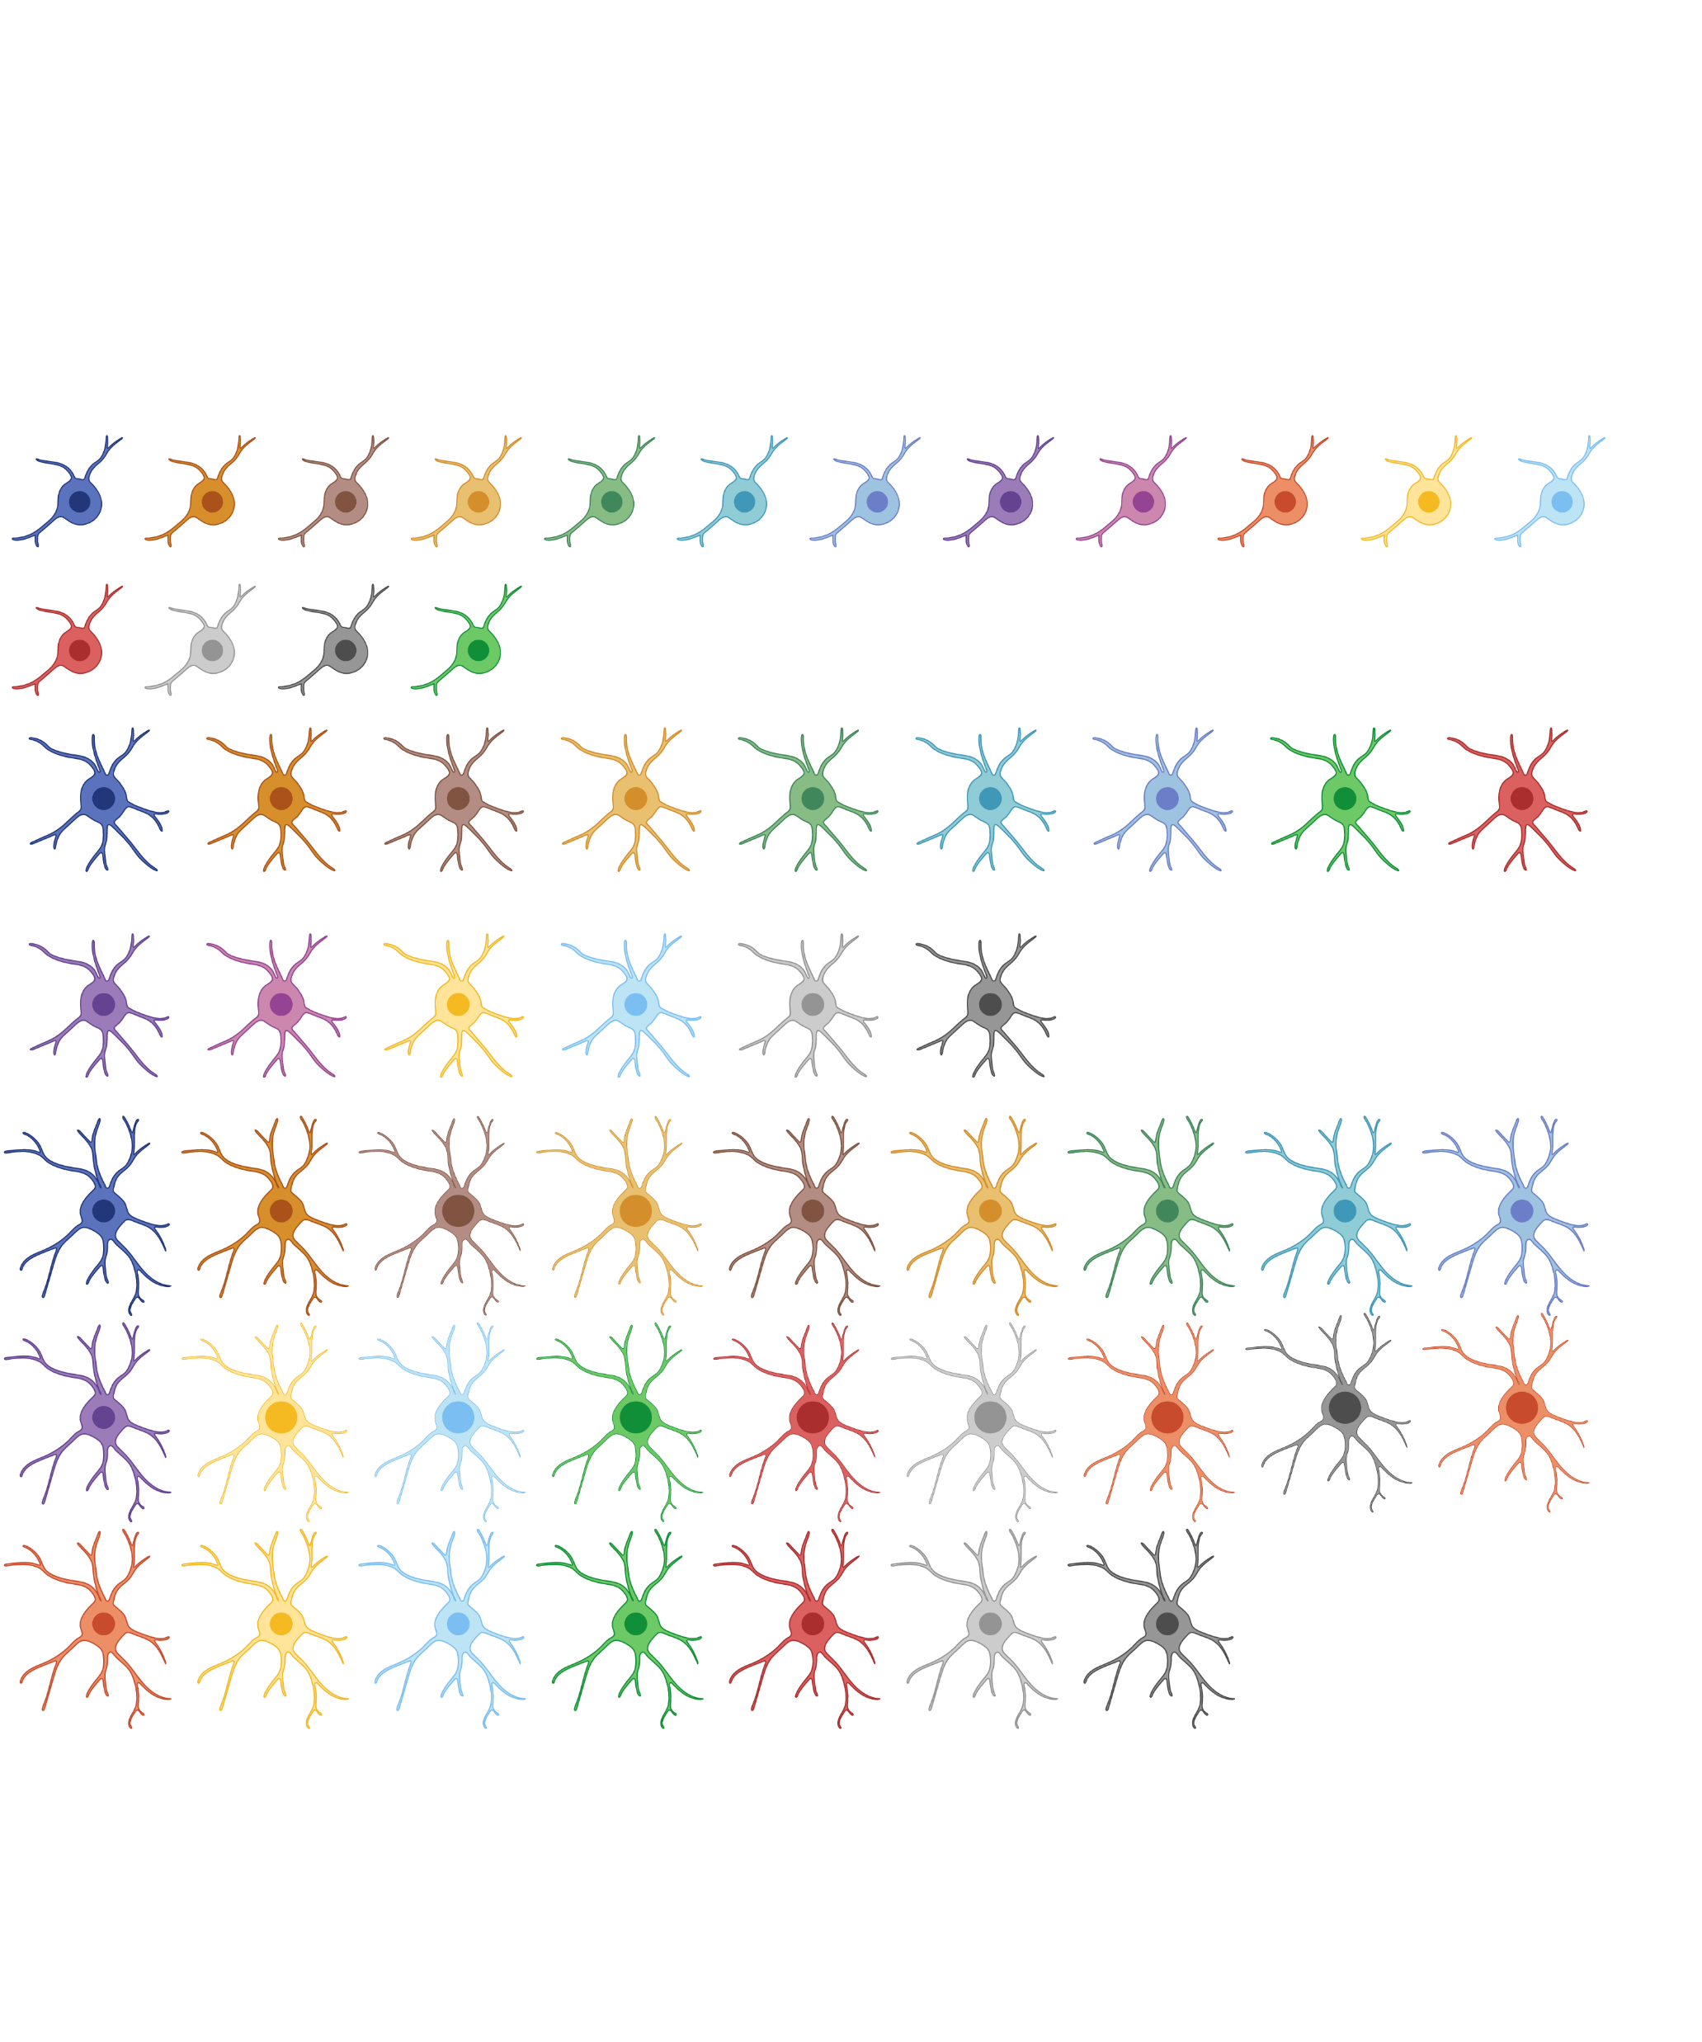
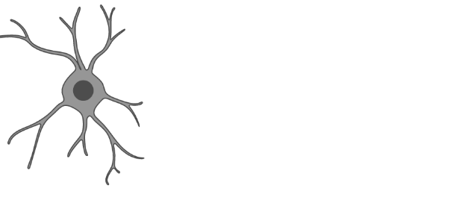
Table 2: Markers for detection of oligodendrocytes at different stages of differentiation
Early OPCs
Intermediate OPCs
Late OPCs
Oligodendrocytes
Olig2⁺ A2B5⁻ PDGFRα⁺ | Olig2⁺ A2B5⁻ PDGFRα⁻ O4⁺ Tppp/p25⁻ | Olig2⁺ A2B5⁻ PDGFRα⁻ O4⁺ Tppp/p25⁺ | Olig2⁺ A2B5⁻ PDGFRα⁻ O4⁻ Tppp/p25⁺

