Slide 1
Fig. S1 Amino acid sequence comparison of A. thaliana and S. tuberosum cv. Désirée GI proteins. Nuclear localisation signals are is glaucescent boxes, LOV binding amino acids have red background. Amino acids corresponding to the genomic sites targeted by gRNAs 1-4 are yellow-labelled, wheras those targeted by gRNAs 5-8 are in green boxes.

Slide 2
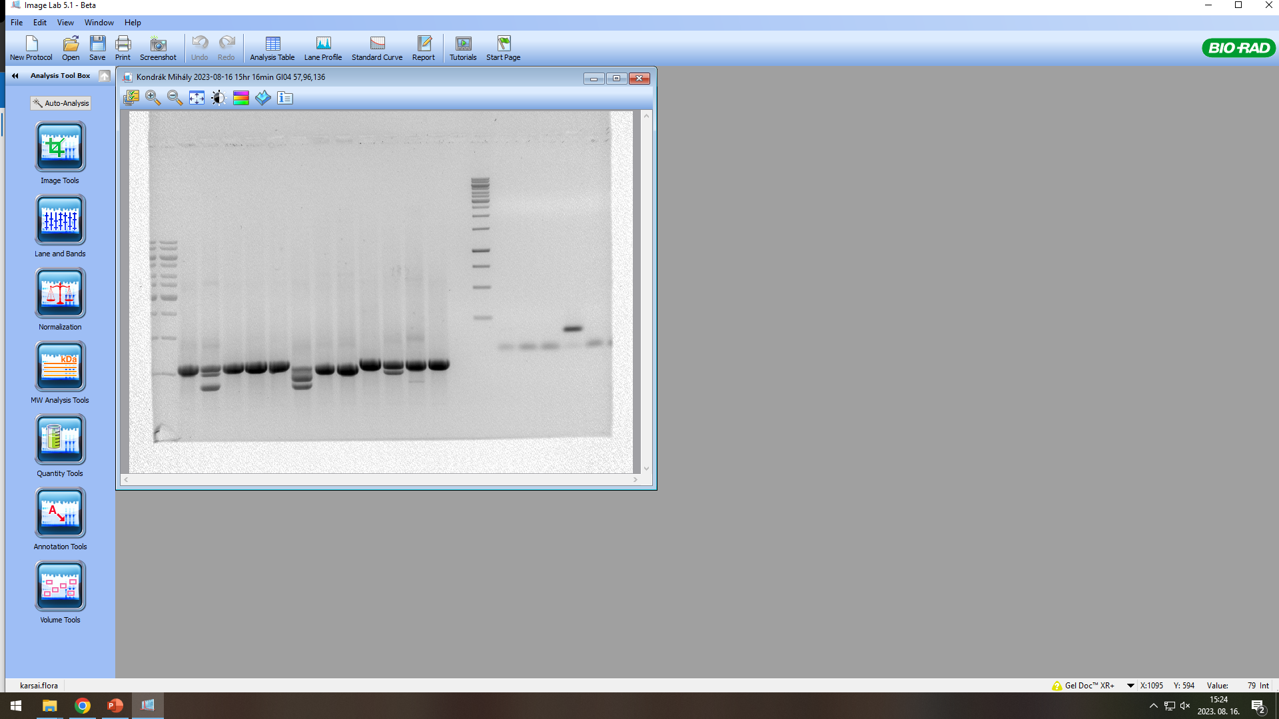
A
B
eGI.04
1 2 3 DES
M
-
250 bp
C
Solanum tuberosum GI.04
chr04
58822026
58855967
ATG
gRNA1
gRNA2
P1
P2
P3
P4
58850777
58852135
a
---
b
eGI.04/1
c
d
---
---
GACA
a
eGI.04/2
b
c
d
a
b
c
eGI.04/3
d
e
f
g
h
G
Fig. S2 Detection the mutations in the eGI.04 lines derived from the potato cv. Désirée. (A) PCR products on agarose gel obtained from the genomic DNA of eGI.04 mutants and Désirée (DES) using the primer pair corresponding to the gRNAs. M, marker; - no-DNA control (B) qPCR result obtained from the genomic DNA of the eGI.04 mutants and DES using the primer pair corresponding to the gRNAs. (C) Schematic drawing presenting the genomic structure of StGI.04 and the mutations in the eGI.04 lines. Gray boxes correspond to the exons. Introns are indicated by lines in GI.04. The numbers specify the location of GI.04 on the chromosome 4 in the S. tuberosum group Phureja DM1-3 (v6.1) genome sequence (https://spuddb.uga.edu). The GI.04 region analysed in the mutants is zoomed out. Primers used for the amplification of the DNA fragments from the mutants are labelled with the letter "P", numbered and indicated by blue boxes. Yellow boxes represent the 20 bps corresponding to the gRNAs. Black boxes symbolize the deletions, whereas the glaucescent boxes show duplications. The base pair changes are indicated in red. The letters from "a" to "h" specify the mutant alleles identified in the mutants eGI.04/1, eGI.04/2 and eGI04/3.

Slide 3
A
mGI.04
B
M
1 2 3 DES -
500 bp
250 bp
C
Solanum tuberosum GI.04
chr04
58822026
58855967
ATG
gRNA3
gRNA4
P5
P6
58849894
58851655
a
b
mGI.04/1
c
d
a
b
mGI.04/2
c
d
a
b
mGI.04/3
c
d
Fig. S3 Detection the mutations in the mGI.04 lines derived from the potato cv. Désirée. (A) PCR products on agarose gel obtained from the genomic DNA of the mGI.04 mutants and Désirée (DES) using the primer pair corresponding to the gRNAs. (B) qPCR result obtained from the genomic DNA of the mGI.04 mutants and DES using the primer pair corresponding to the gRNAs. (C) Schematic drawing presenting the genomic structure of GI.04 and the mutations in the mGI.04 lines. Green boxes represent the 20 bps corresponding to the gRNAs. See the Fig. S2 legend for more details.

Slide 4
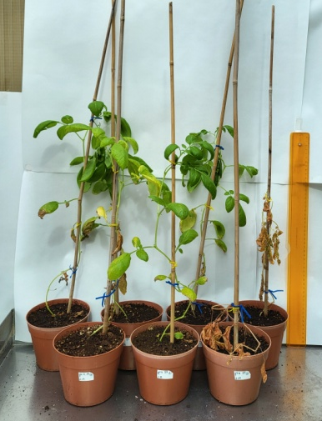


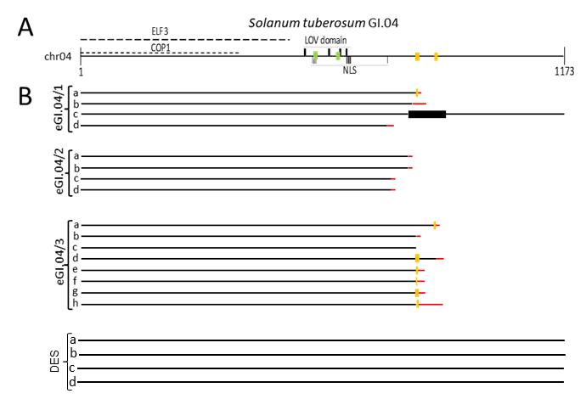
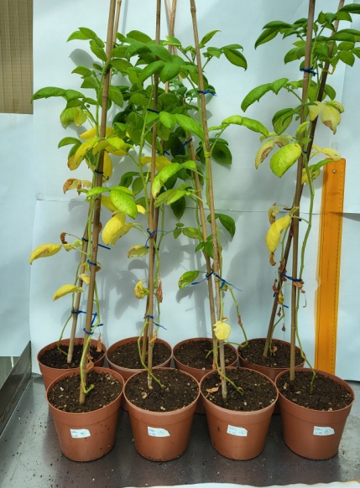
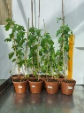
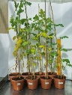
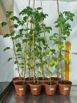
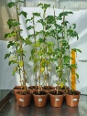
A
Solanum tuberosum cv. Désirée GI.04
LOV domain
B
1
NLS
1166
a
b
eGI.04/1
c
d
a
eGI.04/2
b
c
d
a
b
c
eGI.04/3
d
e
f
g
h
C
a
b
mGI.04/1
c
d
a
b
mGI.04/2
c
d
a
b
mGI.04/3
c
d
Fig. S4 Correlation between the mutations at protein level in GI.04 and the phenotype of the plants. Schematic representation of the GI.04 protein in the S. tuberosum cv. Désirée (A) and its mutants generated by targeted mutagenesis using the gRNAs corresponding to the amino acids labelled in yellow (B) and green (C).

Slide 5

A
eGI.12
B
M
1 2 3 DES -
250 bp
C
Solanum tuberosum GI.12
chr12
6435424
6420024
ATG
gRNA5
gRNA6
P7
P8
6430132
6430441
a
eGI.12/1
b
c
d
AATT
TGCT
a
b
eGI.12/2
c
T
d
a
b
eGI.12/3
c
d
Fig. S5 Detection the mutations in the eGI.12 lines derived from the potato cv. Désirée. (A) PCR products on agarose gel obtained from the genomic DNA of eGI.12 mutants and Désirée (DES) using the primer pair corresponding to the gRNAs. (B) qPCR result obtained from the genomic DNA of the eGI.12 mutants and DES using the primer pair corresponding to the gRNAs. (C) Schematic drawing presenting the genomic structure of GI.12 and the mutations in the eGI.12 lines. See the Fig. S2 legend for more details.

Slide 6
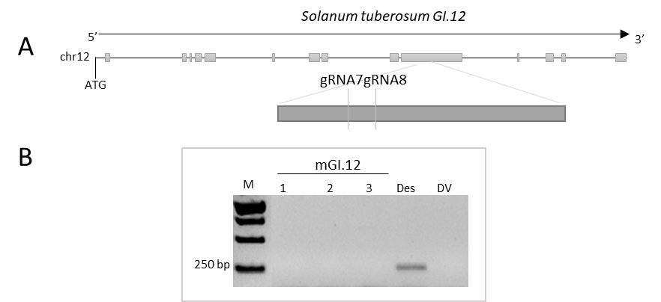
A
mGI.12
B
M
1 2 3 DES -
500 bp
250 bp
C
Solanum tuberosum GI.12
chr12
6435424
6421125
ATG
gRNA7
gRNA8
P9
P10
P11
6430608
6431253
a
mGI.12/1
b
c
d
a
mGI.12/2
b
c
d
a
mGI.12/3
b
c
d
Fig. S6 Detection the mutations in the mGI.12 lines derived from the potato cv. Désirée. (A) PCR products on agarose gel obtained from the genomic DNA of the mGI.12 mutants and Désirée (DES) using the primer pair corresponding to the gRNAs. (B) qPCR result obtained from the genomic DNA of the mGI.12 mutants and DES using the primer pair corresponding to the gRNAs. (C) Schematic drawing presenting the genomic structure of GI.12 and the mutations in the mGI.12 lines. See the Fig. S2 legend for more details.

Slide 7
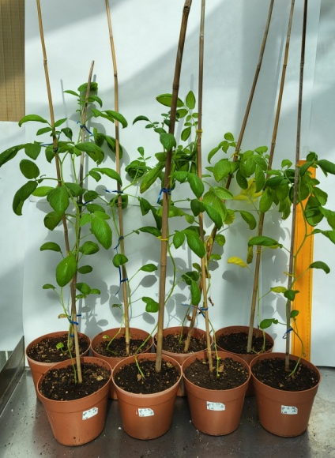
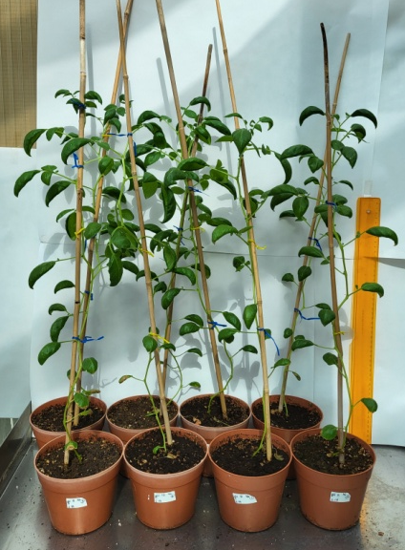
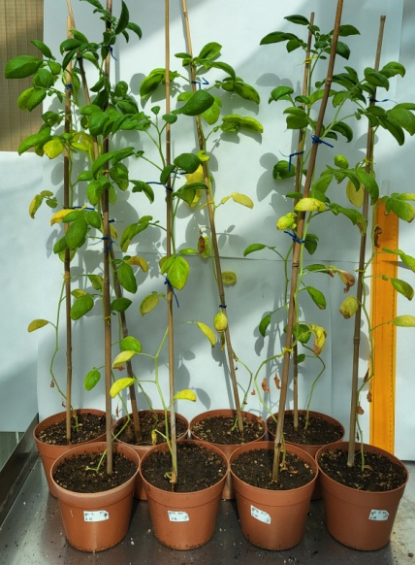
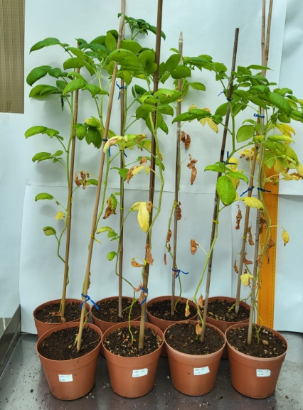
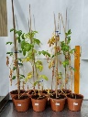
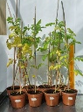
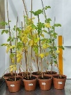
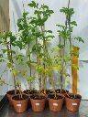
A
Solanum tuberosum cv. Désirée GI.12
LOV domain
B
1
NLS
1171
a
b
eGI.12/1
c
d
a
b
eGI.12/2
c
d
a
b
eGI.12/3
c
d
C
a
b
c
d
a
mGI.12/2
b
c
d
a
b
mGI.12/3
c
d
Fig. S7 Correlation between the mutations at protein level in GI.12 and the phenotype of the plants. Schematic representation of the GI.12 protein in the S. tuberosum cv. Désirée (A) and its mutants generated by targeted mutagenesis using the gRNAs corresponding to the amino acids labelled in yellow (B) and green (C).

Slide 8
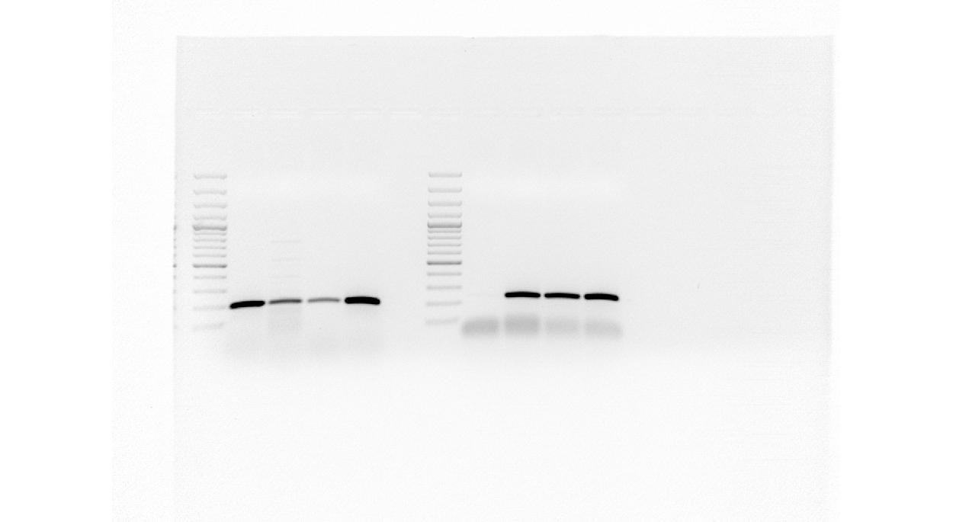
A
mGI.412
B
500 bp
M
1 2 3 DES -
200 bp
C
Solanum tuberosum GI.04
chr04
58822026
58855967
ATG
gRNA3
gRNA4
P12
P5
P13
P14
P15
P3
58849227
58852537
a
mGI.412/1
b
c
d
a
mGI.412/2
b
c
d
a
b
mGI.412/3
c
d
Fig. S8 Detection the mutations in the mGI.412 lines derived from the potato cv. Désirée. (A) PCR products on agarose gel obtained from the genomic DNA of the mGI.412 mutants and Désirée (DES) using the primer pair corresponding to the gRNAs specific for GI.04. (B) qPCR result obtained from the genomic DNA of the mGI.412 mutants and DES using the primer pair corresponding to the gRNAs specific for GI.04. (C) Schematic drawing presenting the genomic structure of GI.04 and the mutations in the mGI.412 lines. See the Fig. S2 legend for more details.

Slide 9
A
mGI.412
B
500 bp
M
1 2 3 DES -
200 bp
C
Solanum tuberosum GI.12
chr12
6435424
6421125
ATG
gRNA8
P16
P17
P9
gRNA7
P10
P18
P8
6430451
6432542
a
b
mGI.412/1
c
d
a
b
mGI.412/2
c
d
a
b
mGI.412/3
c
d
Fig. S9 Detection the mutations in the mGI.412 lines derived from the potato cv. Désirée. (A) PCR products on agarose gel obtained from the genomic DNA of the mGI.412 mutants and Désirée (DES) using the primer pair corresponding to the gRNAs specific for GI.12. (B) qPCR result obtained from the genomic DNA of the mGI.412 mutants and DES using the primer pair corresponding to the gRNAs specific for GI.12. (C) Schematic drawing presenting the genomic structure of GI.12 and the mutations in the mGI.412 lines. See the Fig. S2 legend for more details.

Slide 10
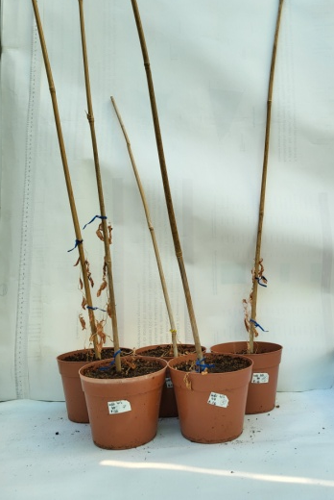
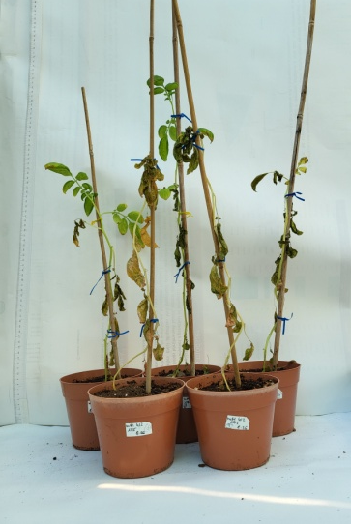
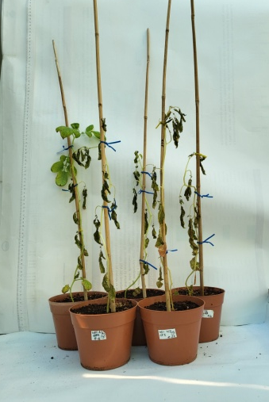
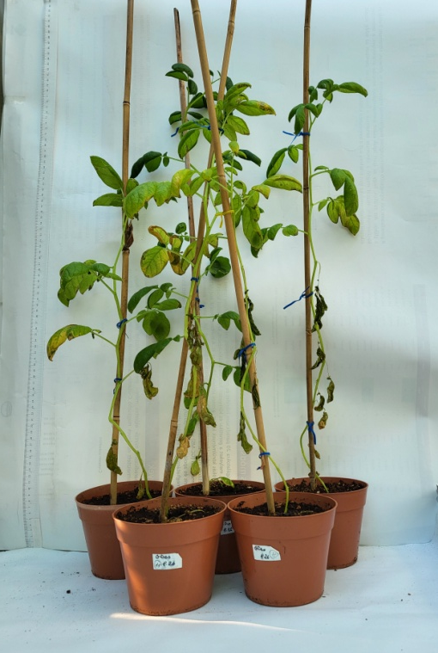
a
b
GI.04
c
mGI.412/1
d
a
b
GI.12
c
d
a
b
GI.04
c
mGI.412/2
d
a
GI.12
b
c
d
a
b
GI.04
c
mGI.412/3
d
a
b
GI.12
c
d
a
b
GI.04
c
DES
d
a
b
GI.12
c
d
Fig. S10 Correlation between the mutations at protein level in GI.04 and GI.12 and the phenotype of the double GI mutant plants. The green boxes indicate the position of the amino acids corresponding to the gRNAs used to generate the mutations.

Slide 11
A
B
C
D
E
Fig. S11 The anthocyanin content of tuber skins. (A) The anthocyanin content of tuber skins in the eGI.04 lines compared to Désirée (DES) was tested in three consecutive plant tests each with 8 plants/line from the same experiments in which the tuber yields were tested (Fig. 2). The average OD of DES was 0.38±0.03, 0.26±0.01 and 0.31±0.06 in the 1st, 2nd and 3rd experiment, respectively, and regarded as 100% for comparison. (B) The anthocyanin content of tuber skins in the mGI.04 lines compared to DES was tested in two consecutive plant tests, with 8 and 16 plants/line from the same experiments in which the tuber yields were tested (Fig. 3). The average OD of DES was 0.17±0.02, and 0.18±0.02 in the 1st and 2nd experiment, respectively, and regarded as 100% for comparison.

Slide 12
(C) The anthocyanin content of tuber skins in eGI.12 lines compared to DES was tested in three consecutive plant tests each with 8 plants/line from the same experiments in which the tuber yields were tested (Fig. 5). The average OD of DES was 0.40±0.01, 0.30±0.07 and 0.31±0.04 in the 1st, 2nd and 3rd experiment, respectively, and regarded as 100% for comparison. (D) The anthocyanin content of tuber skins was tested in two consecutive plant tests with 8 and 16 plants/line from the same experiments in which the tuber yields were tested (Fig. 6). The average OD of DES was 0.09±0.02, and 0.14±0.03 in the 1st and 2nd experiment, respectively, and regarded as 100% for comparison. (E) The anthocyanin content of tuber skins was tested in two consecutive plant tests with 8 and 16 plants/line from the same experiments in which the tuber yields were tested (Fig. 8). The average OD of DES was 0.09±0.02, and 0.14±0.03 in the 1st and 2nd experiment, respectively, and regarded as 100% for comparison. The anthocyanin content of tuber skins was determined spectrofotometrically at OD₅₄₀. The standard deviations are indicated by the error bars. Means presented with the same letter are not significantly different at p ≤ 0.05.

