Slide 1
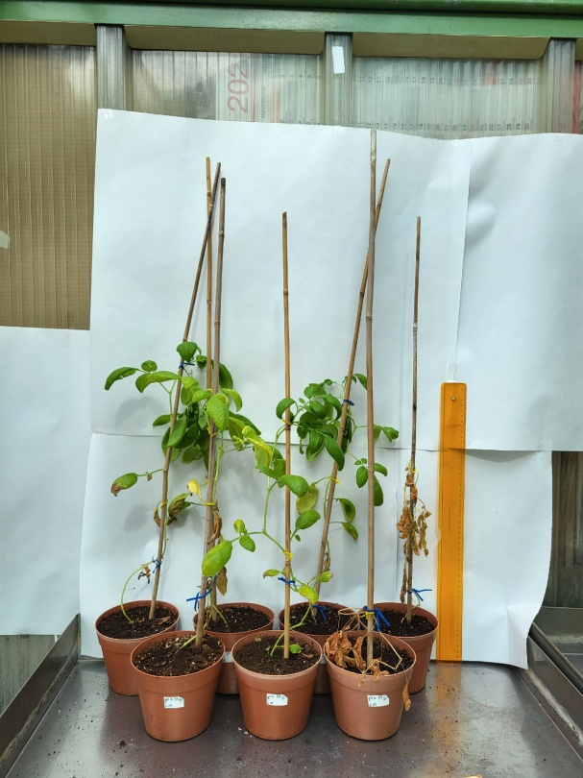
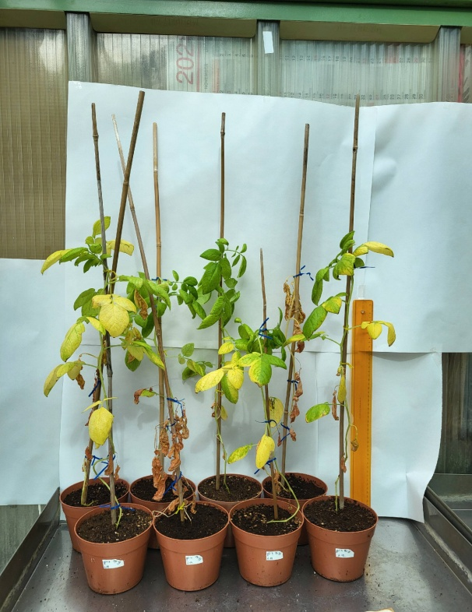
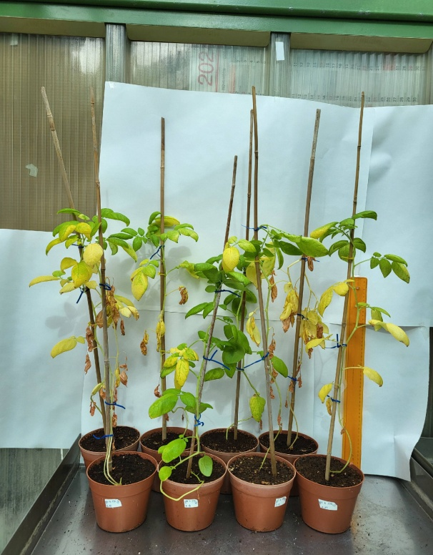
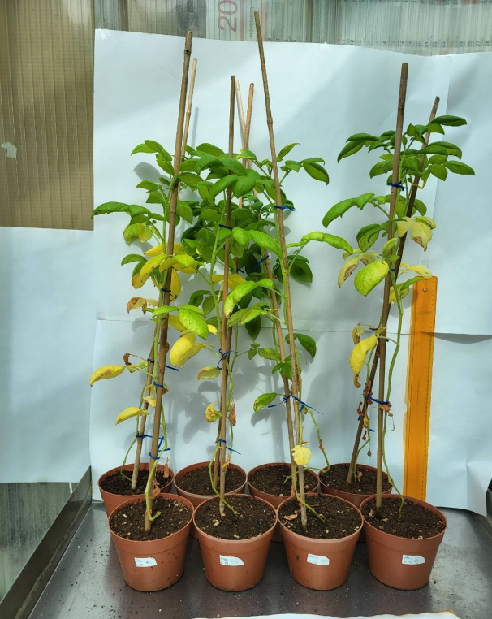
Original photos of eGI.04/1, eGI.04/2 eGI.04/3 and
DES plants (Fig.2)
eGI.04/1
eGI.04/2
eGI.04/3
DES

Slide 2
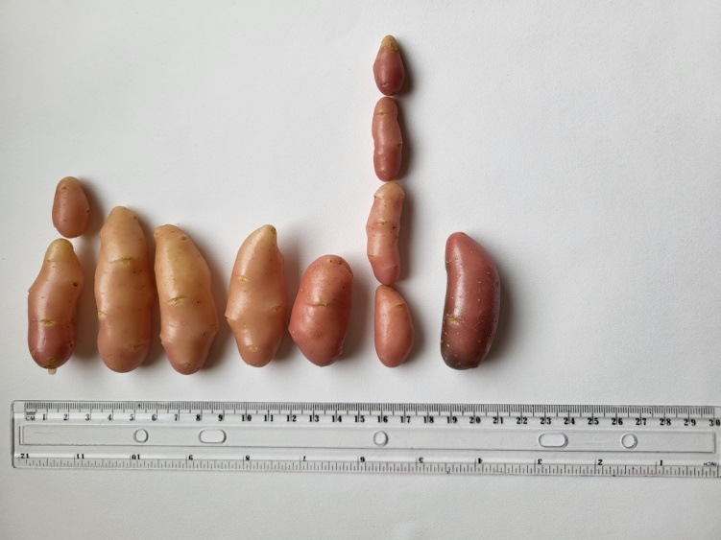
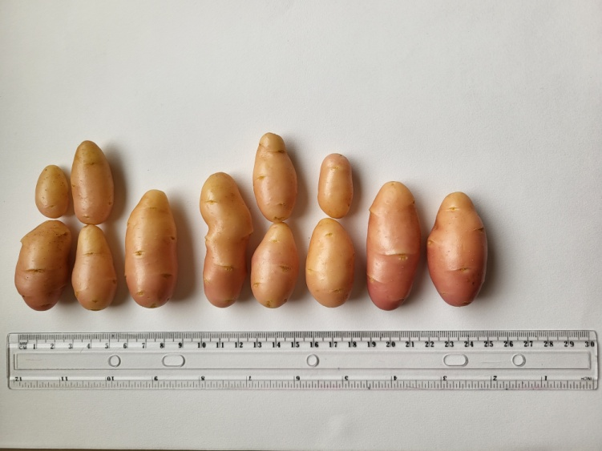
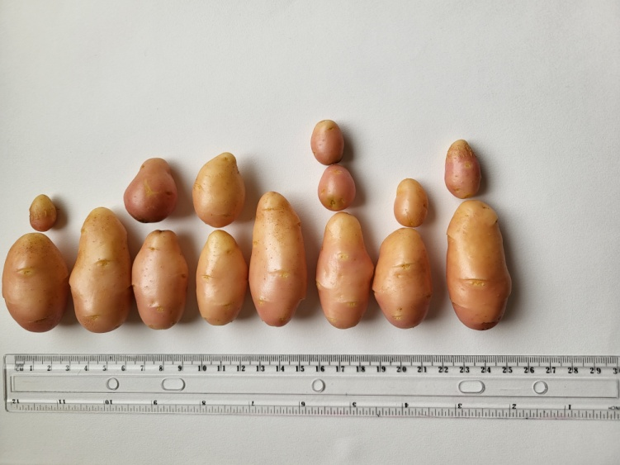
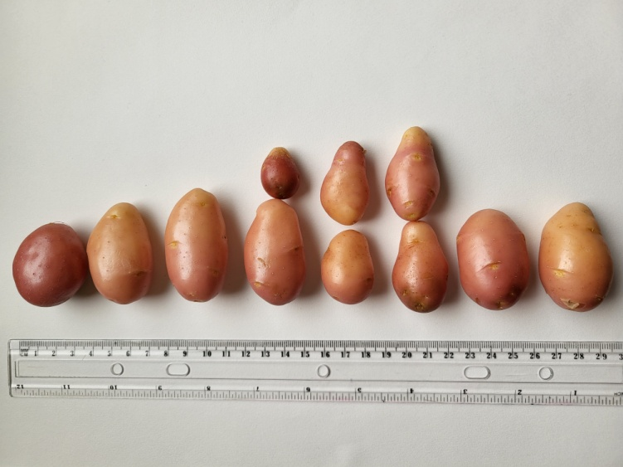
Original photos of eGI.04/1, eGI.04/2 eGI.04/3 and
Des tubers (Fig.2)
eGI.04/1
eGI.04/2
eGI.04/3
DES

Slide 3
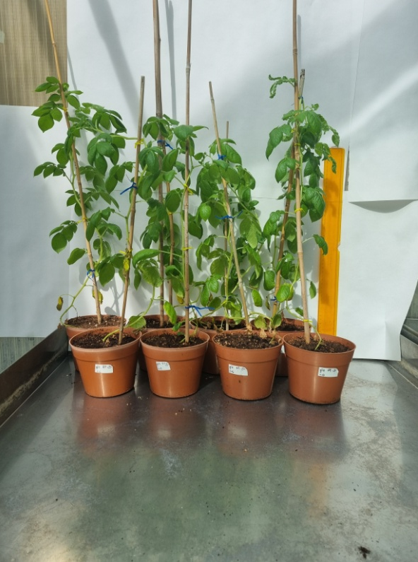
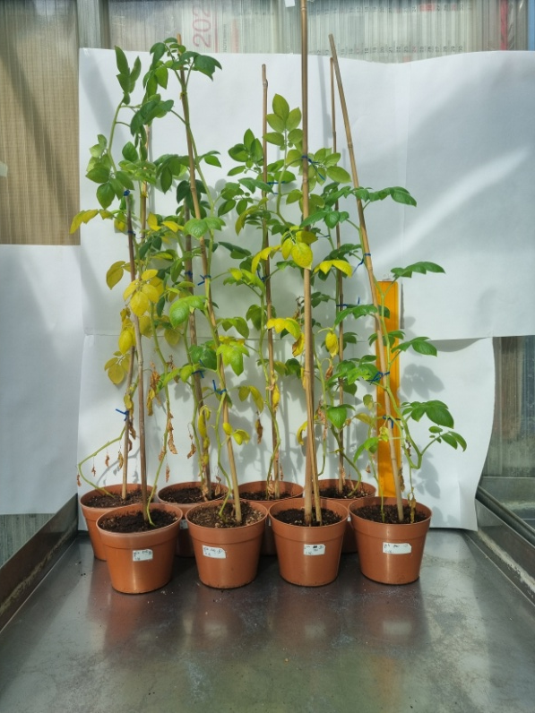
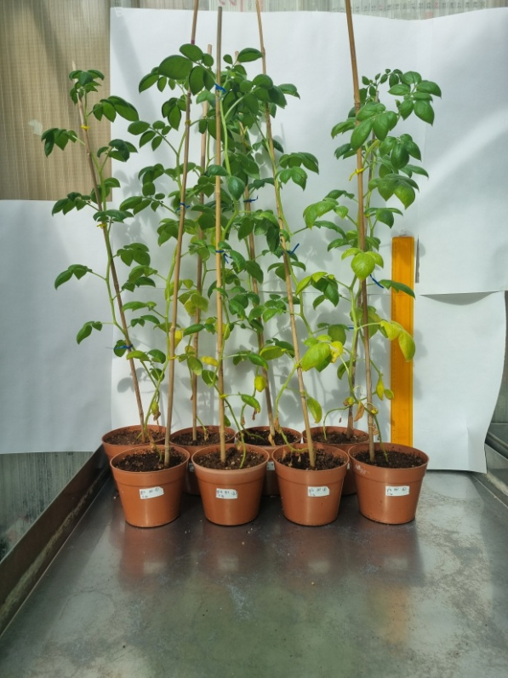
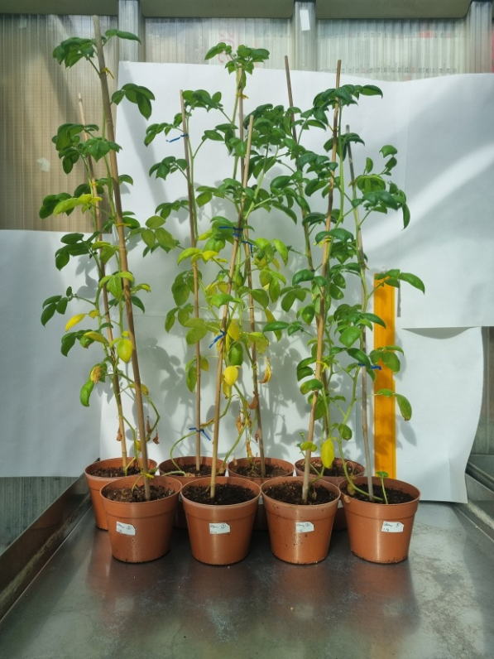
Original photos of mGI.04/1, mGI.04/2 mGI.04/3 and
Des plants (Fig.3)
mGI.04/1
mGI.04/2
mGI.04/3
DES

Slide 4
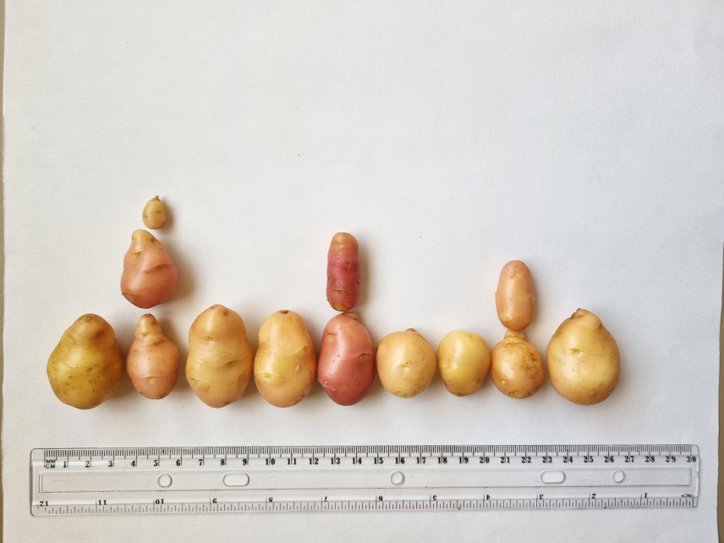
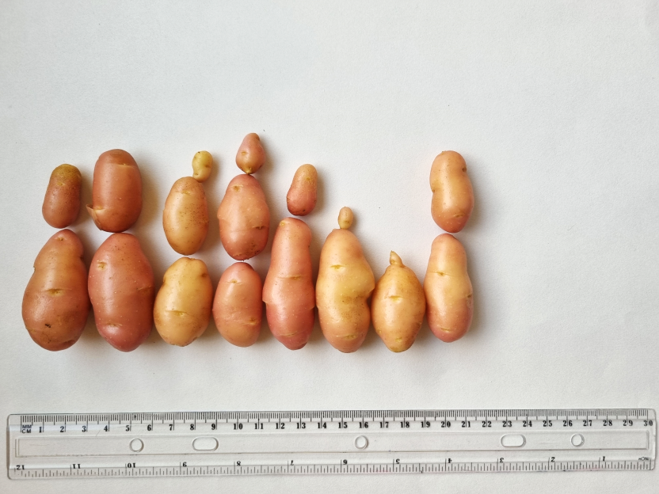
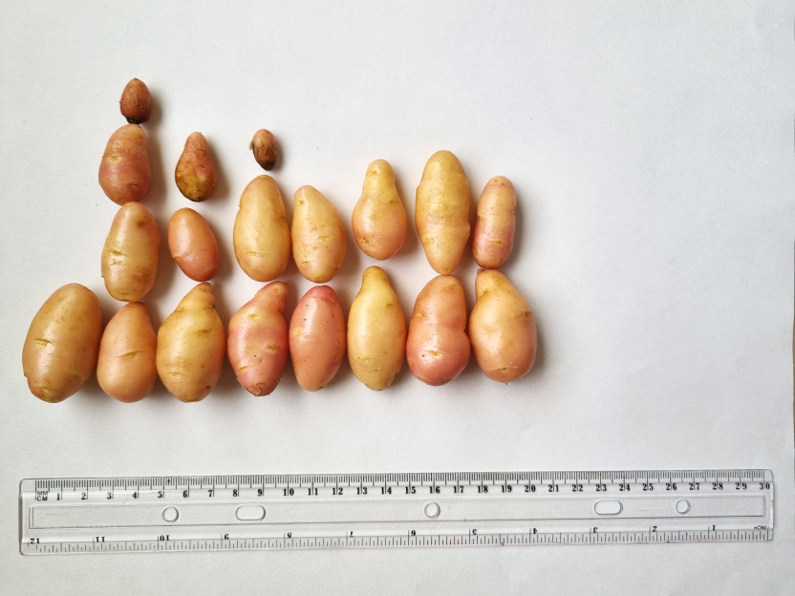
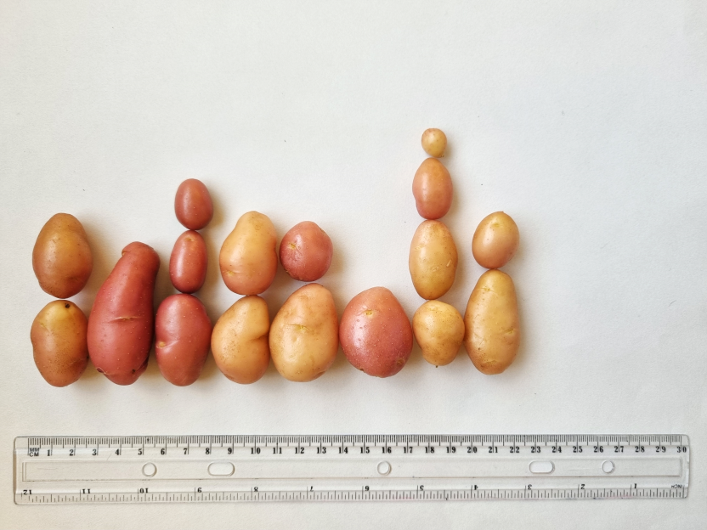
Original photos of mGI.04/1, mGI.04/2 mGI.04/3 and
Des tubers (Fig.3)
mGI.04/1
mGI.04/2
mGI.04/3
DES

Slide 5
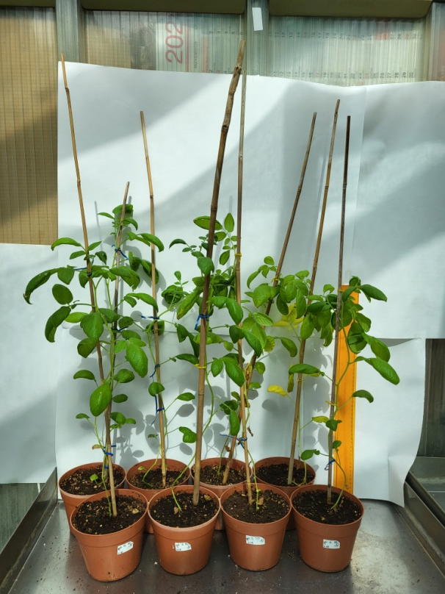
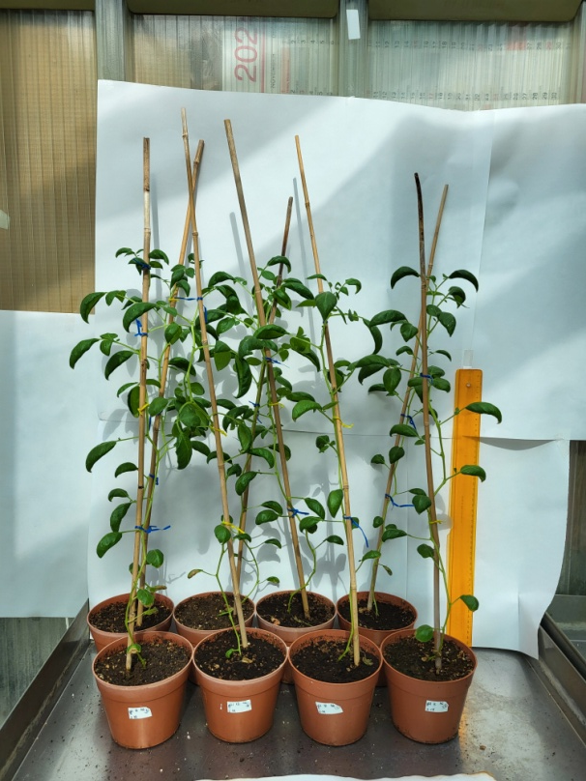
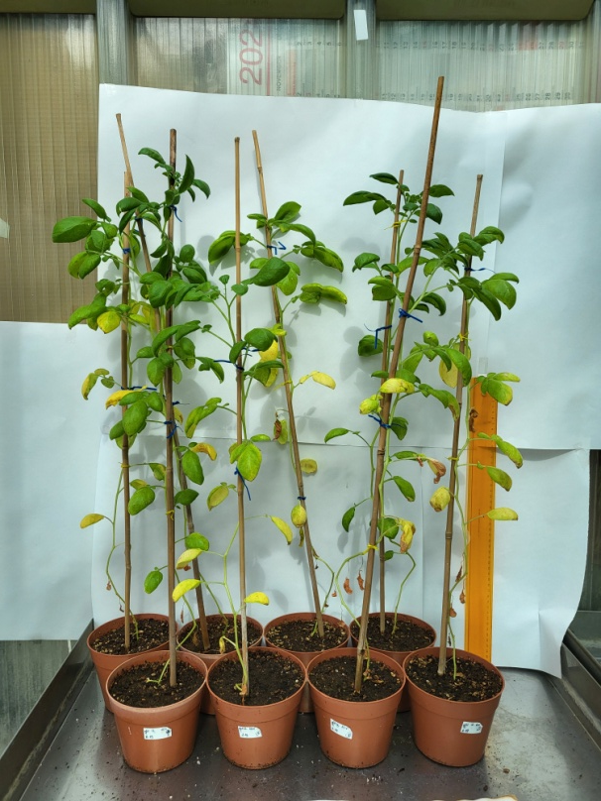
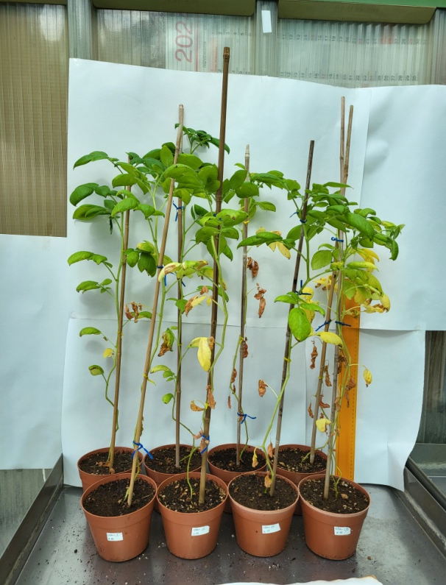
Original photos of eGI.12/1, eGI.12/2 eGI.12/3 and Des
plants (Fig.5)
eGI.12/1
eGI.12/2
eGI.12/3
DES

Slide 6
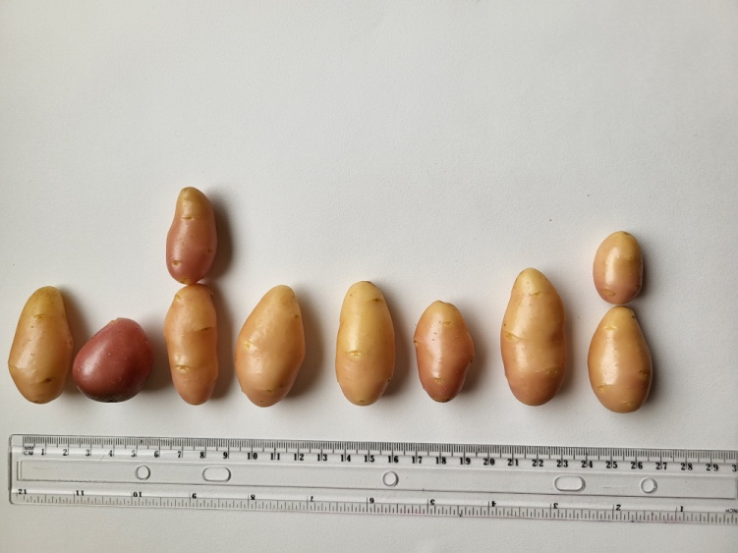
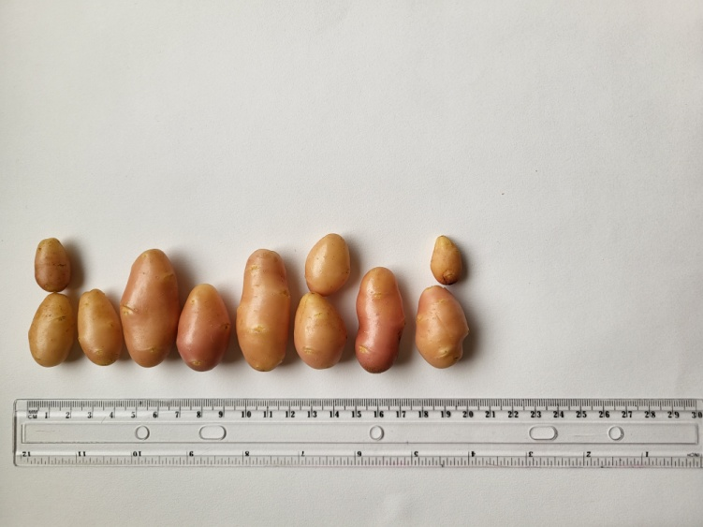
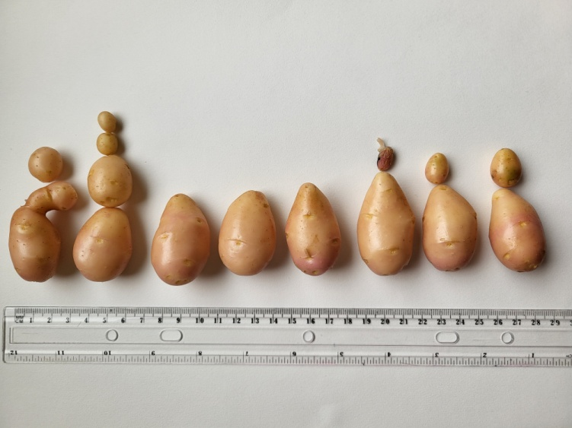
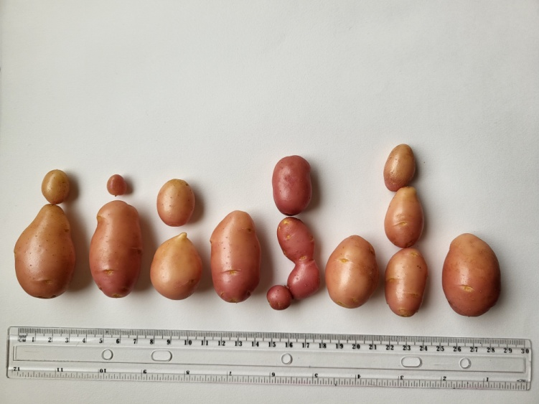
Original photos of eGI.12/1, eGI.12/2 eGI.12/3 and
Des tubers (Fig.6)
eGI.12/1
eGI.12/2
eGI.12/3
DES

Slide 7
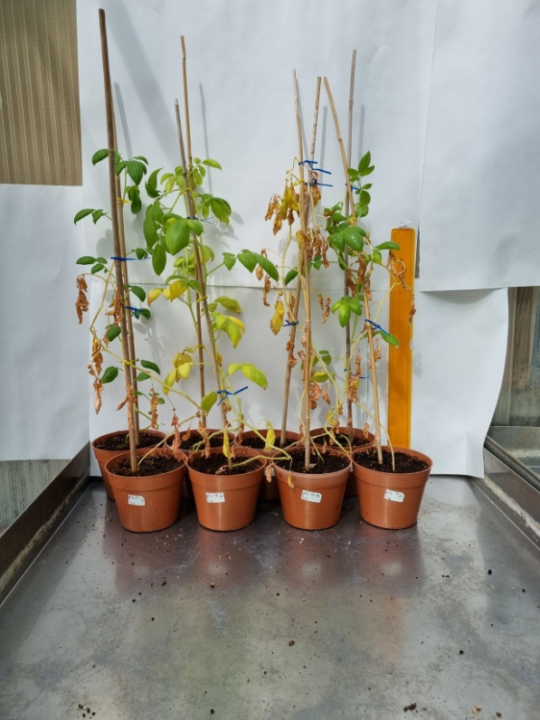
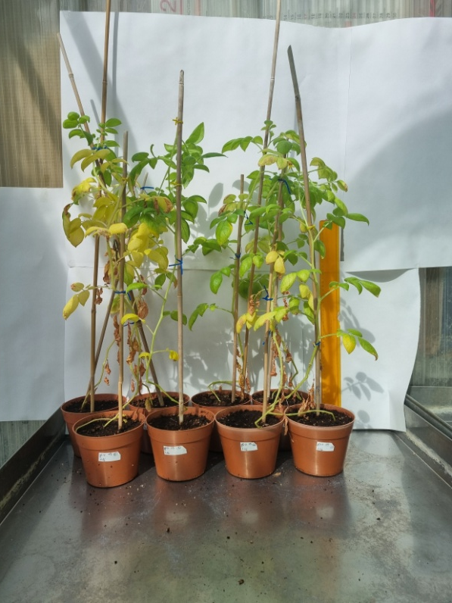
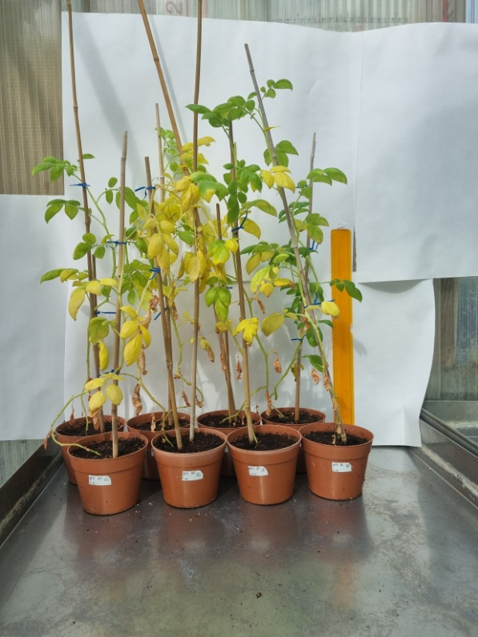
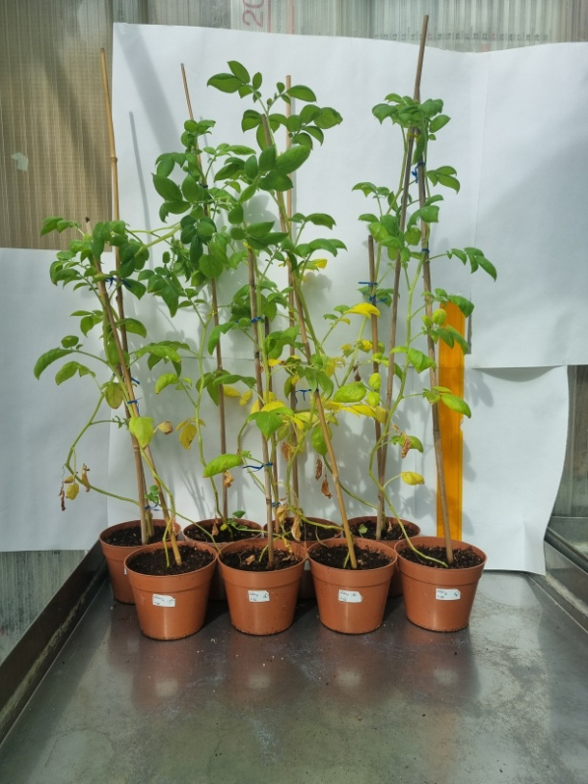
Original photos of mGI.12/1, mGI.12/2 mGI.12/3 and
Des plants (Fig.6)
mGI.12/1
mGI.12/2
mGI.12/3
DES

Slide 8
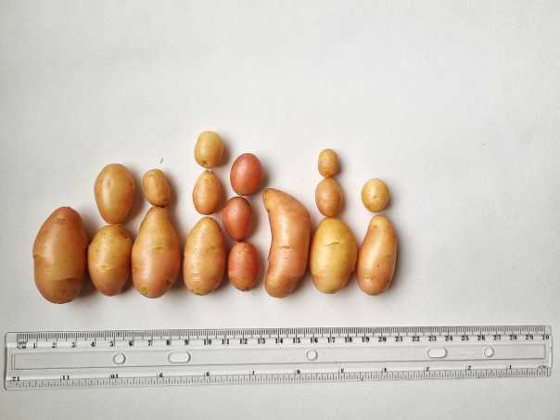
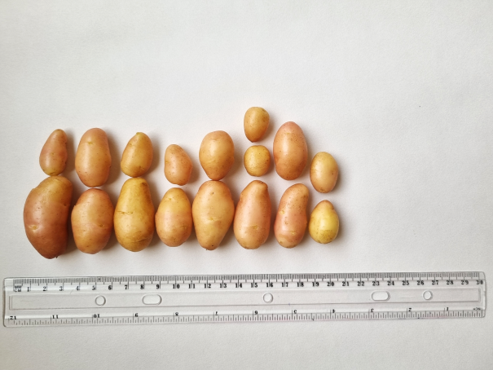
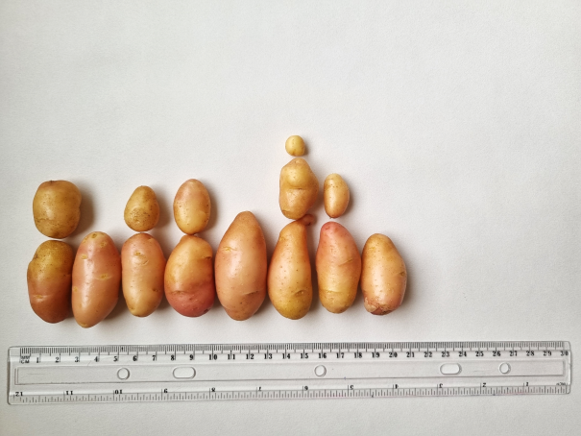
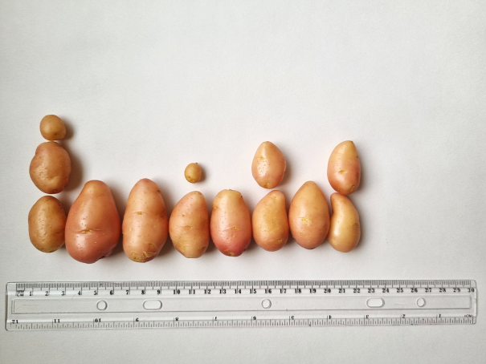
Original photos of mGI.12/1, mGI.12/2 mGI.12/3 and
Des tubers (Fig.6)
mGI.12/1
mGI.12/2
mGI.12/3
DES

Slide 9
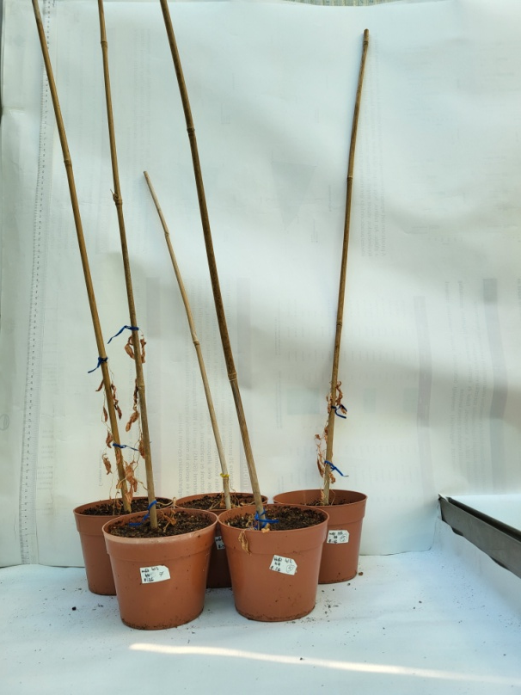
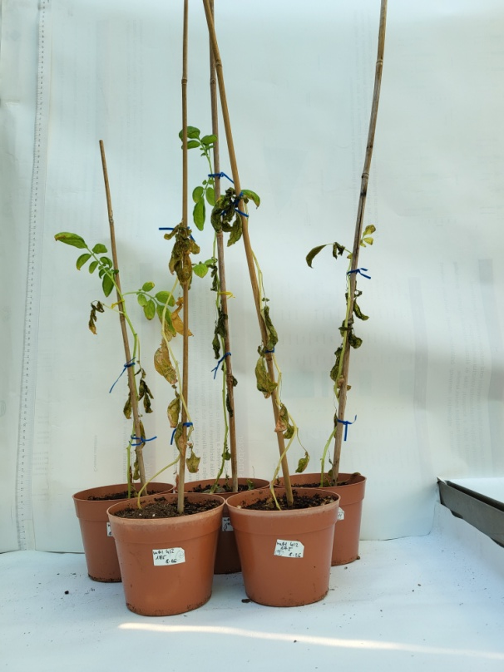
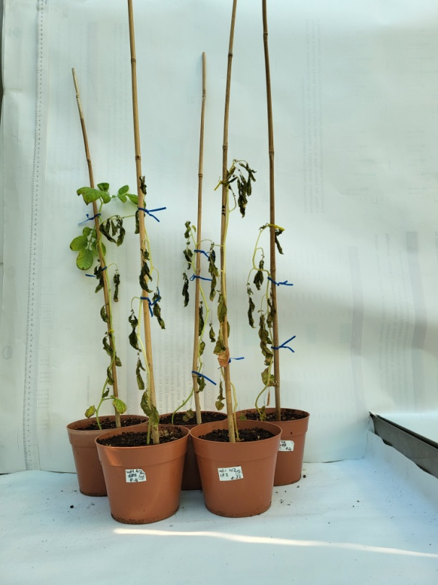
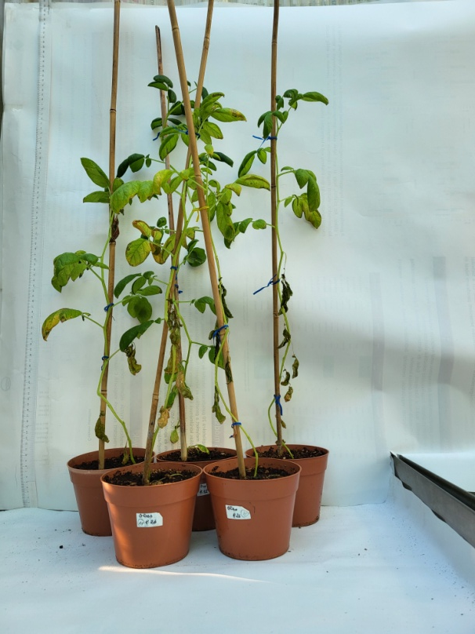
Original photos of mGI.412/1, mGI.412/2 mGI.412/3 and
Des plants (Fig.8)
mGI.412/1
mGI.412/2
mGI.412/3
DES

Slide 10
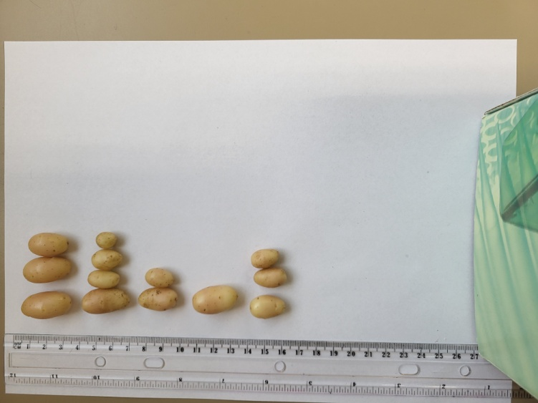
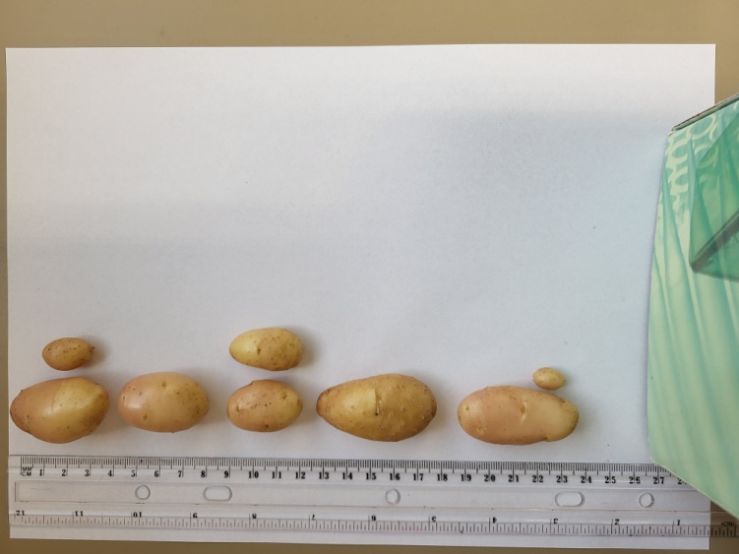
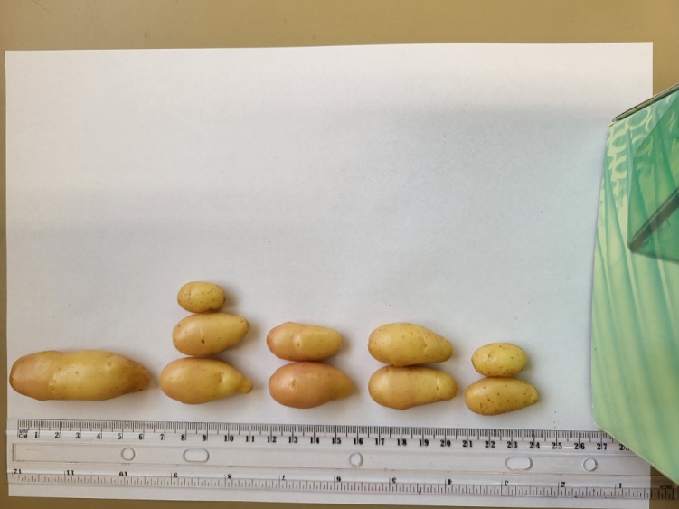
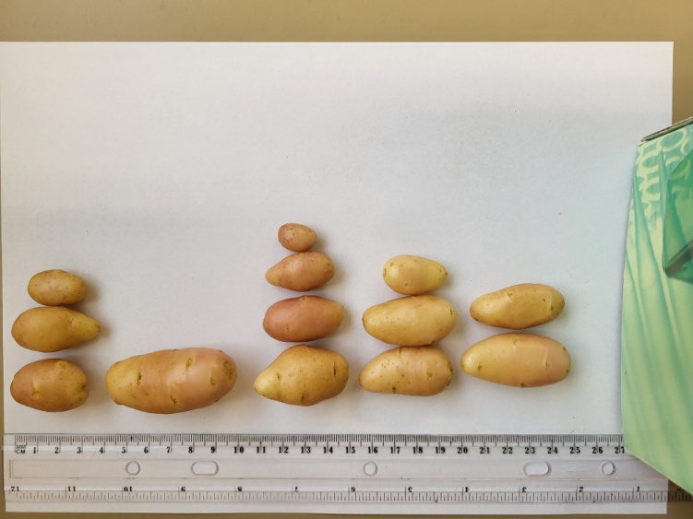
Original photos of mGI.412/1, mGI.412/2 mGI.412/3 and
Des tubers (Fig.8)
mGI.412/1
mGI.412/2
mGI.412/3
DES

