Slide 1
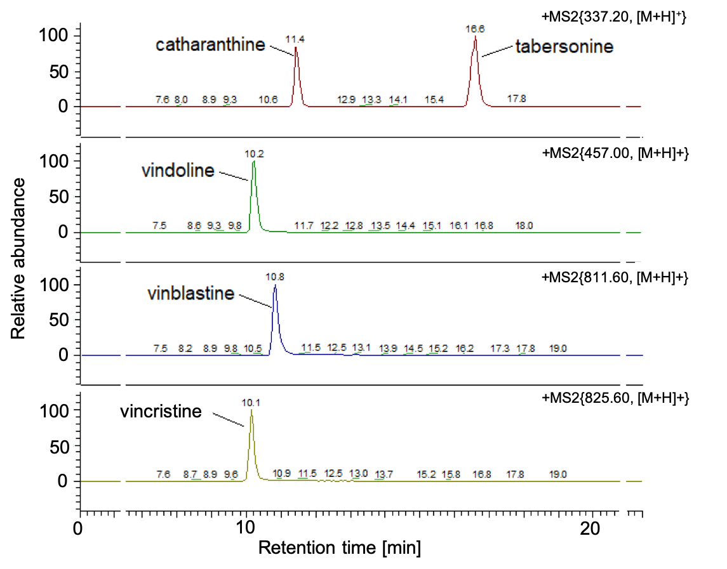
Supplementary Fig. S1
Notes:
Supplementary Fig. S1 HPLC-ESI-MS/MS chromatograms of the vinca alkaloid standard compounds
HPLC-ESI-MS/MS chromatograms of various vinca alkaloid standard compounds used in our study showing various extracted ion chromatograms specific to different alkaloids; m/z 337.2: catharanthine and tabersonine, m/z 457: vindoline, m/z 811.6: vinblastine, m/z 825.6: vincristine

