Slide 1
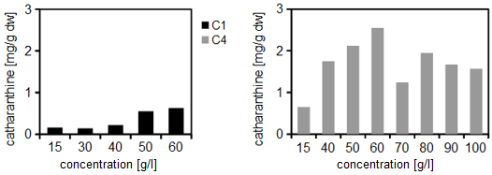
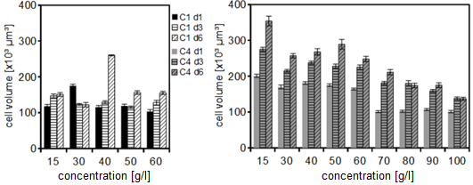
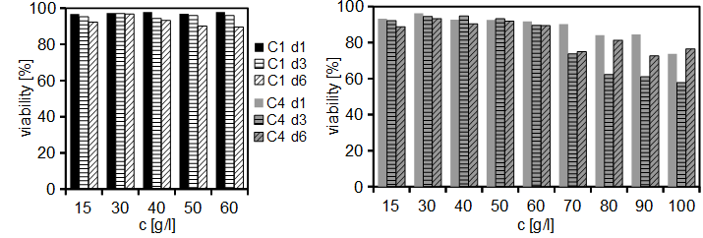
Supplementary Fig. S5
a
C1
C4
2
2
Catharanthine content
[mg/g D.W.]
Catharanthine content
[mg/g D.W.]
1
1
0
0
15
30
40
50
60
15
40
50
60
70 80 90 100
Sugar concentration [g/l]
Sugar concentration [g/l]
b
C1
C4
400
d1
400
d1
d3
d3
d6
d6
cell volume [fL]
cell volume [fL]
200
200
0
0
15
30
40
50
60
70 80 90 100
15
30
40
50
60
Sugar concentration [g/l]
Sugar concentration [g/l]
Notes:
Supplementary Fig. S5 Catharantine content, cell volume and sugar consumption of C1 and C4 cell strains under different sucrose concentrations
(a) Catharanthine content measured intracellularly in C1 and C4 cells during stationary-phase (medium without 2,4-D) over a period of 6 days. (b) Cell volumes inferred from the cellular dimensions assuming a cylindrical shape. Data show mean ± SE, n ≥ 400.

Slide 2
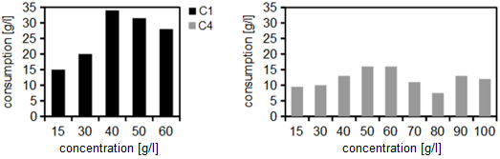
Supplementary Fig. S5
c
C1
C4
30
30
20
20
Consumption [g/l]
Consumption [g/l]
10
10
0
0
15
30
40
50
60
15
30
40
50
60
70 80 90 100
Sugar concentration [g/l]
Sugar concentration [g/l]
Notes:
(c) Catharanthus cell strains C1 and C4 were grown in the medium containing different sucrose concentrations. Sugar consumption was inferred using the Brix refractometric measurement for the two cell strains over a period of 6 days.

