Slide 1
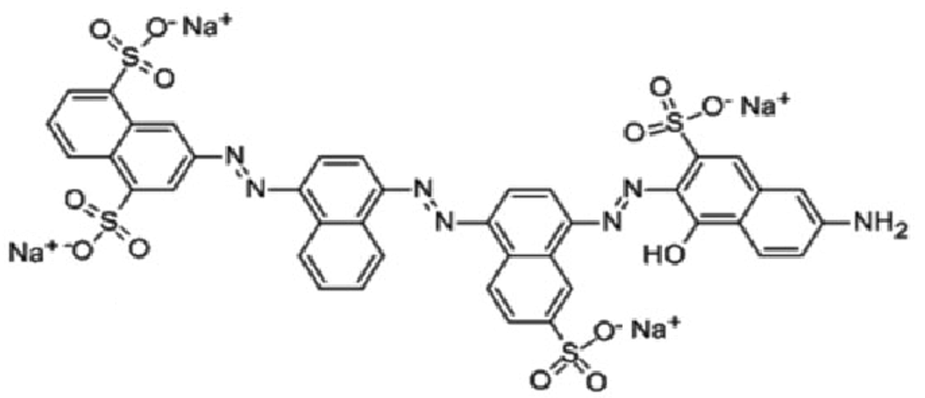
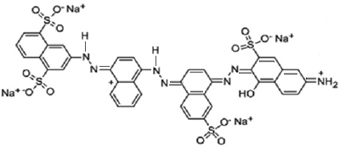
-
H⁺, Cl⁻
-
-
Cl⁻
Cl⁻
pH = 4
Blue
Colorless
pH = 6.8
HSB⁴⁻ (4 Na+)
H₃SB²⁻ (2 Cl⁻, 4 Na+)
Na⁺, OH⁻
- H₂O
pH = 9
Dark blue color
Blue
SB⁵⁻ (5 Na⁺)
pH = 6.8
HSB⁴⁻ (4 Na+)
(H⁺ neutralized by OH⁻)

