Slide 1
Supplementary information
De Biasi et. al.
Circulating mucosal associated invariant T (MAIT) cells identify patients responding to immune checkpoint inhibitors

Slide 2
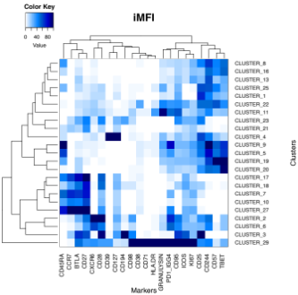



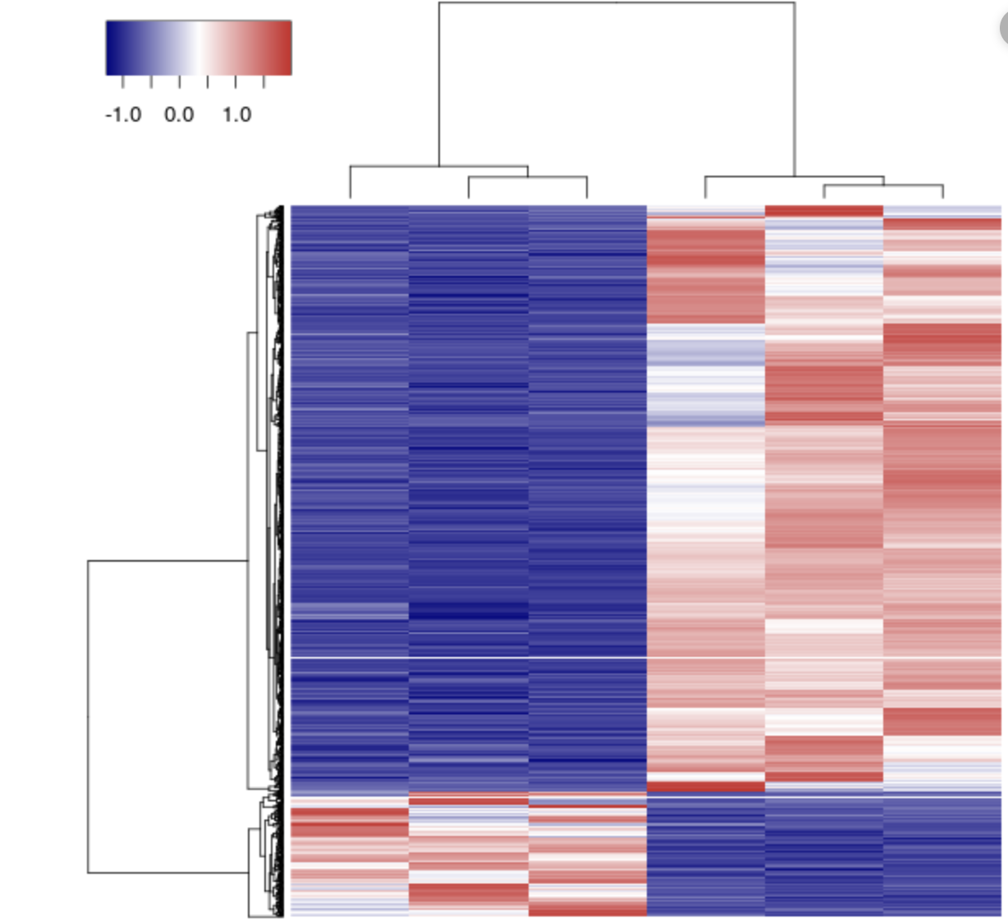
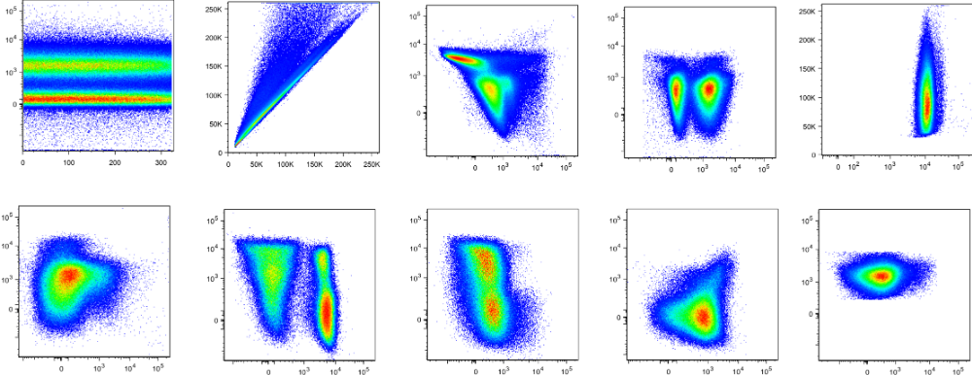
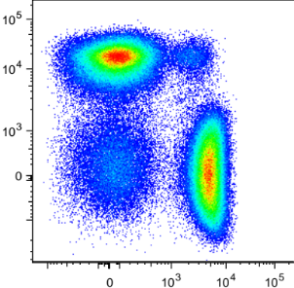
Identify Phenograph clusters (iMFI)
28 colour flow cytometry
Manual gating for
CD8+ T cells (CTLs)
3 timepoints:
T0 before therapy
T1 after 1 cycle of therapy
T2 after 2 cycles of therapy
Perform Phenograph clustering
CD4
CD8
Blood
Process to single cell suspension
Frequency
Clinical outcome
Cluster frequency per sample
Correlation with data obtained
Sorting of CD3+CD8+ T cells
Analysis of transcriptome
by scRNAseq
Experimental workflow on PBMC isolated from patients with metastatic melanoma.
99.9
CD3-BUV496
FSC-A
68.8
Zombie AQUA
Zombie AQUA
FSC-A
60
60.3
98.8
Time
FSC-H
KI67-BV480
CD3-BUV496
SSC-A
97.5
100
100
100
98.5
CD127-APC-R700
CD45RA-BUV563
CD45RA-BUV563
CD39-APC-H7
CD3-BUV396
CCR7-BB660
CD4-BUV615
ICOS-BUV395
CD95-BUV737
43.4
ICOS-BUV395
CD8-BUV805
Gating strategy used to identify CD8+ T cells.
CD4-BUV615
Supplementary Figure 1

Slide 3
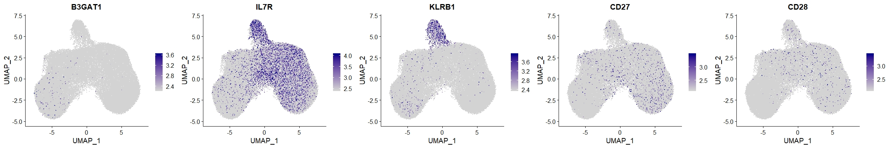
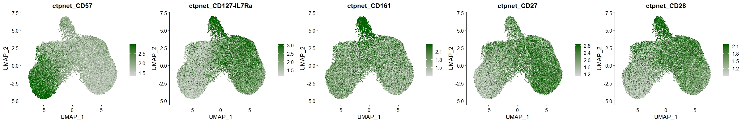
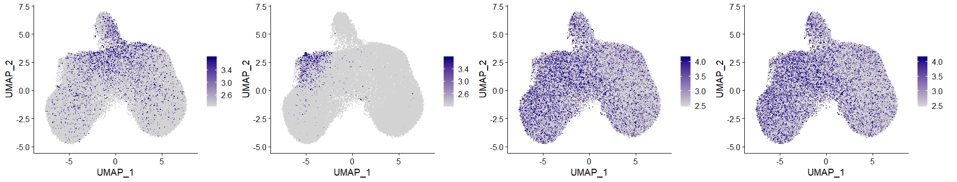
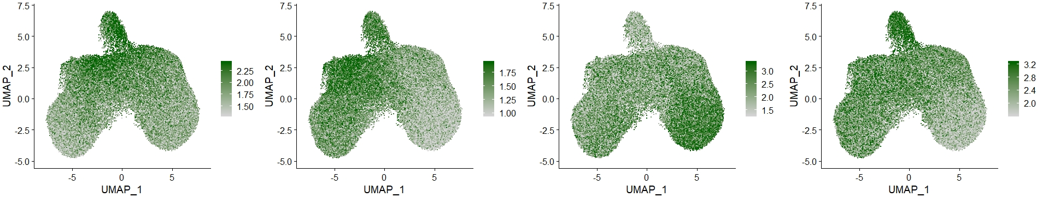
Before
After
Gene expression analysis of TYROBP, FCGR3A and KLRB1 before and after the removal of NK cells.
CD57
CD127
CD161
CD27
CD28
RNA
Protein
CD69
HLA.DR
CD45RA
CD45RO
RNA
Protein
Neural network analysis run after the removal of NK cells. This analysis compares gene and protein expression. The most representative genes expressed by CD8+ T cells are shown.
Supplementary Figure 2

Slide 4
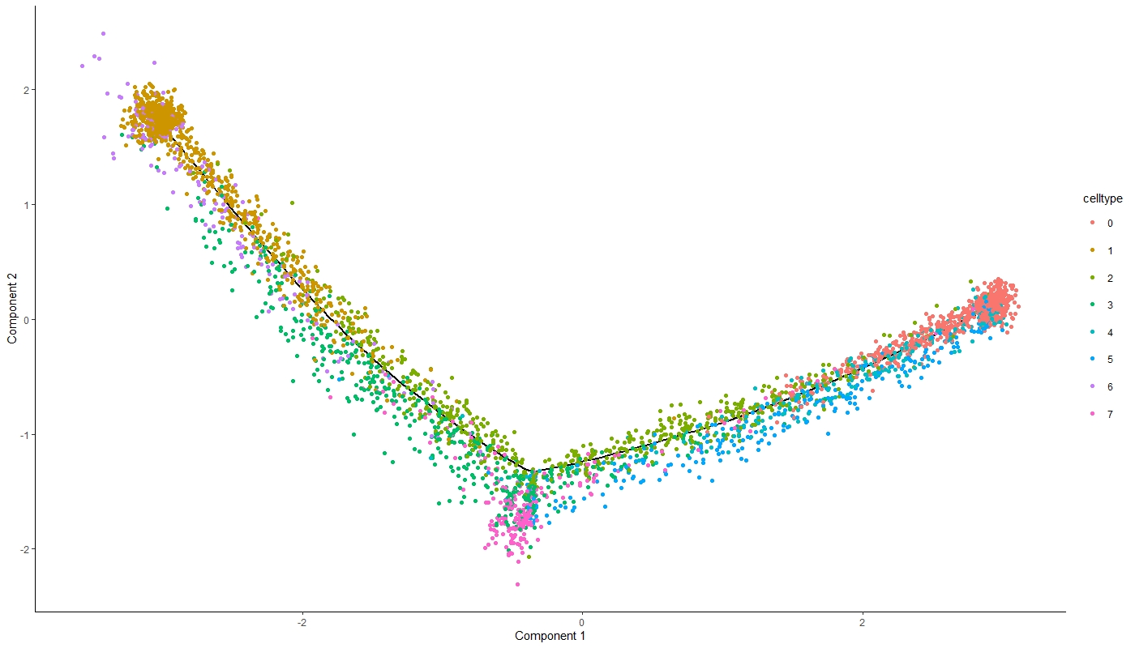
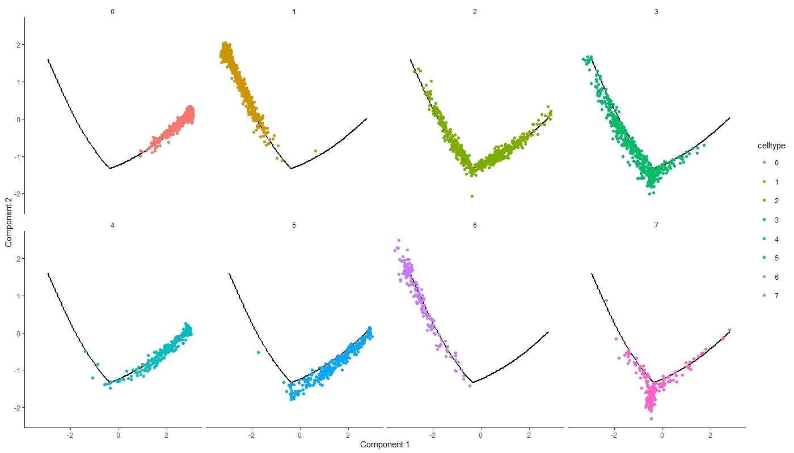
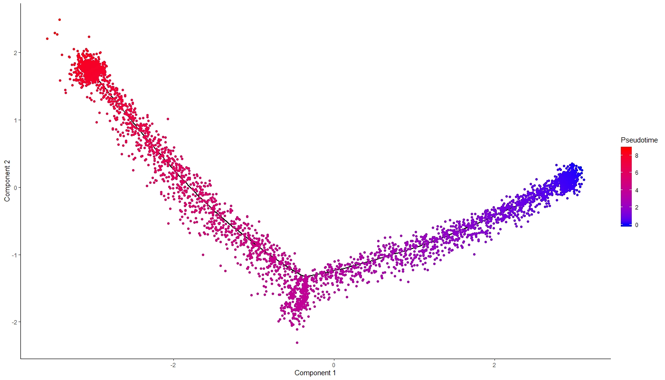
NAIVE (N)
CYTOTOX, EMRA
TM
COMPONENT2
M
N (GATA3)
N (JUN, FOS)
ACTIVATED EM
MAIT
COMPONENT1
NAIVE (N)
CYTOTOX, EMRA
TM
M
COMPONENT2
N (GATA3)
N (JUN, FOS)
ACTIVATED EM
MAIT
COMPONENT1
PSEUDOTIME
COMPONENT2
COMPONENT1
Trajectory analysis for the eight CD3⁺CD8⁺ T cells clusters. Cell expression profiles in a two-dimensional independent space. Solid black line indicates the main diameter path of the minimum spanning tree (MST) and provides the backbone of Monocle’s pseudotime ordering of the cells.
Each dot represents an individual cell colored by cluster or by pseudotime.
Supplementary Figure 3

Slide 5
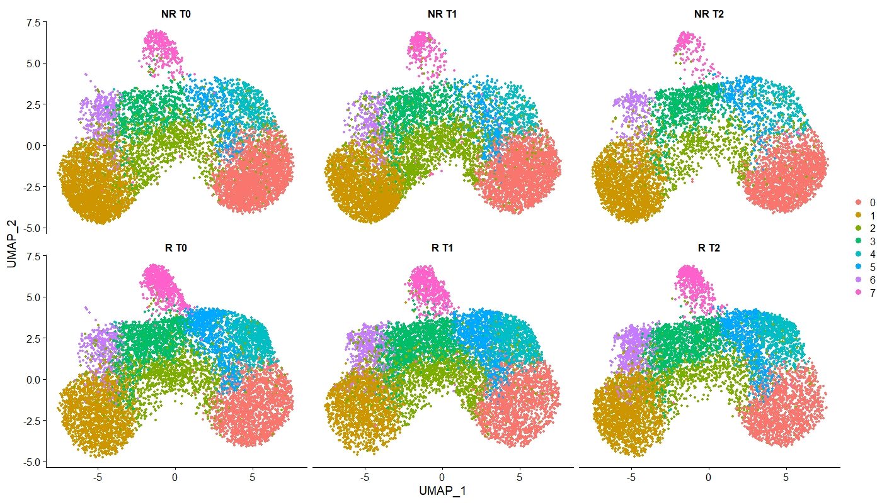
NR T0
NR T1
NR T2
NAIVE (N)
CYTOTOX, EMRA
TM
UMAP2
R T0
R T1
R T2
M
N (GATA3)
N (JUN, FOS)
ACTIVATED EM
MAIT
UMAP1
Distribution of different cell clusters identified by sc-RNAseq analysis.
NR
R
proportion of N
proportion of N (GATA3)
proportion of N (JUN,FOS)
proportion of TM
proportion of M
proportion of T cytotox
Proportion of different cell clusters identified by sc-RNAseq analysis Statistical analysis by two-sided Mann–Whitney nonparametric test.
Supplementary Figure 4

Slide 6
96.9
SSC-H
FSC-H
PROMOKINE-840
51.7
90
FSC-H
FSC-A
CD3-AF700
80.2
0.79
45.4
CD3-AF700
SSC-A
TCR 7.2-PE
Time
CD8-APC-Cy7
CD161-PC7
Gating strategy used for the analysis of MAIT cells.
Gated on MAIT
R, T0
R, T2
*
20.4%
46.0%
% of MAIT, CXCR4+ cells
among CD8+ T cells
CCR7-BV605
CXCR4-BV421
Representative dot plots of MAIT cells expressing CXCR4 of one R analyzed at T0 (left) and T2 (central panel). On the right, proportion of MAIT cells expressing CXCR4 between R and NR at T0, T1, T2. *p<0.05
Supplementary Figure 5

Slide 7
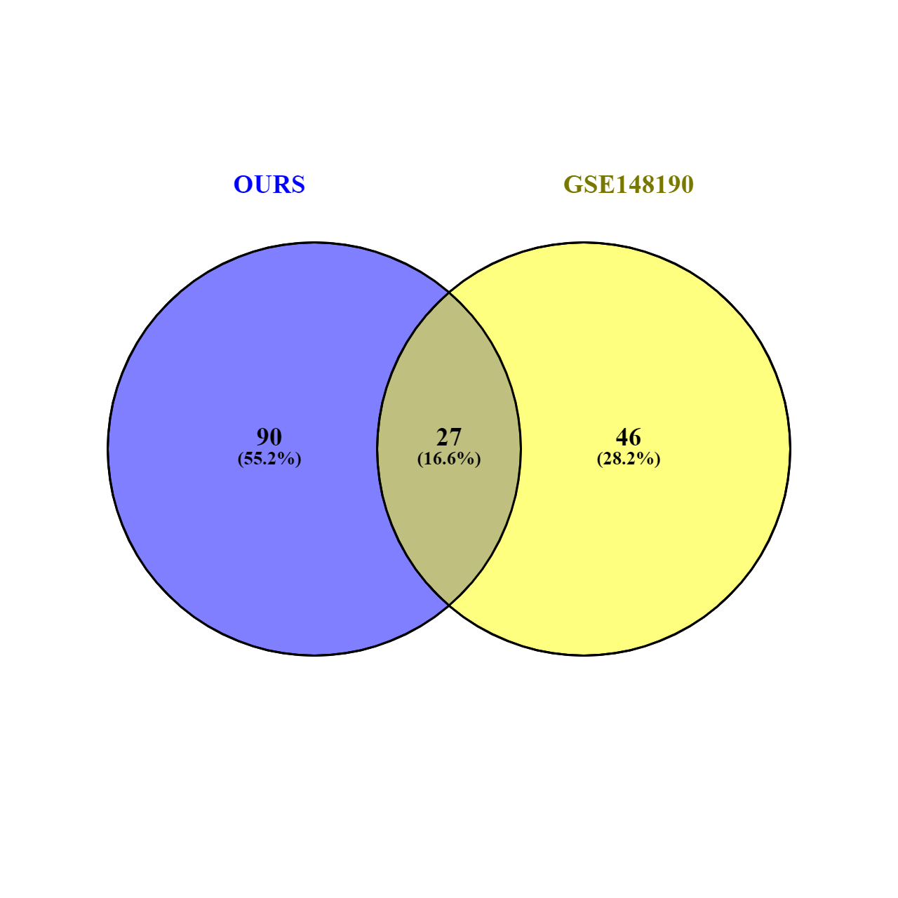
MAIT signature
(our scRNAseq dataset)
MAIT signature (GSE148190)
Overlapping p-value=1.2e-42
Jaccard Index=0.2
MAIT signature in TIL dataset. MAIT signature was confirmed by using GeneOverlap. In blue circle (left) numbers (percentage) of genes identifying MAIT cluster in our scRNAseq dataset; in yellow circle (right) numbers (percentage) of genes identifying MAIT cluster in GSE148190. The intersection between the two circles represent the number of genes (percentage) shared by the MAIT signature found in the two different datasets.
Supplementary Figure 6

Slide 8
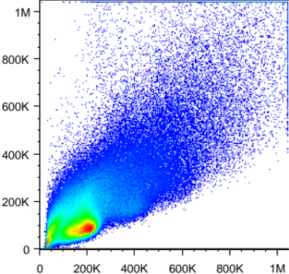
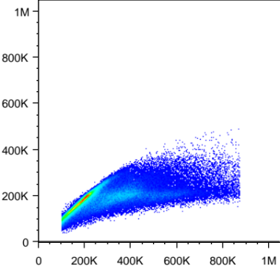
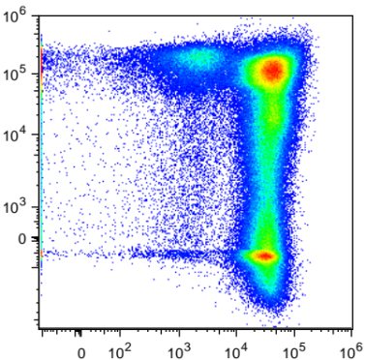
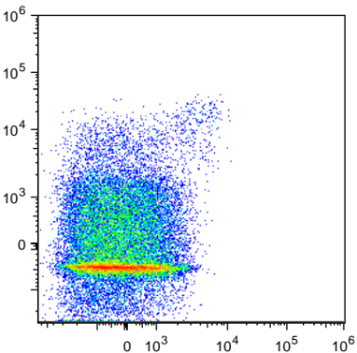
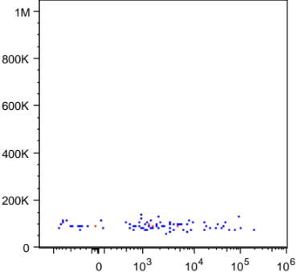
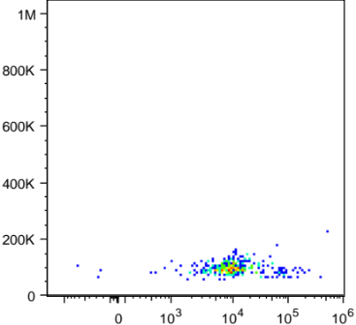
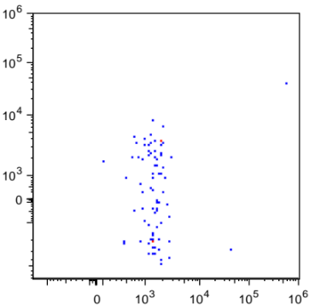
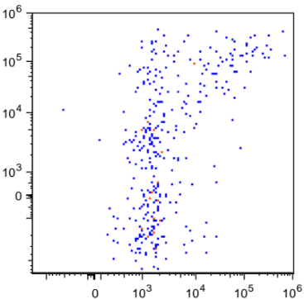
83.5
SSC-A
FSC-H
LIVE DEAD AQUA
79.1
30.1
FSC-A
FSC-A
CD3-APC
1.24
TCR 7.2-PE
Gated on MAIT cells
CD161-PE-CY7
Unstimulated
Stimulated
V
V
10.7
28.4
SSC-A
GRANZYME-B-BV421
2.53
39.5
TNF-BV605
2.53
28.4
IFN-γ-FITC
Gating strategy used for the analysis cytokine production by MAIT cells.
Supplementary Figure 7

