Slide 1

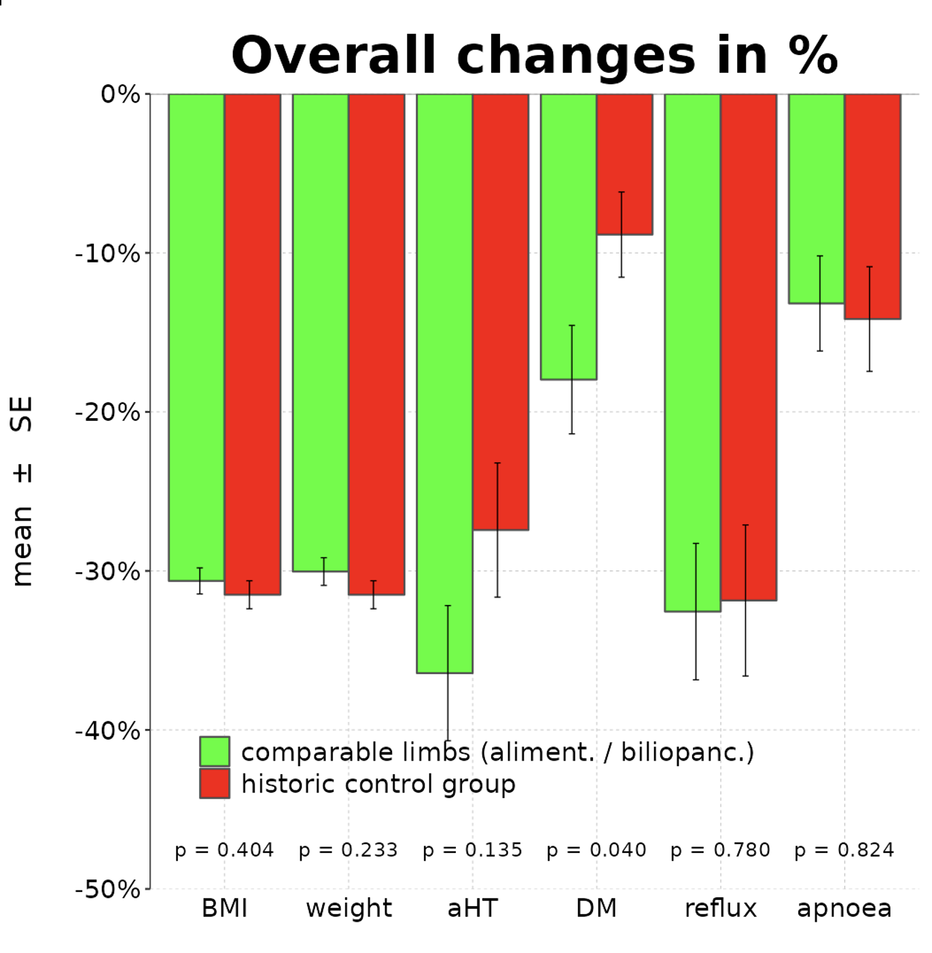
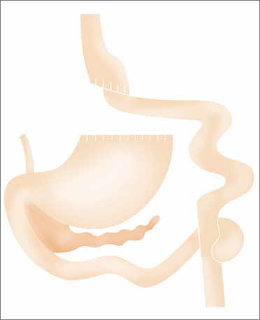


Adapting the biliopancreatic and alimentary limb lengths to the total small bowel length in RYGB leads to better postoperative outcomes, such as quality of life, satisfaction with body weight, resolution of comorbidities and iron deficiency
Conclusion
METHODS
RESULTS
CONCLUSIONS
RYGB with equal limb lengths leads to higher QoL, resolution of aHT , T2DM, iron deficiency and satisfaction with body weight,
while BMI-reduction is similar in both groups
242 patients
undergoing RYGB
This represents an individualized approach, suggesting that incorporating proportional limb length selection into RYGB improves metabolic and QoL-related outcomes.
- 113 patients received RYGB with standard limb lengths
- 129 patients received RYGB with equal alimentary and biliopancreatic limb lengths based on total small bowel length, resulting into proportional CC
Study period: July 2019 to May 2022

