Slide 1
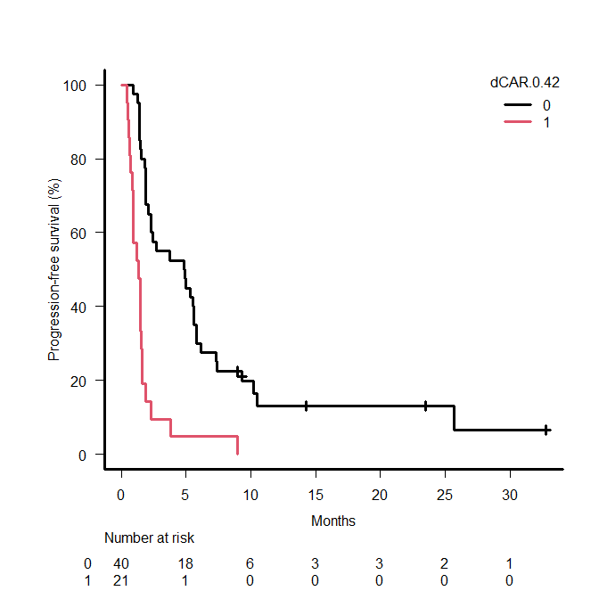
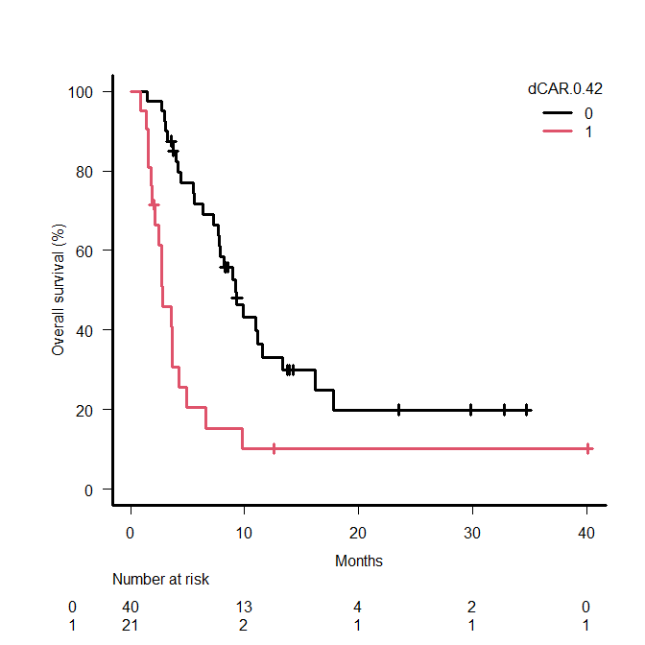
Supplementary Figure S4
a
b
Nivolumab monotherapy
high CAR group
Nivolumab monotherapy
high CAR group
dCAR < 0.42
dCAR ≥ 0.42
dCAR < 0.42
dCAR ≥ 0.42
PFS | Event | Median (95% CI) (month) | P value
CAR ≥ 0.072 and dCAR < 0.42 (n = 40) | 35 | 4.9 (2.1-5.6) | <0.001
CAR ≥ 0.072 and dCAR ≥ 0.42 (n = 21) | 21 | 1.3 (0.9-1.6)
OS | Event | Median (95% CI) (month) | P value
CAR ≥ 0.072 and dCAR < 0.42 (n = 40) | 27 | 9.2 (7.3-11.6) | <0.001
CAR > 0.072 and dCAR ≥ 0.42 (n = 21) | 18 | 2.8 (1.9-4.2)

