Slide 1
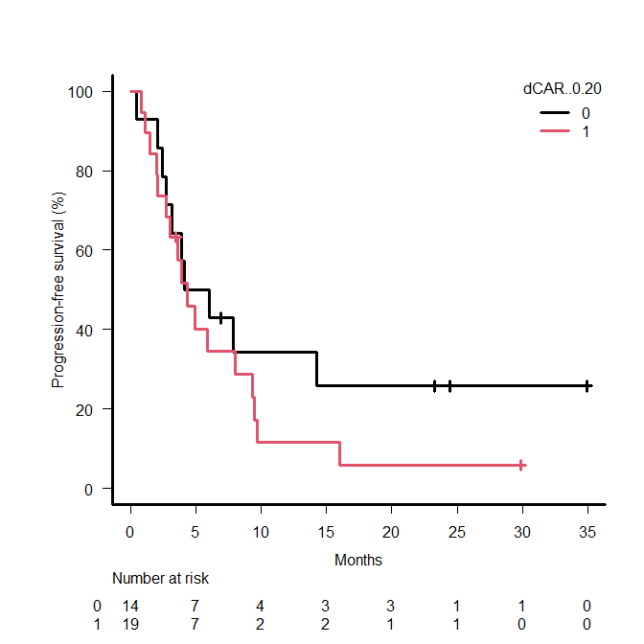
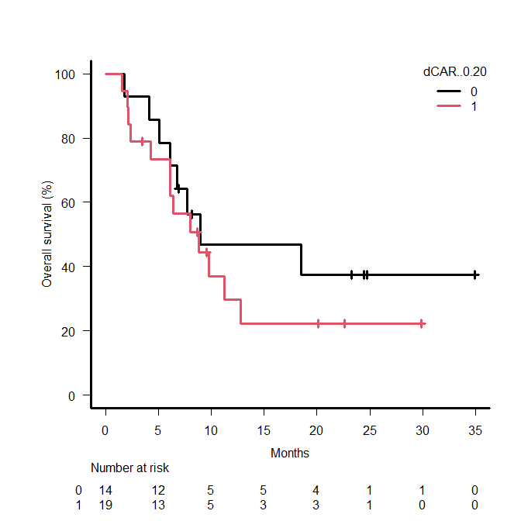
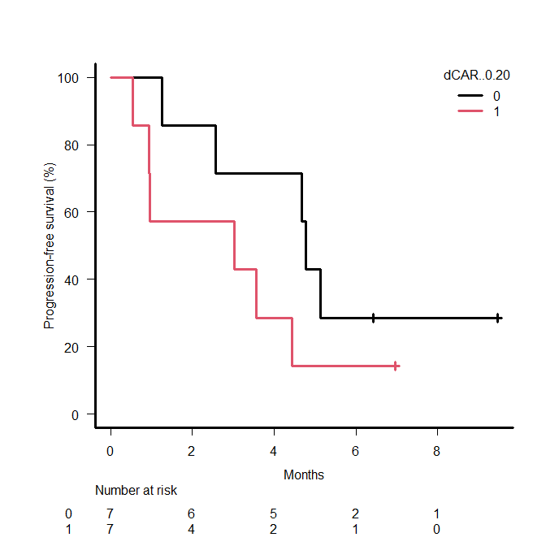
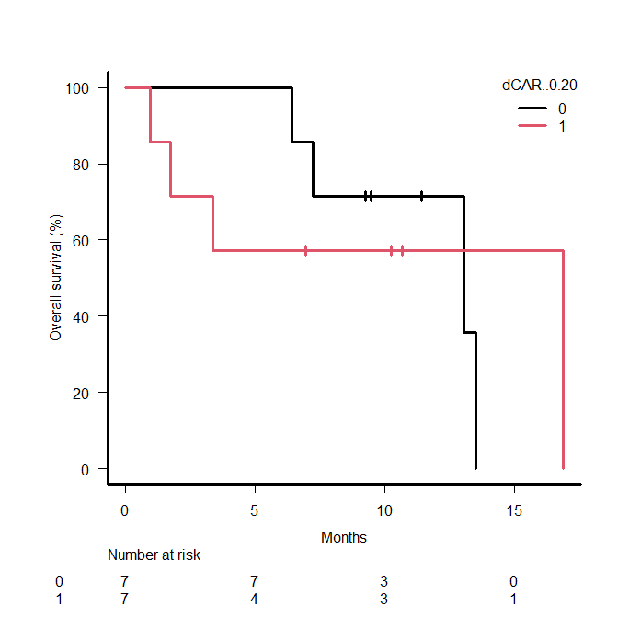
Supplementary Figure S5
a
b
c
d
1st-line Chemo + ICI
high CAR
1st-line Chemo + ICI
high CAR
1st- line Nivolumab + Ipilimumab
high CAR
1st-line Nivolumab + Ipilimumab
high CAR
dCAR < -0.20
dCAR ≥ -0.20
dCAR < -0.20
dCAR ≥ -0.20
dCAR < -0.20
dCAR ≥ -0.20
dCAR < -0.20
dCAR ≥ -0.20
PFS | Event | Median (95% CI) (month) | P value
dCAR< -0.20 (n = 14) | 14 | 5.4 (2.5-NR) | 0.29
dCAR≥ -0.20 (n = 19) | 17 | 4.3 (2.1-8.0)
OS | Event | Median (95% CI) (month) | P value
dCAR< -0.20 (n = 14) | 8 | 8.9 (5.1-NR) | 0.41
dCAR≥ -0.20 (n = 19) | 13 | 8.8 (4.3-12.8)
PFS | Event | Median (95% CI) (month) | P value
dCAR<-0.20 (n = 7) | 5 | 4.8 (1.3-NR) | 0.17
dCAR≥-0.20 (n = 7) | 6 | 3.0 (0.5-4.4)
OS | Event | Median (95% CI) (month) | P value
dCAR<-0.20 (n = 7) | 4 | 13.1 (6.4-NR) | 0.94
dCAR≥-0.20 (n = 7) | 4 | 16.9(1.0-NR)

