Slide 1
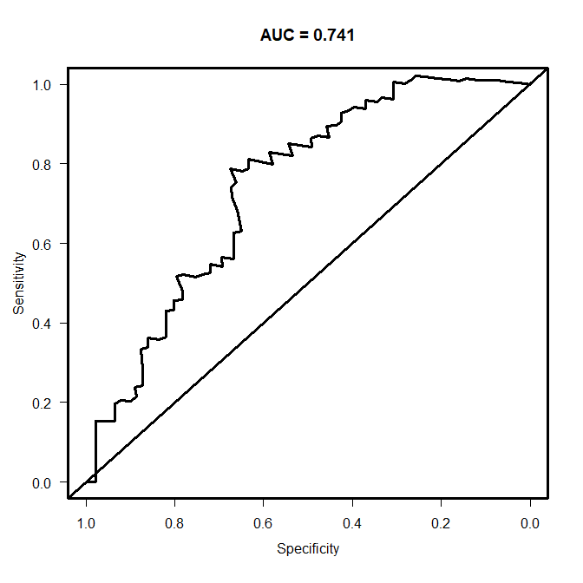
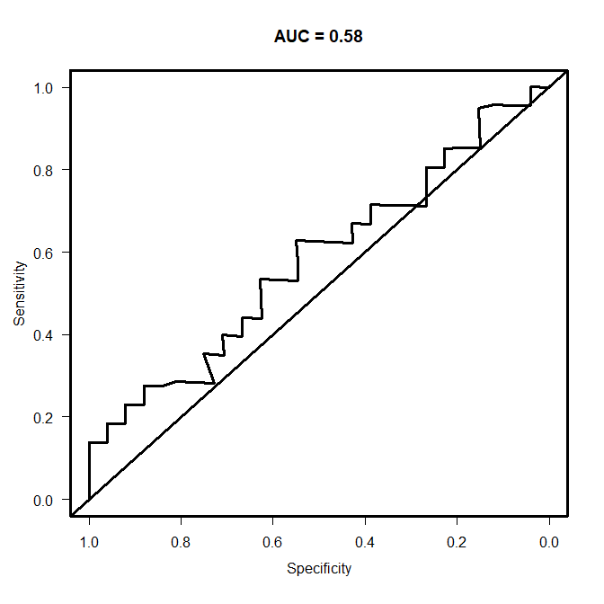
a
b
Supplementary Figure S3
CAR 0.072 (0.59, 0.87)
mOS 9.3
dCAR 0.42 (0.91, 0.63)
mOS 5.5
Nivolumab monotherapy cohort
and high CAR group
Nivolumab monotherapy cohort
c
d
CAR 0.090 (0.68, 0.79)
mOS 16.7
dCAR -0.20 (0.55, 0.63)
mOS 8.9
1st-line treatment cohort
and high CAR group
1st-line treatment cohort

