Slide 1
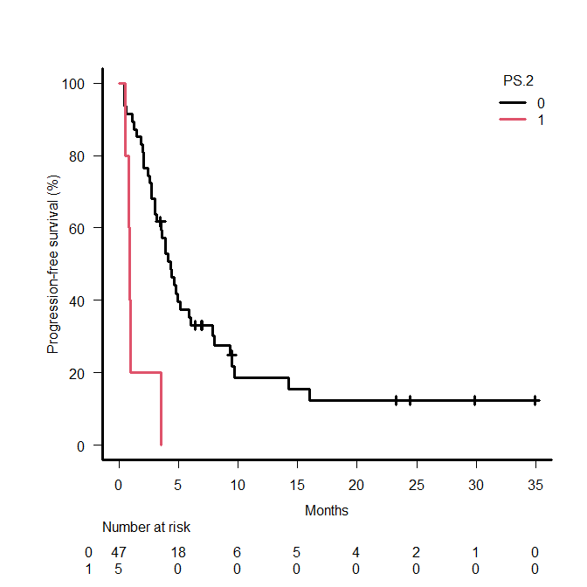
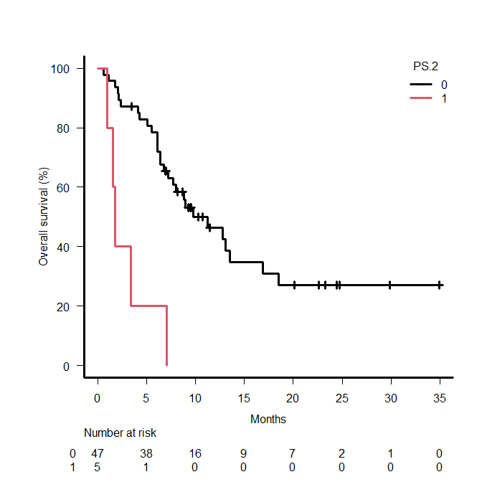
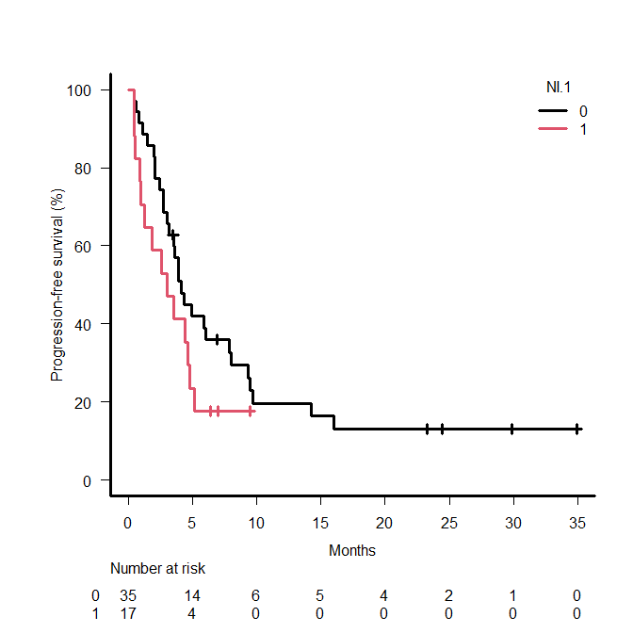
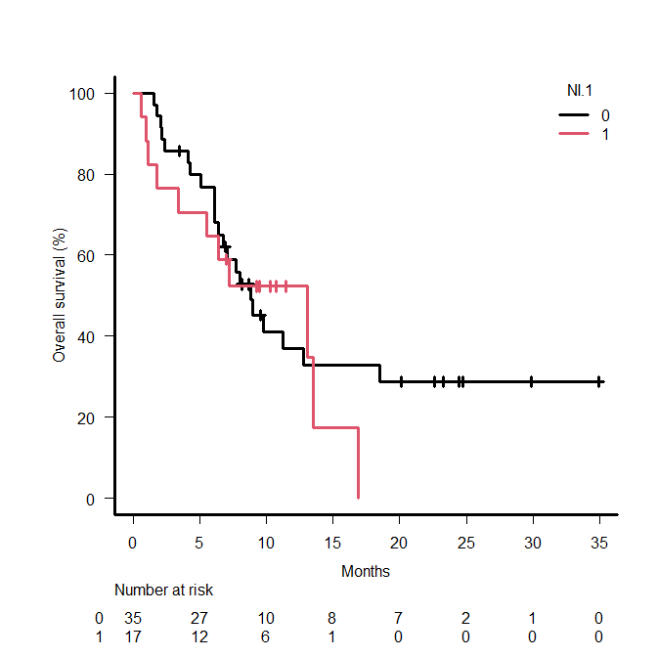
Supplementary Figure S6
a
b
c
d
1st-line treatment cohort
high CAR
1st-line treatment cohort
high CAR
1st- line treatment cohort
high CAR
1st-line treatment cohort
high CAR
PS 0,1
PS 2
PS 0,1
PS 2
Chemo + ICI
Nivo + Ipi
Chemo + ICI
Nivo + Ipi
PFS | Event | Median (95% CI) (month) | P value
PS 0,1 (n = 47) | 38 | 4.3 (3.0-5.9) | <0.001
PS 2 (n = 5) | 5 | 0.9 (0.5-NA)
OS | Event | Median (95% CI) (month) | P value
PS 0,1 (n = 47) | 28 | 9.8 (6.7-16.9) | <0.001
PS 2 (n = 5) | 5 | 1.8 (1.0-NA)
PFS | Event | Median (95% CI) (month) | P value
Chemo + ICI (n = 35) | 29 | 4.1 (3.0-7.9) | 0.14
Nivo + Ipi (n = 17) | 14 | 3.0 (0.9-14.8)
OS | Event | Median (95% CI) (month) | P value
Chemo + ICI (n = 35) | 22 | 8.8 (6.1-18.5) | 0.56
Nivo + Ipi (n = 21) | 17 | 13.1 (1.8-NR)

