Slide 1
A
B
Figure S1. Structure and pathways of quantified metabolites and hormones. A) Chemical structure of the glucosinolates and their degradation products quantified in this study B) A schematic view of the biosynthetic pathways of phenylpropanoids and representative intermediates and chemical structures. For simplicity, only the enzymes involved in the formation of 4-coumaryl CoA from phenylalanine are shown. Solid arrows represent single enzymatic steps. Dashed arrows indicate multiple consecutive enzymatic steps. The colors are representative of following chemical classes: Coumarins (green), cinnamic acid derivatives (black), benzoic acids (dark red), lignin precursors (monolignols) (blue), and lignans (light red).

Slide 2
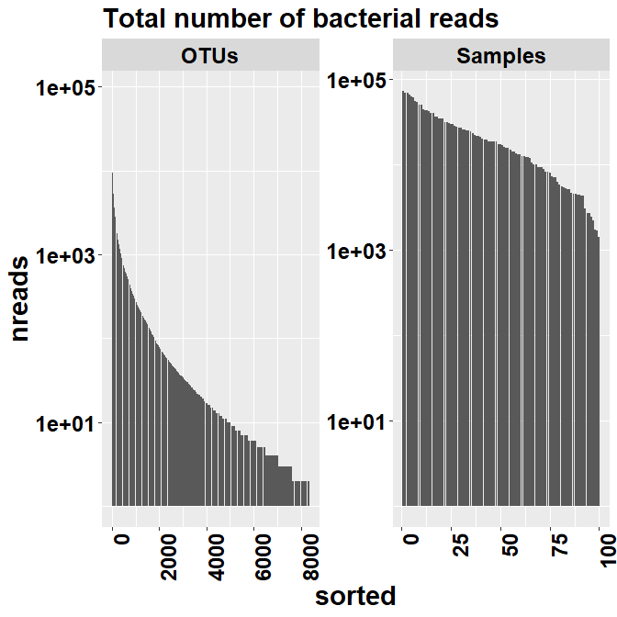
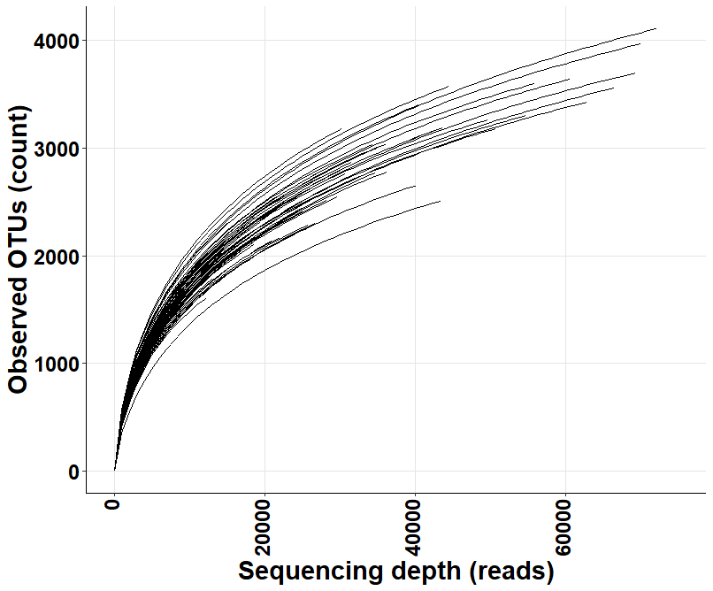
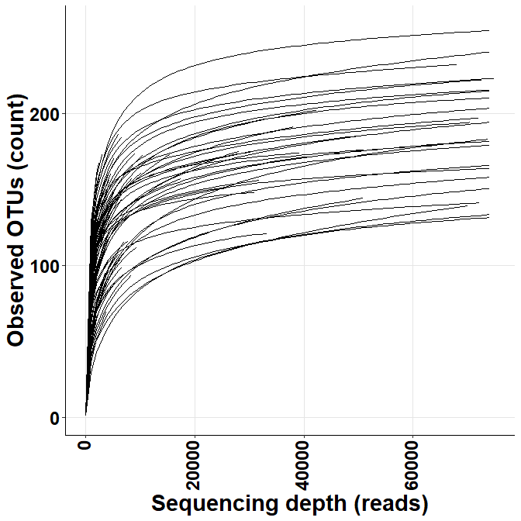
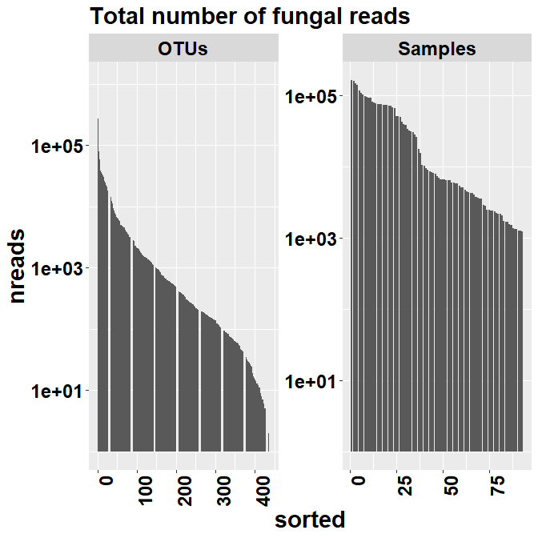
A
C
B
D
Figure S2. Distribution of (A) bacterial and (B) fungal sequence reads and OTUs in samples used for this study. Rarefaction curves showing the coverage of (C) bacterial and (D) fungal OTU richness (species richness in number of OTUs) as a function of sequencing depth (sample size in number of reads).

Slide 3
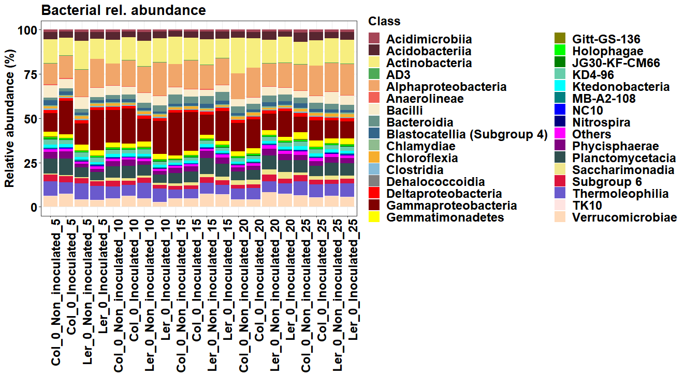
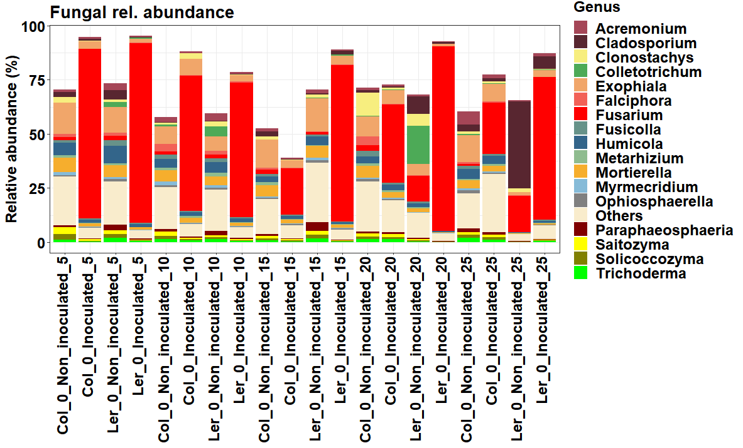
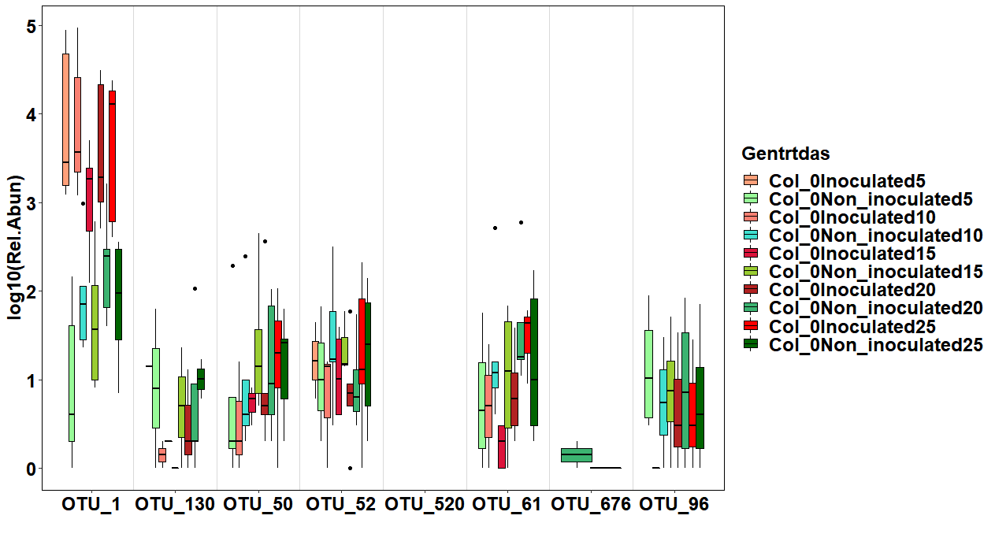
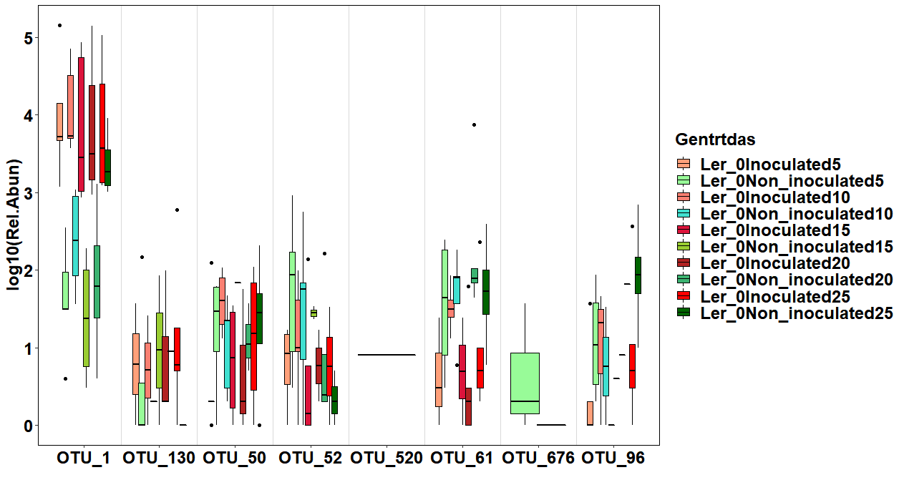
A
B
C
D
Figure S3. Microbial relative abundance in infected and control Arabidopsis. Class-level relative abundances of A) bacterial and B) fungal communities in infected and control Col-0 and Ler-0. C) Relative abundance of fOTUs assigned to the Fusarium genus in Col-0 control and infected samples. D) Relative abundance of fOTUs assigned to the Fusarium genus in Ler-0 control and infected samples at different DAI. Red colour shades represented infected samples while green colour shades represent control samples at different DAI.

Slide 4
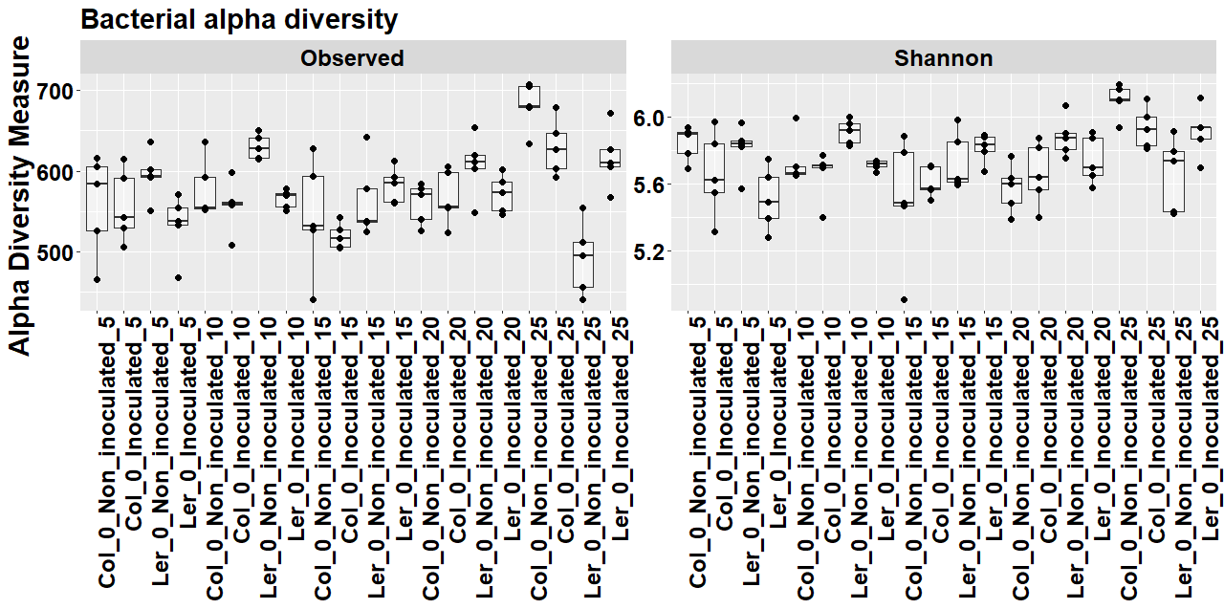
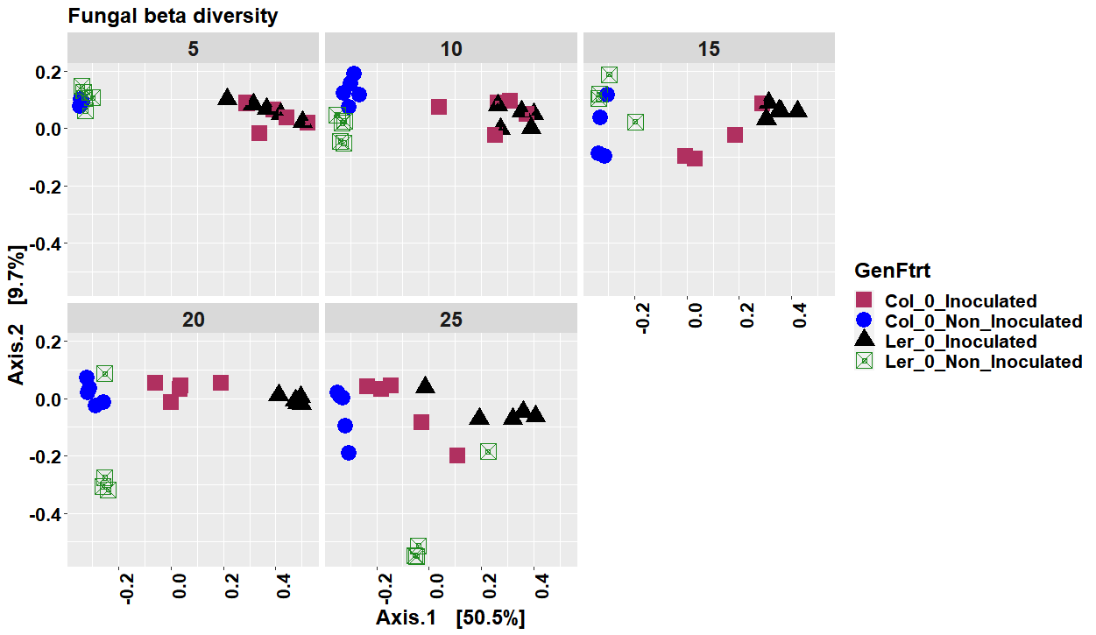
A
B
Figure S4. Microbial community composition and diversity in infected and control Arabidopsis. Bacterial alpha diversity A) and B) fungal beta diversity visualized using Principal coordinates analysis (PCoA) in infected and control Col-0 and Ler-0.

Slide 5
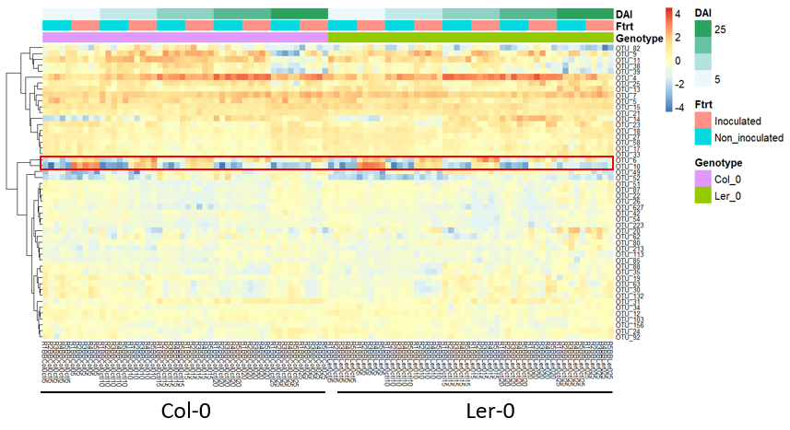
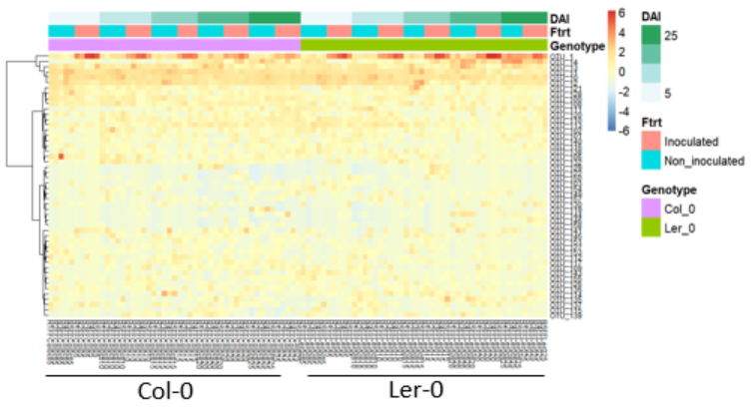
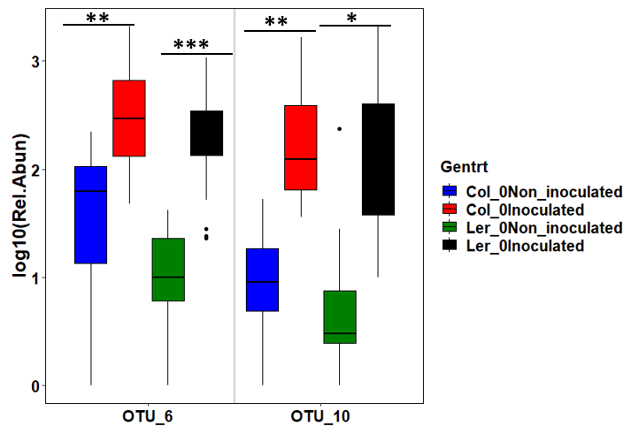
A
B
C
Figure S5. Heatmap showing top50 bacterial (A) and B) fungal OTU relative abundances in inoculated and non-inoculated samples across different 5 DAI. (C) Bacterial OTUs (bOTUs6 and bOTU10) displaying the most distinct differential abundances in inoculated and non-inoculated of Col.0 and Ler-0 across different sampling times. One-way ANOVA was used to determine statistically significant differences between sample means, followed by the Tukey post hoc test using R statistical package. Significance of test indicated as *** for p < 0.001, ** p > 0.01, *p < 0.05.

Slide 6
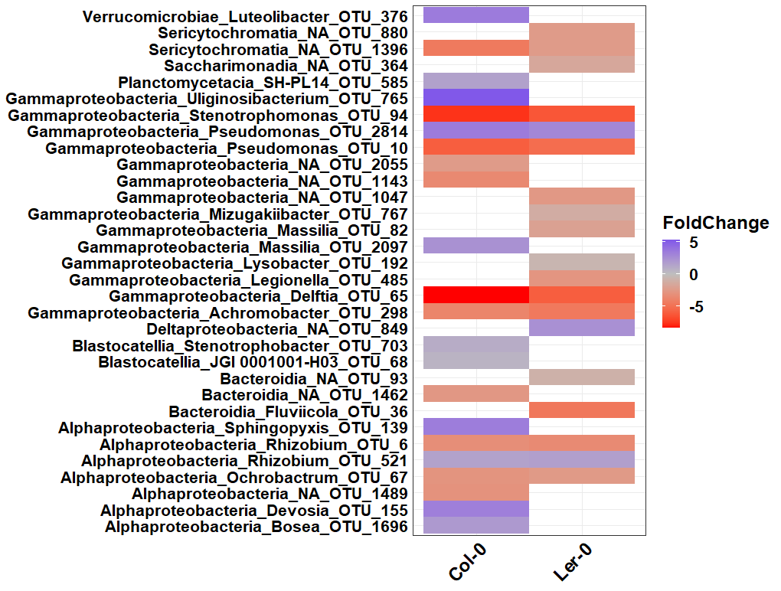
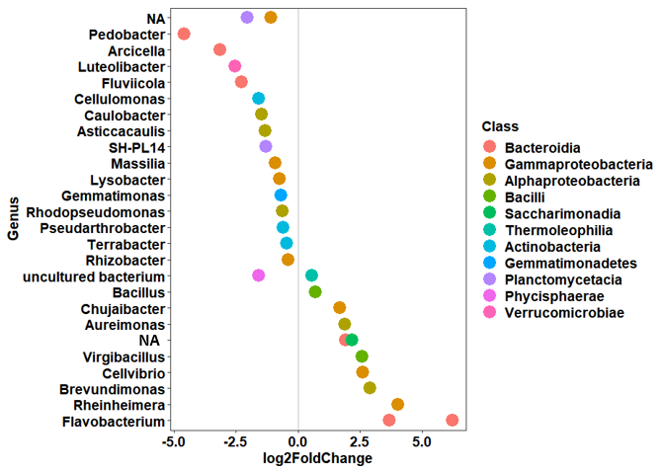
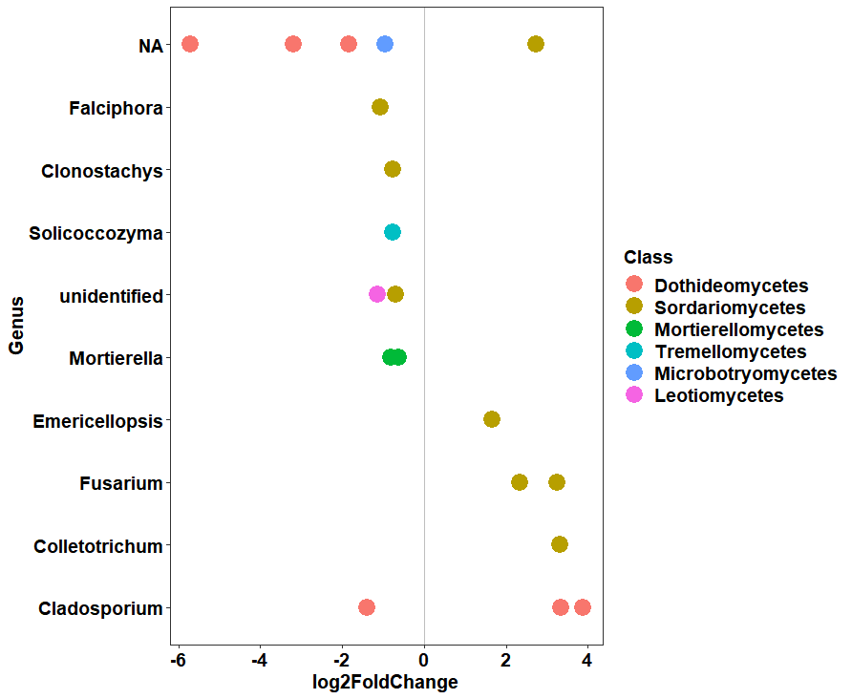
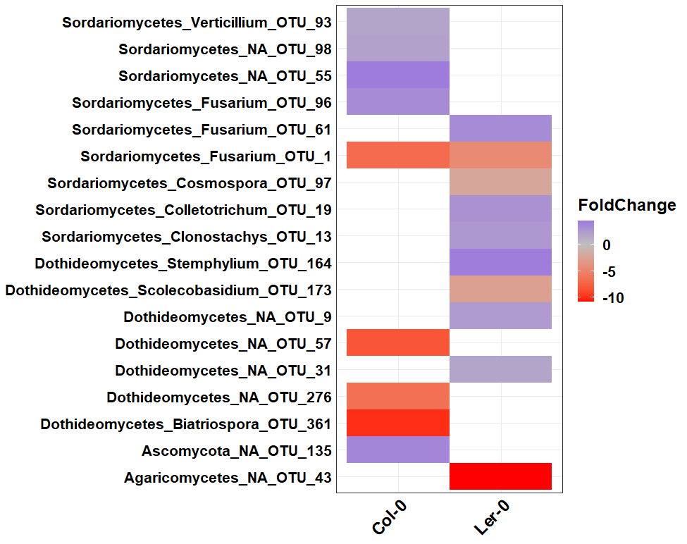
C
A
Col-0
Ler-0
Col-0
Ler-0
B
D
Figure S6. Differential abundances of microbial taxa between genotypes and treaments (non-inoculated and inoculated) for each genotypes. Differentially affected bacterial (A) and fungal (B) taxa between samples of Col-0 and Ler-0 C) Heatmap showing differentially abundant bacteria taxa in inoculated and non-inoculated samples of Col-0 and Ler-0. Species assigned to the genus Pseudomonas were differentially enriched in inoculated (OTU10;P. protegens) and non-inoculated (OTU2814). D) Heatmap showing differentially abundant fungal taxa in inoculated and non-inoculated samples of Col-0 and Ler-0. OTU1 (FOM) was significantly enriched in the inoculated samples. The analysis was performed using DESeq2. Statistical significance was based on p value < 0.01 (with FDR < 5% under the Benjamini-Hochberg correction)

