Slide 1
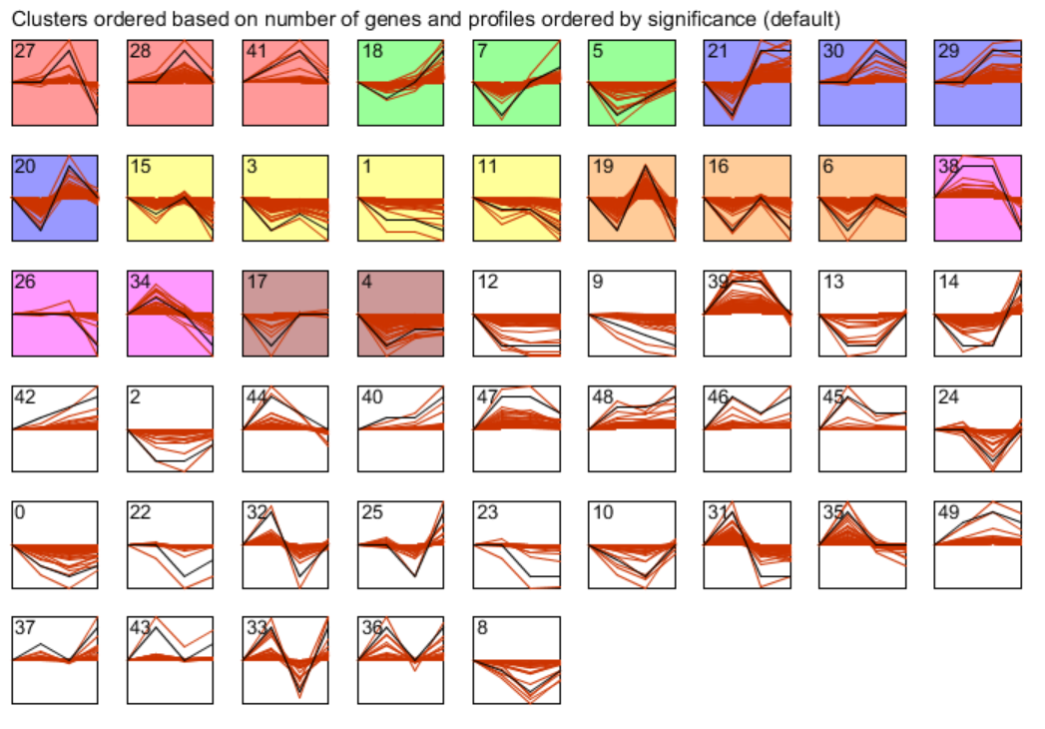
Additional file 2: A total of 50 profiles in G. emersonii were generated by STEM analysis

