Slide 1
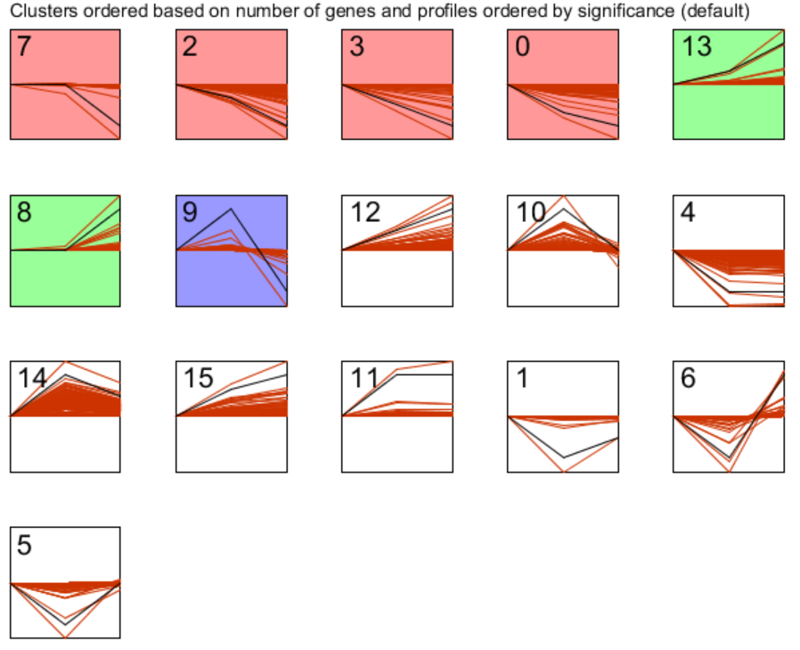
Additional file 4: A total of 16 profiles in A. protococcarum were generated by STEM analysis

