Slide 1
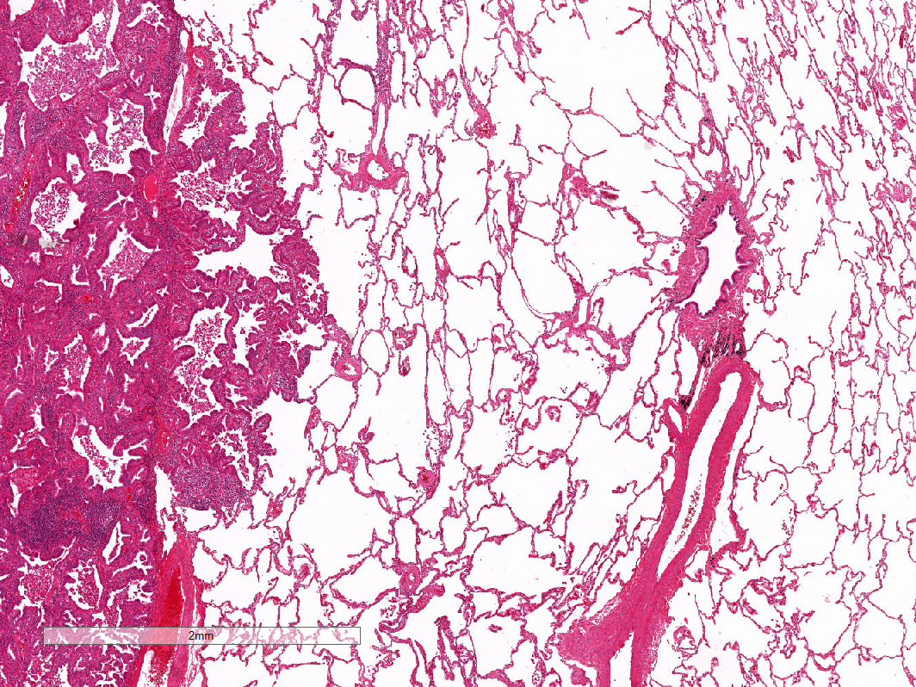
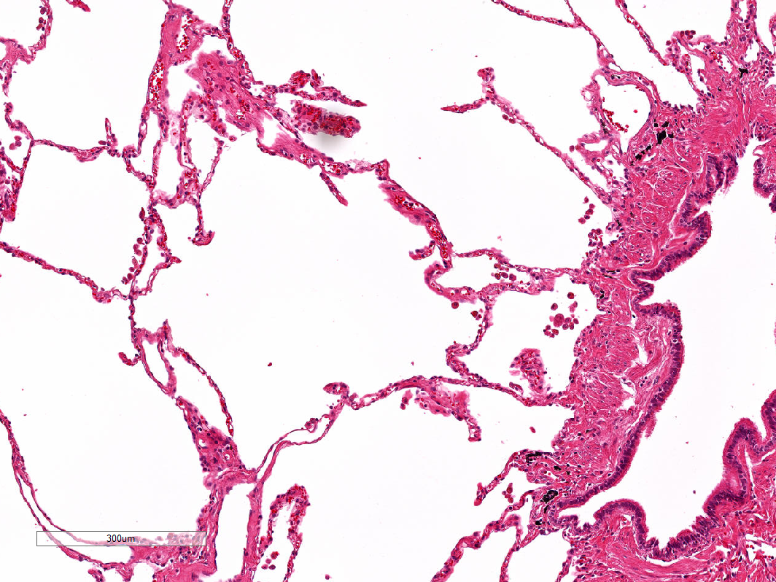
Supplementary Figure 3
A
B
Tumor
area
Peritumoral
area
Nonadjacent
area
Peritumoral
area
Nonadjacent
area
At least 2μm
C
70
r²=0.723
60
50
40
The number of peritumoral AMs
30
20
10
0
0
10
20
30
40
50
The number of nonadjacent AMs
Notes:
O13-1586
O15-2052
O15-1979

