Slide 1
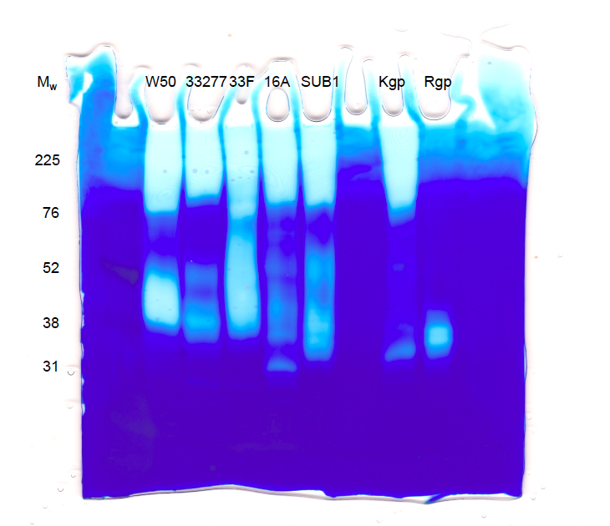
Supplementary File 1. Zymogram gel showing aliquots (2µl) from 3-day old cultures of P. gingivalis strains [W50, 33F, SUB1 and 2 strains not otherwise mentioned in the paper (ATCC33277 and 16A) as well as commercial preparations of Kgp and RgpB on a gelatin-containing gel stained with Coomassie brilliant blue. This image has not been subjected to digital enhancement.

