Slide 1
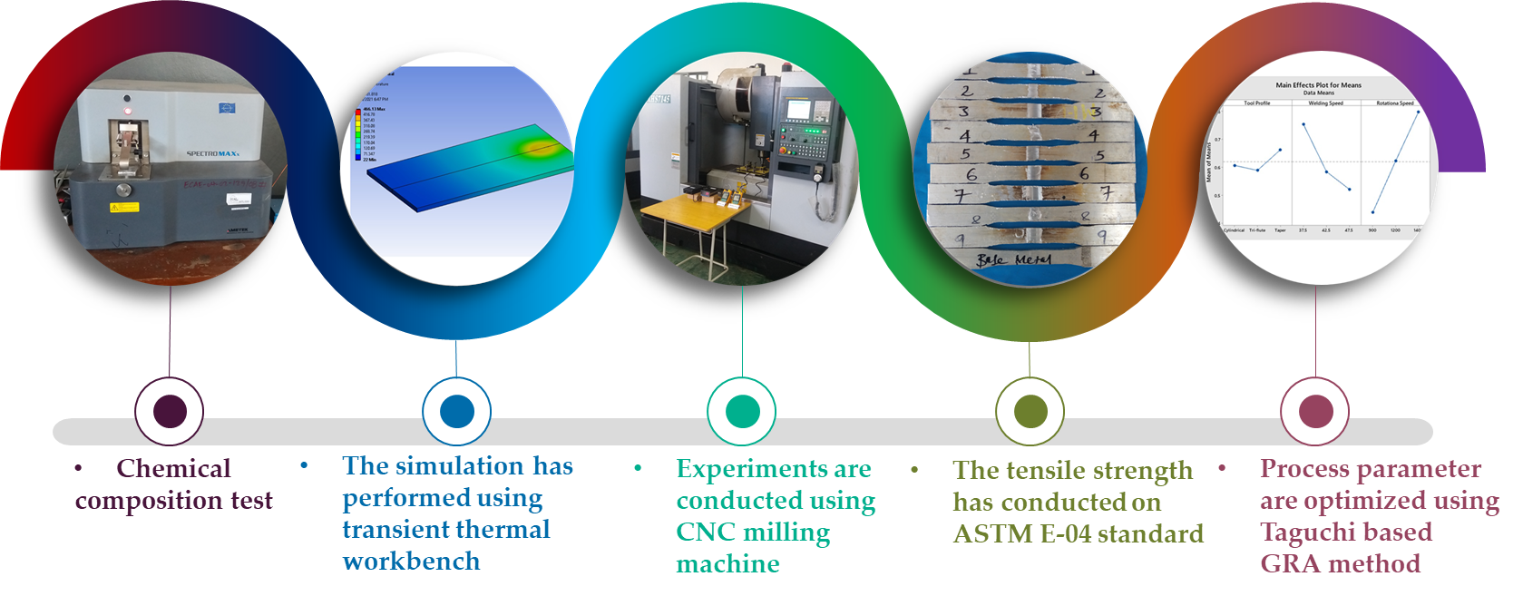
Graphical Abstract

