Slide 1
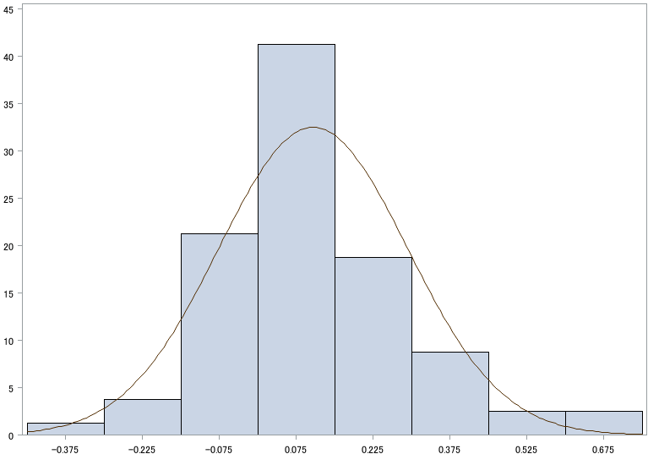
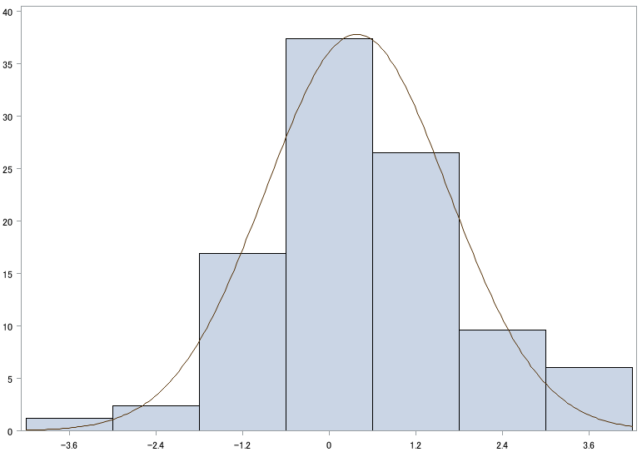
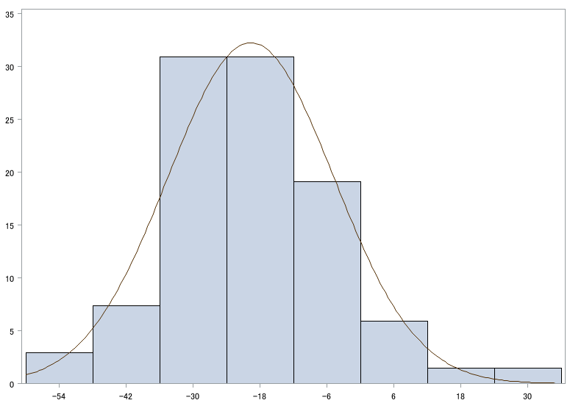
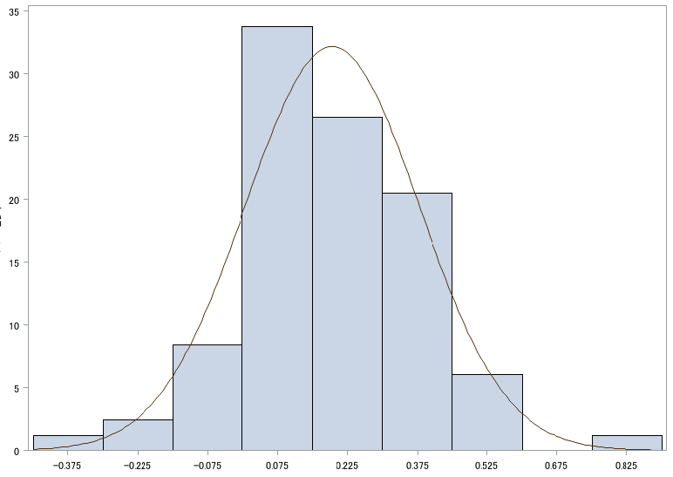
Percent
Two-step test
Stand-up test
Total GLFS-25
EQ-5D
Distribution of difference between pre- and post-operation in locomotive syndrome risk test and eq5d
Supplementary Figure1

