Slide 1
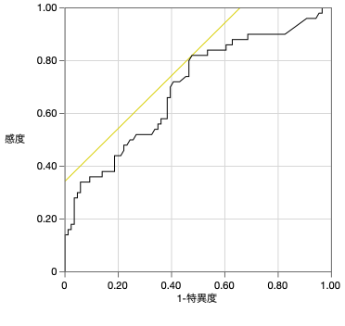
Figure S1
1.00
0.80
0.60
sensitivity
0.40
cut-off: 4.0
AUC=0.71
0.20
0
0
0.20
0.40
0.60
0.80
1.00
1-specificity
Figure S1.
Receiver operating characteristic (ROC) curve analysis for overall survival. The area under the ROC curve (AUC)
for predicting overall survival using PET-SUVmax was 0.71, with an optimal cutoff value of 4.0.
Notes:
2025/1

Slide 2
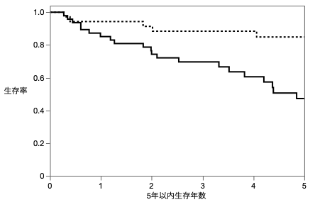
Figure S2A
(%)
Low SUVmax（N=36）
Median; NE
95%CI; 7.80-NE
100
84.9% (5year)
80
47.2% (5year)
60
Overall survival rate (%)
High SUVmax（N=44）
Median; 4.85 year
95%CI; 3.52-NE
40
20
NE; Not Estimable
CI; confidence intervals
p=0.0059
0
Years after hepatic resection
Figure S2A.
Kaplan–Meier analysis of overall survival in patients without diabetes mellitus (DM-), stratified by PET-SUVmax.
Among patients with diabetes mellitus, those with high PET-SUVmax (≥4.0, n = 44) had significantly worse overall survival
compared to those with low PET-SUVmax (<4.0, n = 36) (p = 0.0059).
Notes:
2025/1

Slide 3
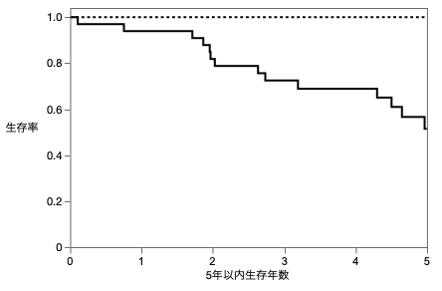
Figure S2B
(%)
Low SUVmax（N=18）
Median; NE
95%CI; 8.53-NE
100% (5year)
100
80
51.4% (5year)
60
Overall survival rate (%)
High SUVmax（N=34）
Median; 5.08
95%CI; 4.97-9.58
40
20
NE; Not Estimable
CI; confidence intervals
p=0.0026
0
Years after hepatic resection
Figure S2B.
Kaplan–Meier analysis of overall survival in patients with diabetes mellitus (DM+), stratified by PET-SUVmax.
Among patients with diabetes mellitus, those with high PET-SUVmax (≥4.0, n = 34) had significantly worse overall survival
compared to those with low PET-SUVmax (<4.0, n = 18) (p = 0.0059).
Notes:
2025/1

Slide 4
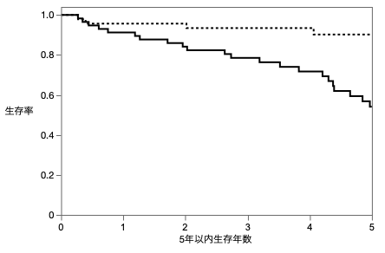
Figure S3A
(%)
Low SUVmax（N=47）
Median; NE
95%CI; NE-NE
100
90.2% (5year)
80
54.1% (5year)
60
Overall survival rate (%)
High SUVmax（N=59）
Median; 5.35
95%CI; 4.38-9.58
40
20
NE; Not Estimable
CI; confidence intervals
p = 0.0003
0
Years after hepatic resection
Figure S3A.
Kaplan–Meier analysis of overall survival in patients with solitary hepatocellular carcinoma (HCC) stratified by PET-SUVmax.
Among patients with solitary HCC, those with high PET-SUVmax (≥4.0, n = 47) had significantly worse overall survival
compared to those with low PET-SUVmax (<4.0, n = 59) (p = 0.0003).
Notes:
2025/1

Slide 5
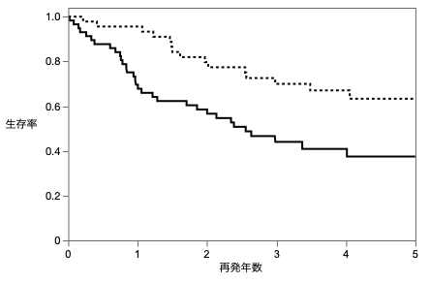
Figure S3B
(%)
100
Low SUVmax（N=47）
Median; NE
95%CI; 4.05-NE
80
63.3% (5year)
60
Recurrence-free survival rate(%)
37.5% (5year)
40
High SUVmax（N=59）
Median; 2.56
95%CI; 1.28-NE
20
NE; Not Estimable
CI; confidence intervals
p = 0.0027
0
Years after hepatic resection
Figure S3B.
Kaplan–Meier analysis of recurrence-free survival in patients with solitary hepatocellular carcinoma (HCC) stratified by
PET-SUVmax. Among patients with solitary HCC, those with high PET-SUVmax (≥4.0, n = 47) had significantly worse
recurrence-free survival compared to those with low PET-SUVmax (<4.0, n = 59) (p = 0.0003).
Notes:
2025/1

Slide 6
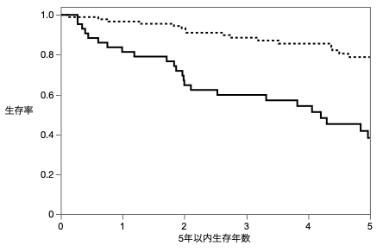
Figure S4
(%)
mvi -（N=91）
Median; NE
95%CI; 7.81-NE
100
78.8% (5year)
80
60
38.2% (5year)
Overall survival rate (%)
40
mvi +（N=45）
Median; 4.21
95%CI; 2.00-7.73
20
NE; Not Estimable
CI; confidence intervals
p<0.0001
0
Years after hepatic resection
Figure S4.
Kaplan–Meier analysis of overall survival according to the presence of microscopic vascular invasion (mvi).
Patients with mvi-positive tumors (n = 45) had significantly worse overall survival compared to those without mvi (n = 91)
(p < 0.0001).
Notes:
2025/1

