Slide 1
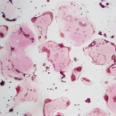
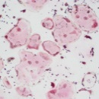
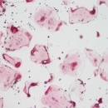
RAW264.7
(A)
(C)
c-Fos
(D)
NFATc1
(%)
RAW264.7
Relative
mRNA expression
Relative
mRNA expression
Cell viability
ERN (μM)
ERN (μM)
sRANKL
sRANKL
ERN (μM)
(E)
TRAP
(F)
Ctsk
(B)
sRANKL
Relative
mRNA expression
Relative
mRNA expression
ERN (μM)
0
0
0.01
0.1
0.5
1
RAW264.7
ERN (μM)
ERN (μM)
sRANKL
sRANKL
(%)
(G)
DC-STAMP
(H)
OC-STAMP
Rate of
osteoclast formation
Relative
mRNA expression
Relative
mRNA expression
ERN (μM)
ERN (μM)
ERN (μM)
sRANKL
sRANKL
sRANKL
Fig. S1

