Slide 1
Supplemental Figures

Slide 2
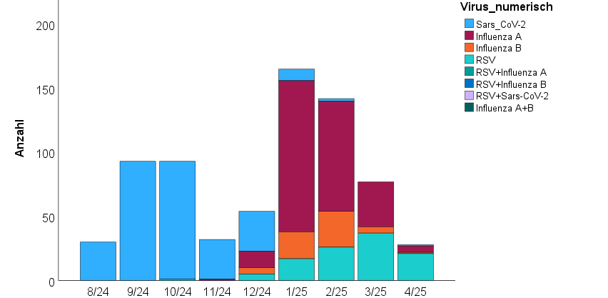
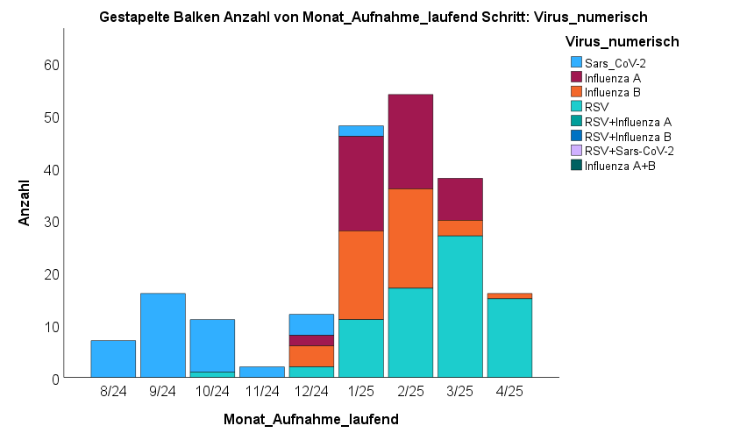
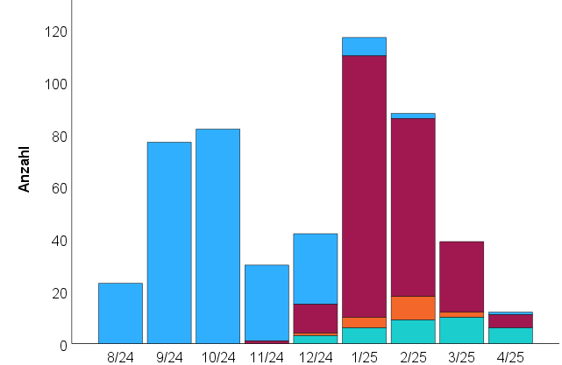
Time course of infections
All
<18 years of age
≥18 years of age
Type of infection
SARS-CoV-2
Influenza A
Influenza B
RSV
Number
Number
Number
Supplemental Figure S1: Time course of infections. Numbers of patients stratified according to type of infections versus month of admission. Absolute numbers are shown. Please note the differences in scales

Slide 3
Absolute number of infections in past seasons
ALL
>= 18 YEARS OF AGE
< 18 YEARS OF AGE
Type of infection
SARS-CoV-2
Influenza A
Influenza B
RSV
Supplemental Figure S2: Absolute numbers of infections in past three season [3], [4], either for all patients or stratified according to age group. The numbers given within the bars indicate the absolute number of respective patients. Please note the different observation windows: 2022/23 October – February; 2023/24 August – February; 2024/25 August - April

