Slide 1
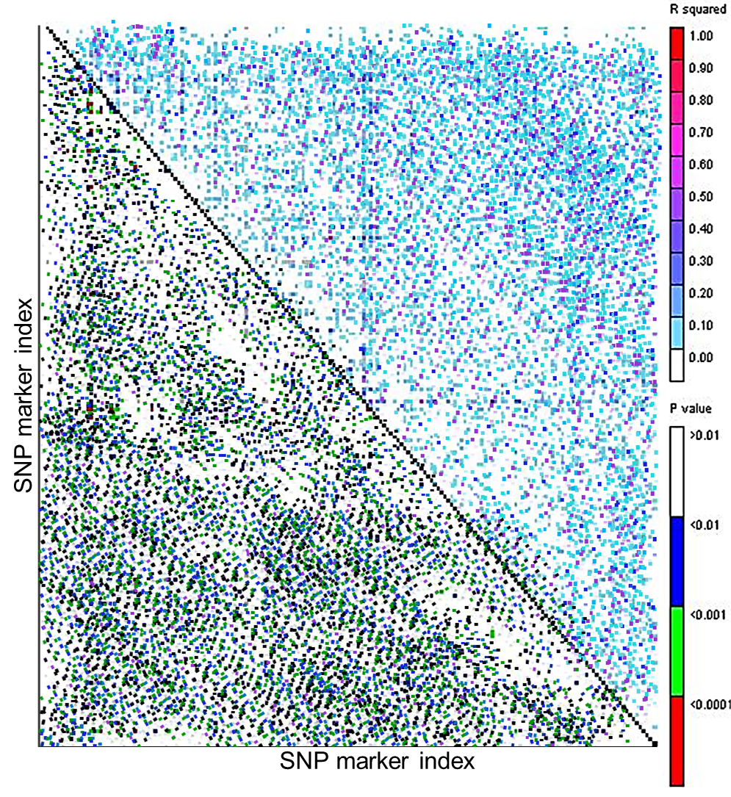
Suppl. Fig. 1: Genome wide linkage disequilibrium (LD) decays based on 15,737 SNP markers. Each cell represents the relationship between two markers with color codes showing the level of significance.

