Slide 1
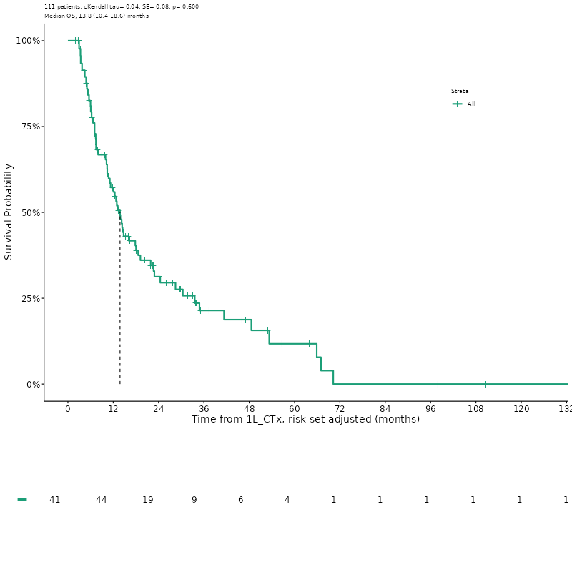
Supplementary figure 1
Median survival
13.8 months (95%CI: 10.4-18.6)

Slide 2
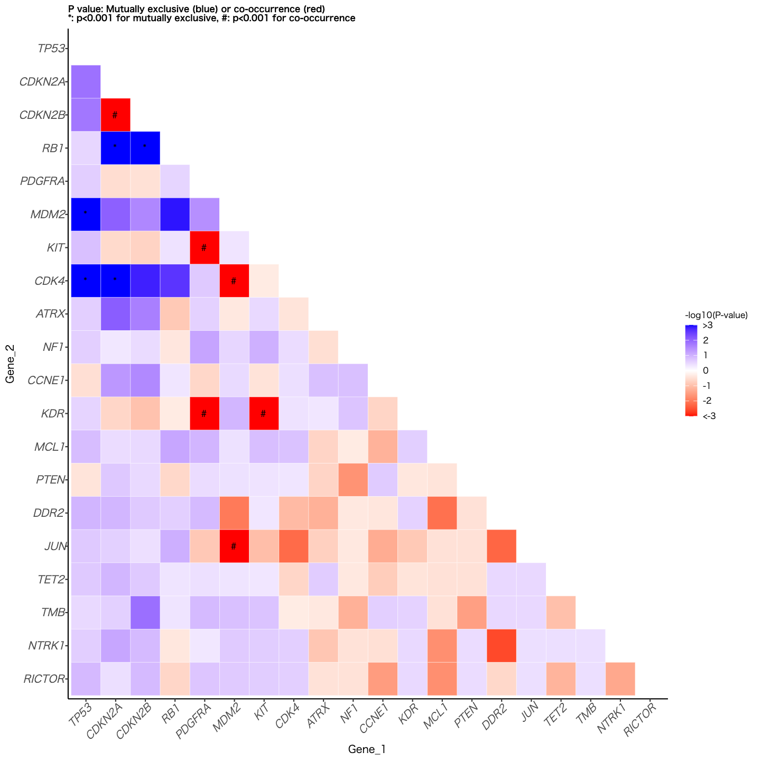
Supplementary figure 2

Slide 3
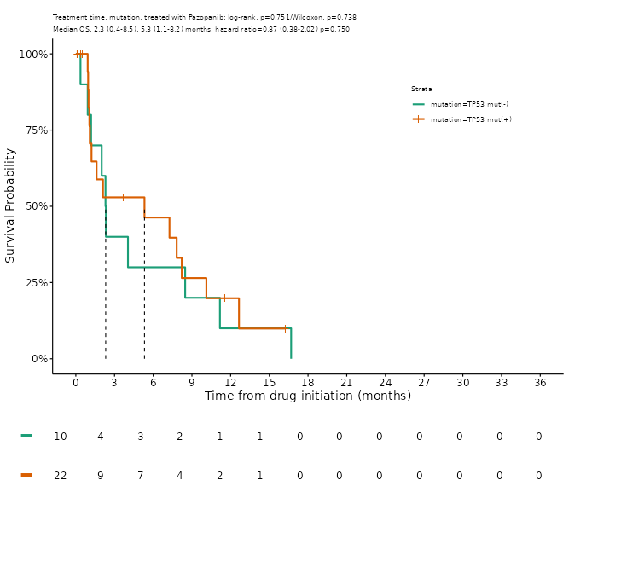
Supplementary figure 3
TP53 alterations (+)
TP53 alterations (−)

