Slide 1
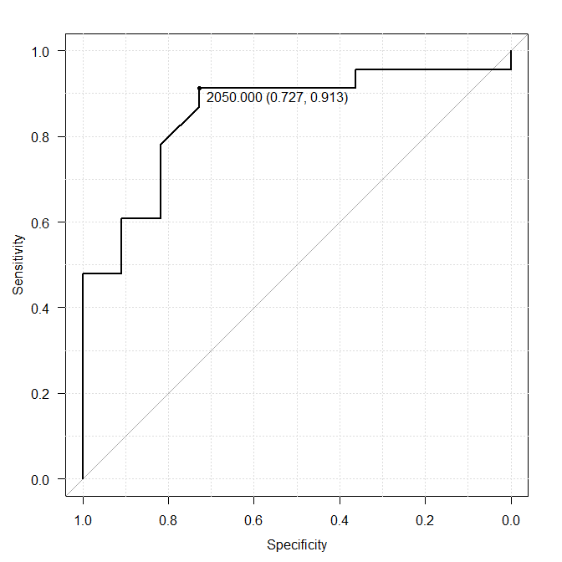
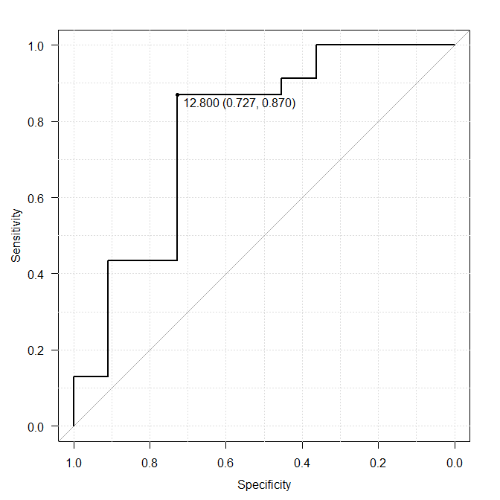
CT attenuation
Stone diameter
AUC: 0.854
(95%CI: 0.718–0.990)
AUC: 0.775
(95%CI: 0.583–0.967)
Supplemental Figure 1: ROC analysis (CT attenuation, Stone diameter)
Supplemental Figure 1

