Slide 1
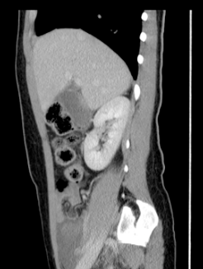
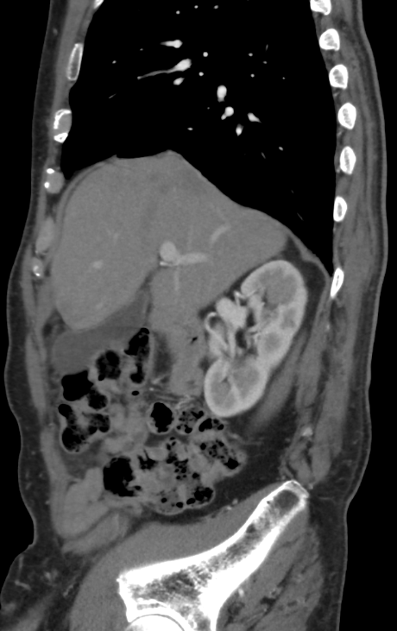
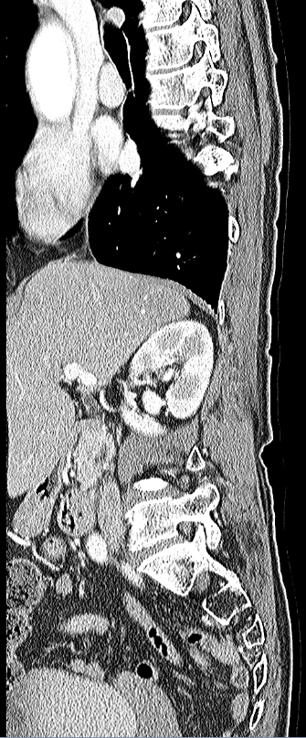
Supplemental figure 1
(a)
(b)
(c)
The portion covered by the liver

Slide 2
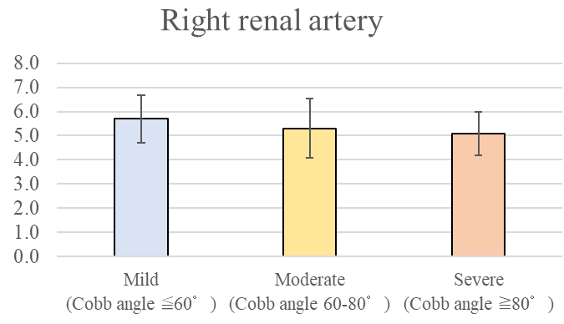
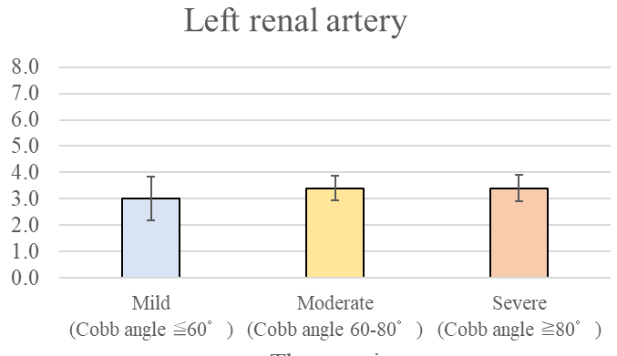
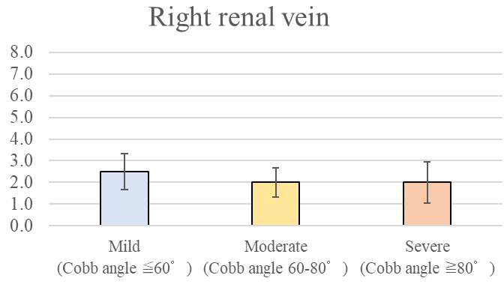
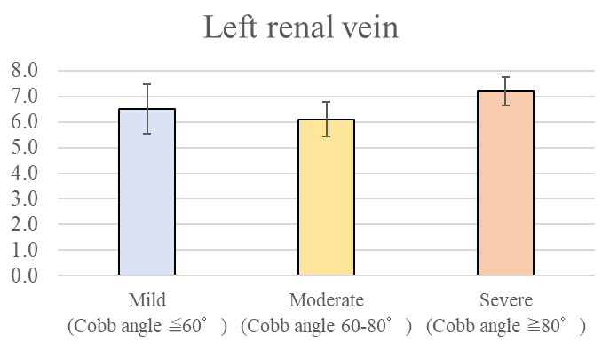
Supplemental figure 2
The Length of the vessels (cm)
The length of the vessels (cm)
＊：p < 0.05
(a)
(b)
The length of the vessels (cm)
The length of the vessels (cm)
(c)
(d)

Slide 3
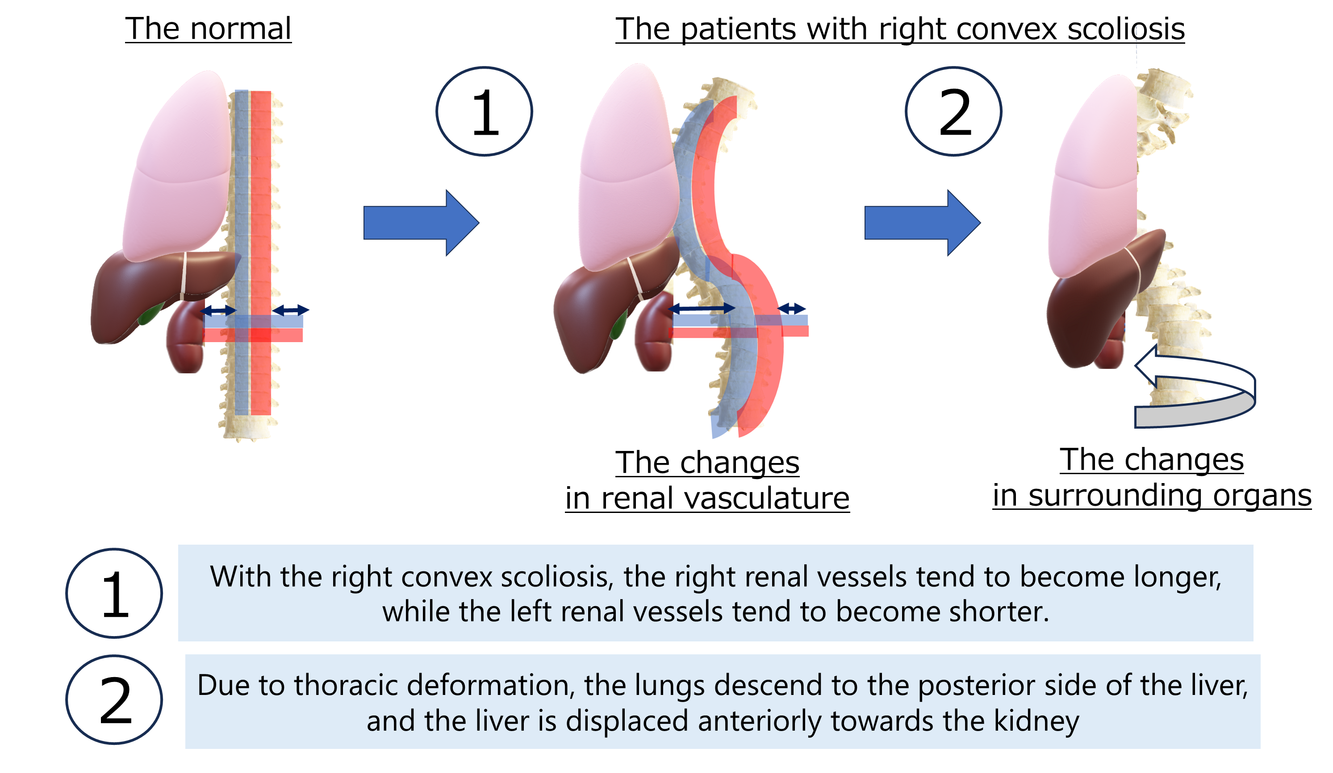
Supplemental figure 3

