Slide 1

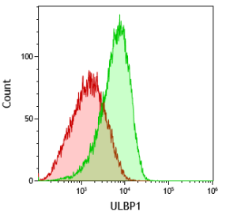
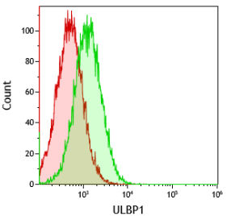
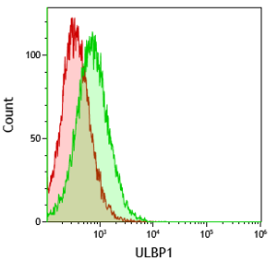
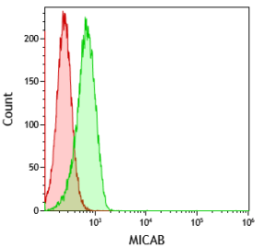
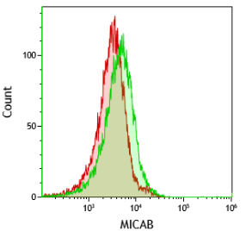
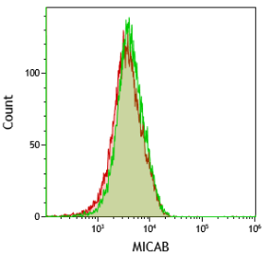
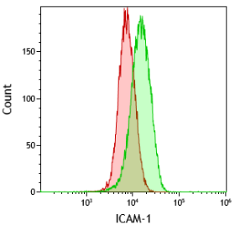
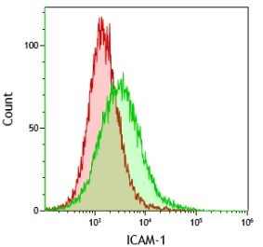
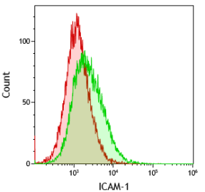
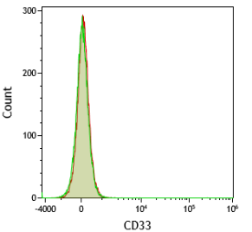
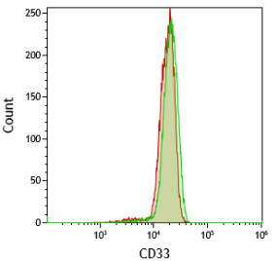
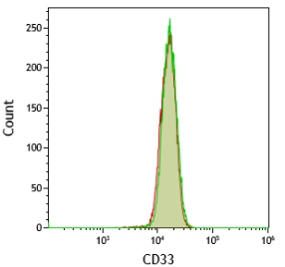
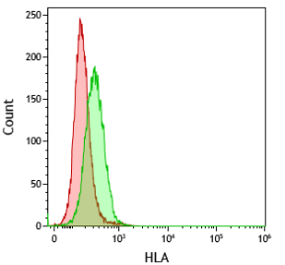
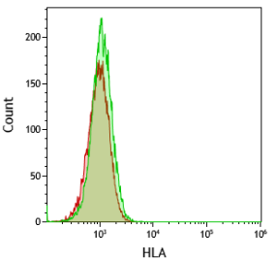
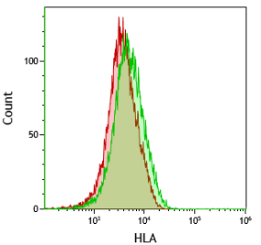
Metformin
OCI-AML-1
NB4
HL60
Control
ULBP-1
MICA/B
ICAM-1
CD33
HLA
Supplemental Figure 1. Metformin regulated expression of stress ligands and ICAM-I in leukemic cells. Different AML cell lines OCI-AML-3 wtp53, HL-60 nullp53, NB4 mutp53 were treated with 2 mM metformin for 3 days and plasma membrane expression of the stress ligands MICA/B and ULBP1, the integrin ICAM-1, the myeloid marker CD33 and MHC class I HLA were analyzed by FACs analysis.

Slide 2
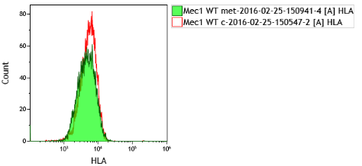
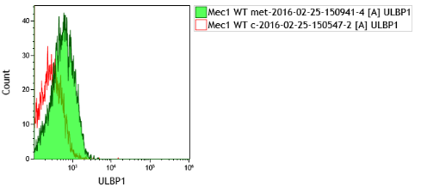
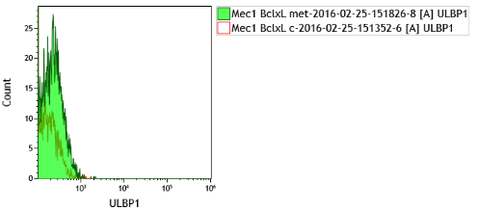
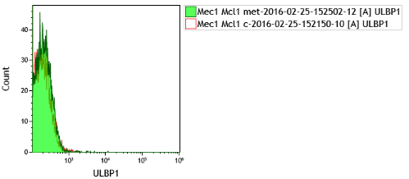
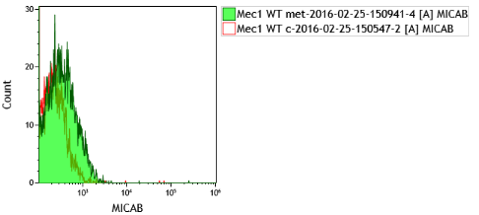
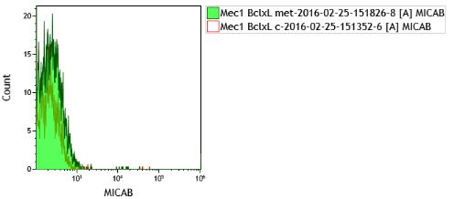
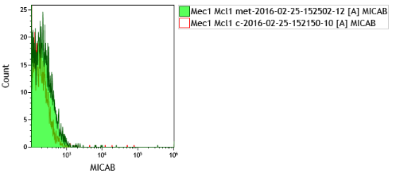
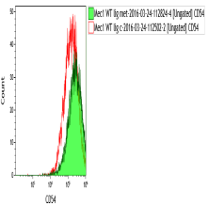
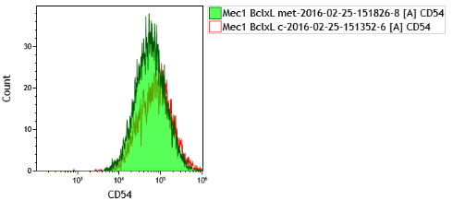
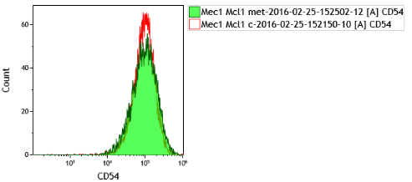
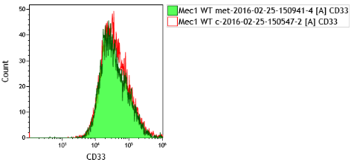
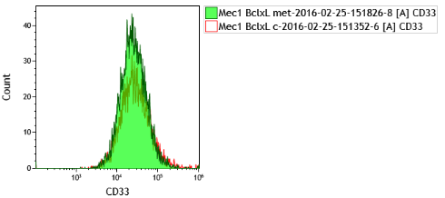
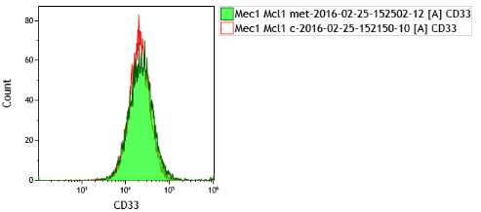
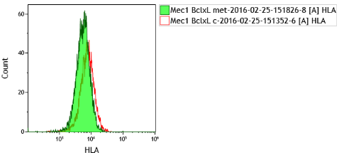
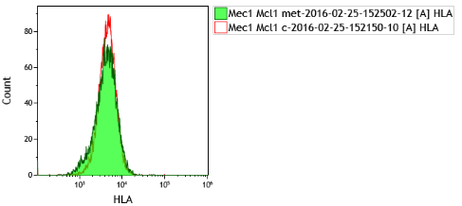
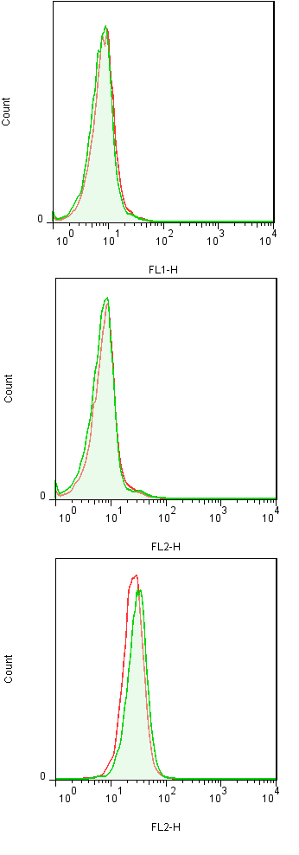
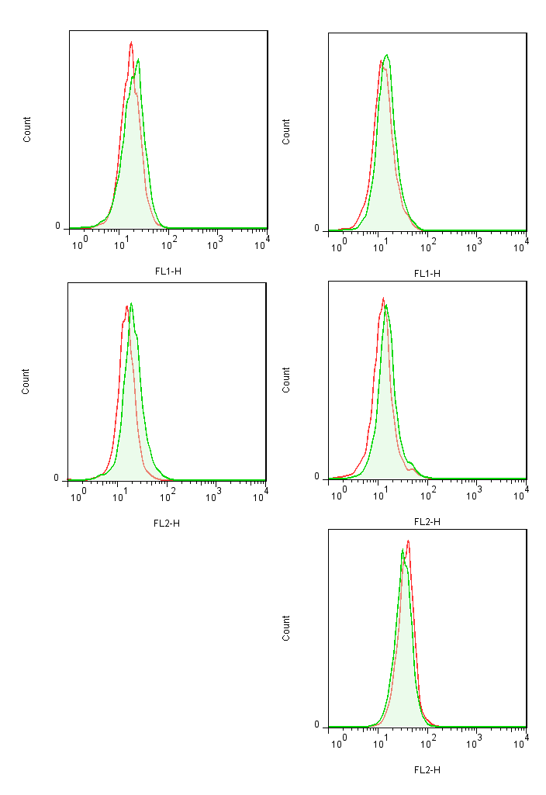
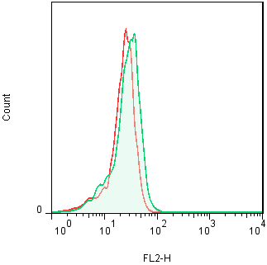
Metformin
Mec-1 WT
Mec-1 Bcl-x_{L}
Mec-1 Mcl-1
Control
ULBP-1
MICA/B
ICAM-1
CD20
CD20
CD20
CD20
HLA
Fas
DR4
DR5
Supplemental Figure 2. Overexpression of antiapoptotic Bcl-2 members affected metformin effects on leukemic cells. A) Mec-1 cell line and stable cell lines overexpressing Bcl-XL or Mcl-1 were incubated with 2 mM metformin for 3 days and plasma membrane expression of the different markers were analyzeed by FACs.
Notes:
Mec1 WT ICAM-1: 198,30 vs 329,95 (x-Fold: 1,66)
Mec1 Bcl-xL
Fas: 19,1 vs 21,8 (x-Fold: 1,14)
DR4: 16,4 vs 23,5 (x-Fold: 1,43)
DR5: 24,6 vs 32,0 (x-Fold: 1,30)

Slide 3
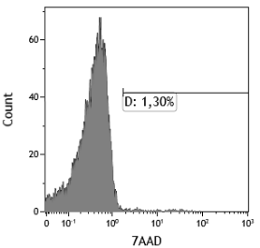
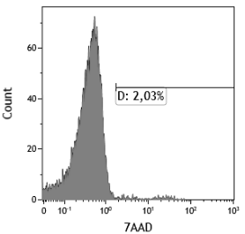
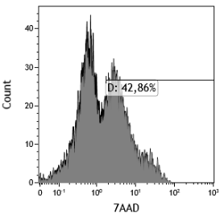
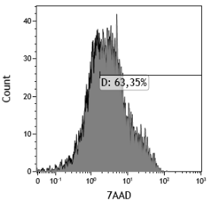
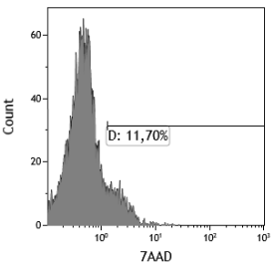
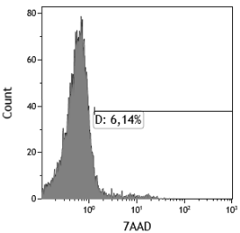
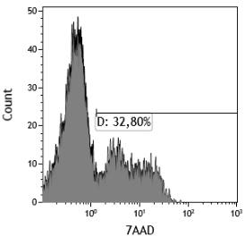
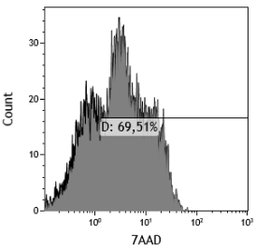
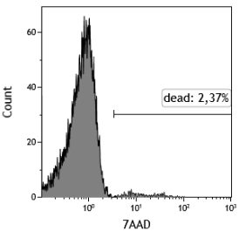
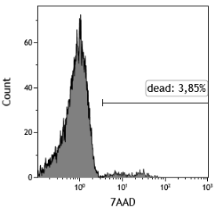
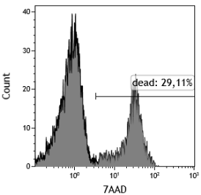
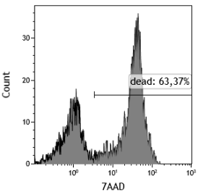
-
Met
NK
NK + Met
OCI-AML-3
NB4
HL60
Supplemental Figure 3. Metformin sensitizes leukemic cells to NK cells. OCI-AML3, NB4 and HL60 AML cell lines were treated with 2 mM metformin for 3 days before overnight incubation at 1:1 effector:target (E:T) ratio with e-NK cells. The specific killing of tumor cells (7-AAD+) was quantified by FACs.

Slide 4
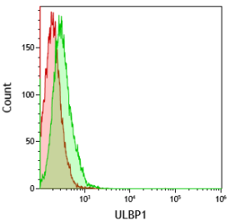
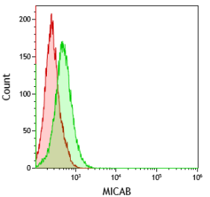
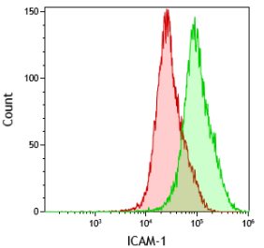
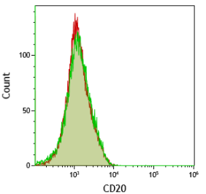
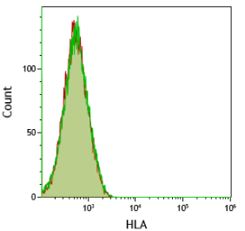
Metformin
Control
ULBP-1
MICA/B
ICAM-1
CD20
HLA
Supplemental Figure 4. Metformin regulated expression of stress ligands and ICAM-I in primary leukemic cells. Tumor cells from a B cell lymphoma patient were treated with 2 mM metformin for 3 days and plasma membrane expression of the stress ligands MICA/B and ULBP1, the integrin ICAM-1, the B cell marker CD20 and MHC class I HLA were analyzed by FACs analysis.

Slide 5












E:T 0.3 1 3
Metformin
-
Donor
NK1
+
-
Donor
NK2
+
-
Donor
NK3
+
-
Donor
NK4
+
Supplemental Figure 5. Metformin sensitizes primary leukemic cells to NK cells. A) BCL-P2 cells were treated with 2 mM metformin for 3 days and incubated overnight at different E:T ratios with e-NK cells derived from 4 donors. The specific death of tumor cells (7-AAD+) was quantified by FACs.

