Slide 1
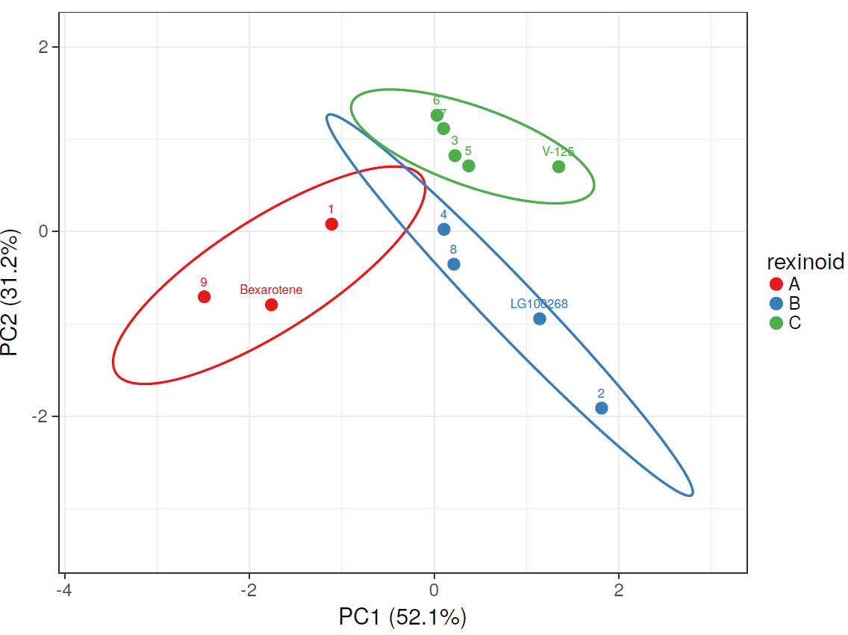
Supplemental Figures
Figure S1. V-125 displays unique activity in principal component analysis (PCA). Unit variance scaling is applied to rows; singular value decomposition (SVD) with imputation is used to calculate principal components. X and Y axis show principal component 1 and principal component 2 that explain 52.1% and 31.2% of the total variance, respectively. Prediction ellipses are such that with probability 0.95, a new observation from the same group will fall inside the ellipse. N = 12 data points.

Slide 2
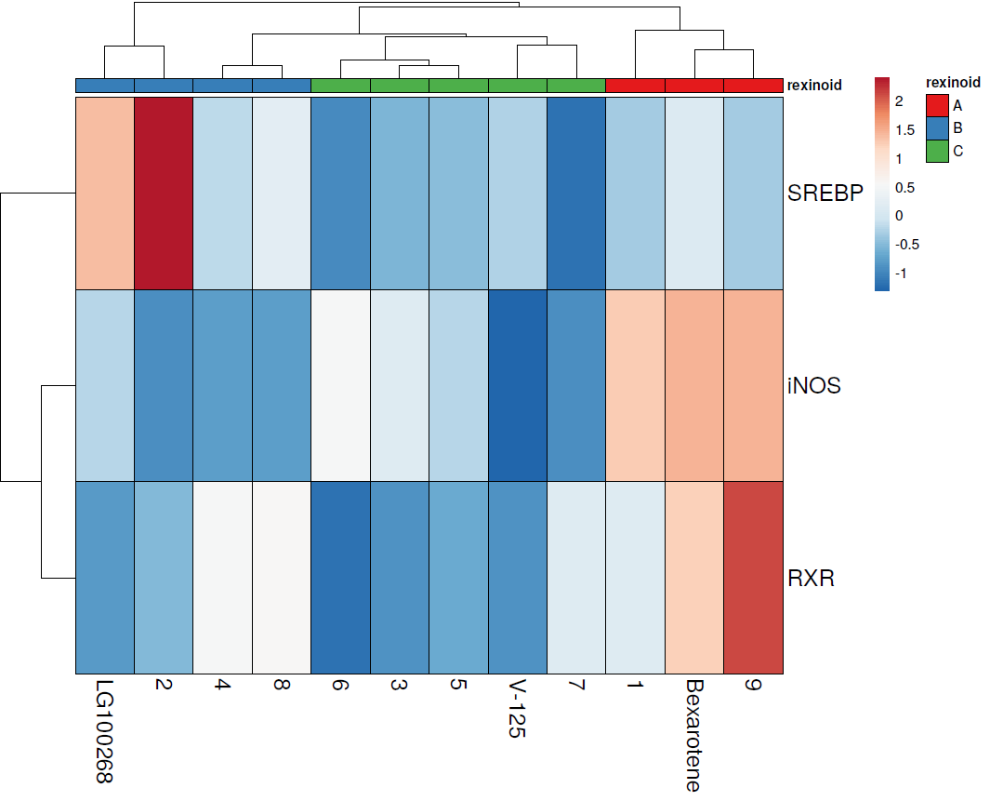
Figure S2. Heat map of activity of novel rexinoids in in vitro screening assays. Rows are centered; unit variance scaling is applied to rows. Rows are clustered using correlation distance and average linkage. Columns are clustered using maximum distance and average linkage. 3 rows, 12 columns. SREBP = SREBP activation. RXR = RXR activation. iNOS = iNOS suppression. Scale is centered around average value for each column.

Slide 3
A
B
Figure S3. V-125 does not decrease weight of A/J or MMTV-Neu mice in prevention studies. A/J mice (A) were fed bexarotene (80 mg/kg diet), V-125 (80 mg/kg diet) or control diet for 16 weeks, as described in Figure 2. Mice were weighed weekly throughout the course of the study. MMTV-Neu mice (B) were fed control or V-125 (30 mg/kg diet) in a prevention study, as described in Figure 3. A. N = 14-15 mice/group. B. N = 14 mice/group.

Slide 4
*
Figure S4. Bexarotene reduces total tumor weight in MMTV-Neu mice. Female MMTV-Neu mice with established mammary tumors 5 mm in diameter were placed on control or bexarotene (100 mg/kg diet) for 10 days. Tumor weight at the end of 10 days is presented as a percent of mouse body weight. *, P < 0.05 vs. control; N=8-9 mice per group.

