Slide 1
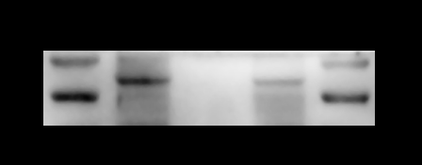
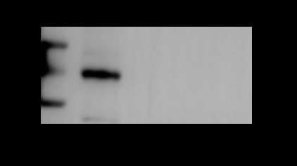
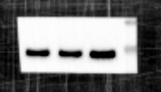
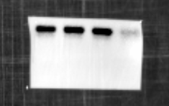
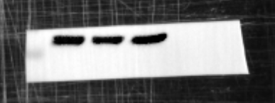
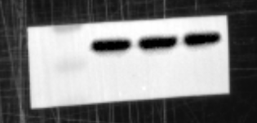
Fig 3G
PCM1
250kD
GAPDH
37kD
Fig 3M
PCM1
250kD
GAPDH
37kD
Fig 3N
PCM1
250kD
GAPDH
37kD

Slide 2
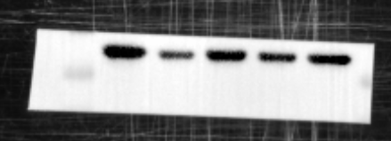
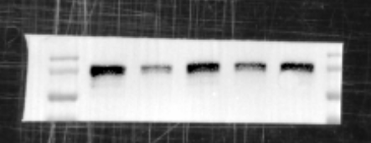

Fig 4I
SYN
75kD
PSD95
57kD
GAPDH
37kD

Slide 3
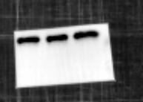
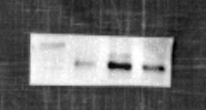
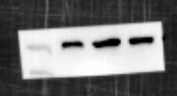
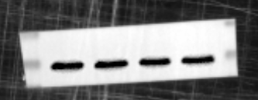

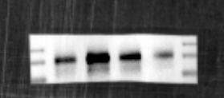
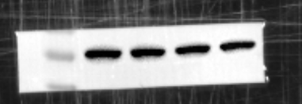
Fig 5A
PCM1
250kD
PKC
77kD
77kD
p-PKC
IFN-γ
30kD
37kD
GAPDH
Fig 5E
PKC
77kD
p-PKC
77kD
IFN-γ
30kD
GAPDH
37kD

Slide 4
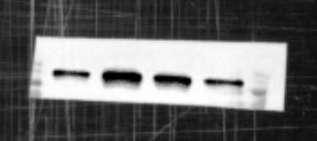

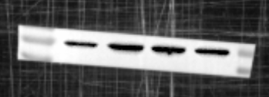

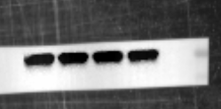
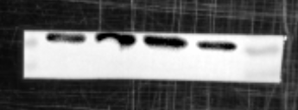
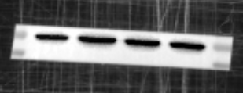
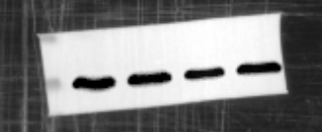
Fig 5G
Bax
18kD
Bcl-2
26kD
cleaved-Caspase3
17kD
pro-Caspase3
35kD
GAPDH
37kD
Fig 5H
IFN-γR1
75kD
IFN-γR2
57kD
GAPDH
37kD

Slide 5

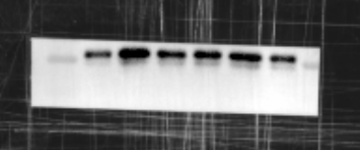
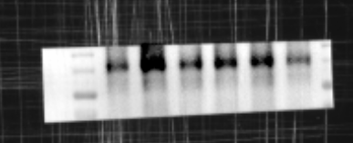


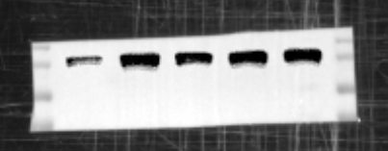
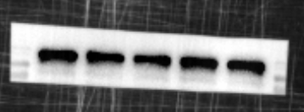
Fig 6A
PKC
77kD
p-PKC
77kD
IFN-γ
30kD
GAPDH
37kD
Fig 6D
Nrf2
75kD
Keep1
57kD
GAPDH
37kD

Slide 6
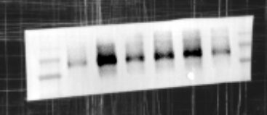


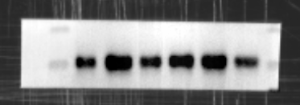
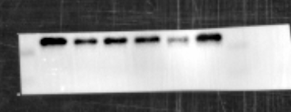
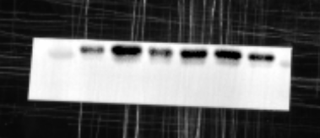


Fig 6E
IFN-γR1
75kD
IFN-γR2
57kD
GAPDH
37kD
Fig 6G
Bax
18kD
Bcl-2
26kD
cleaved-Caspase3
17kD
pro-Caspase3
35kD
GAPDH
37kD

