Slide 1

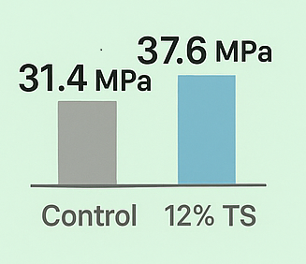

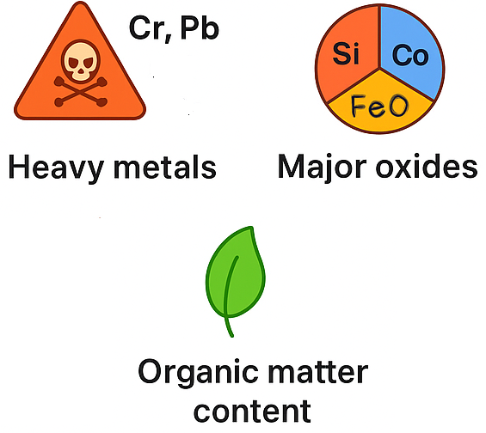



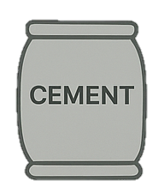

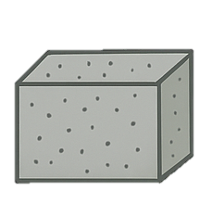
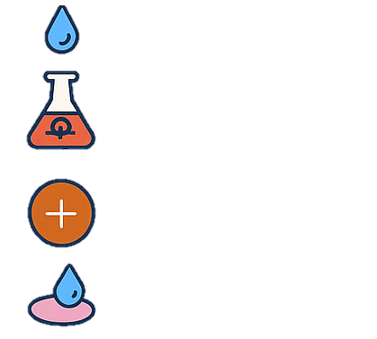


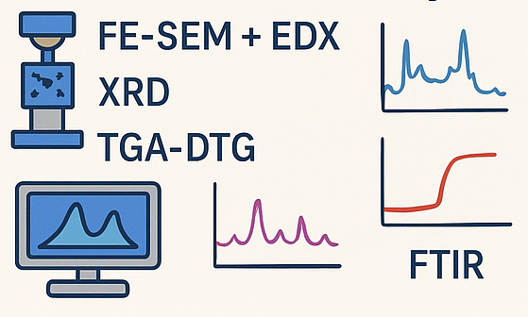

Physical properties
&
Chemical properties
Compressive strength test
Durability test
Sorptivity
RCPT
Acid resistance
Carbonation
0%
12%
30%
Tannery sludge:
Hazardous by-product
Leaching
Micro-structure study
7% cost
Economic analysis
LCA study

