Slide 1





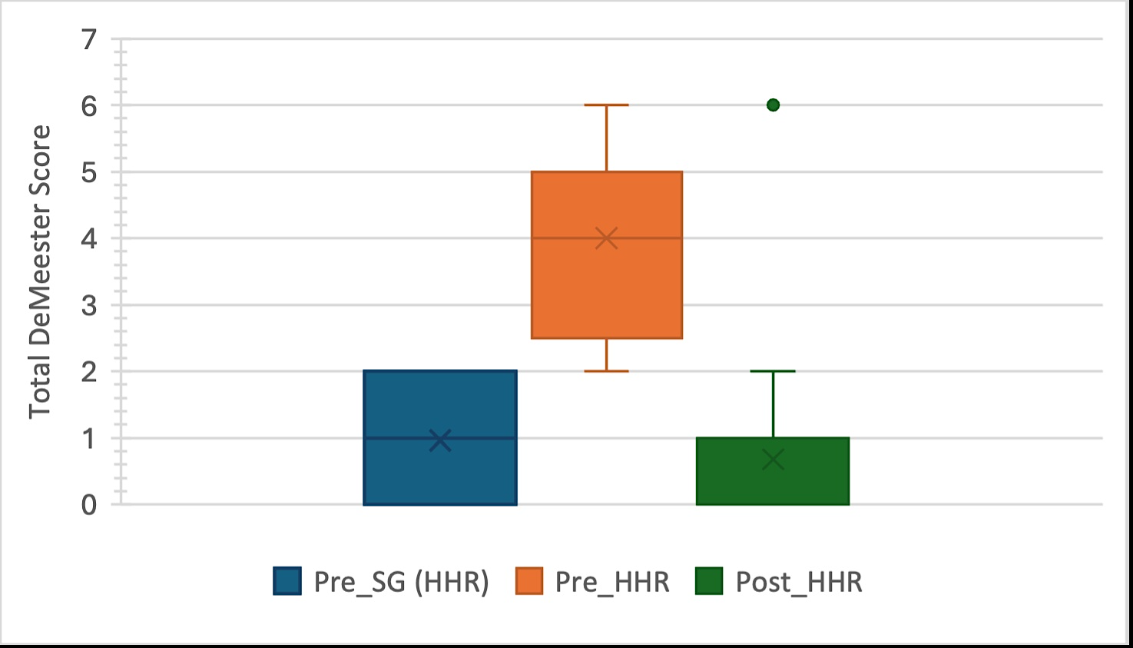
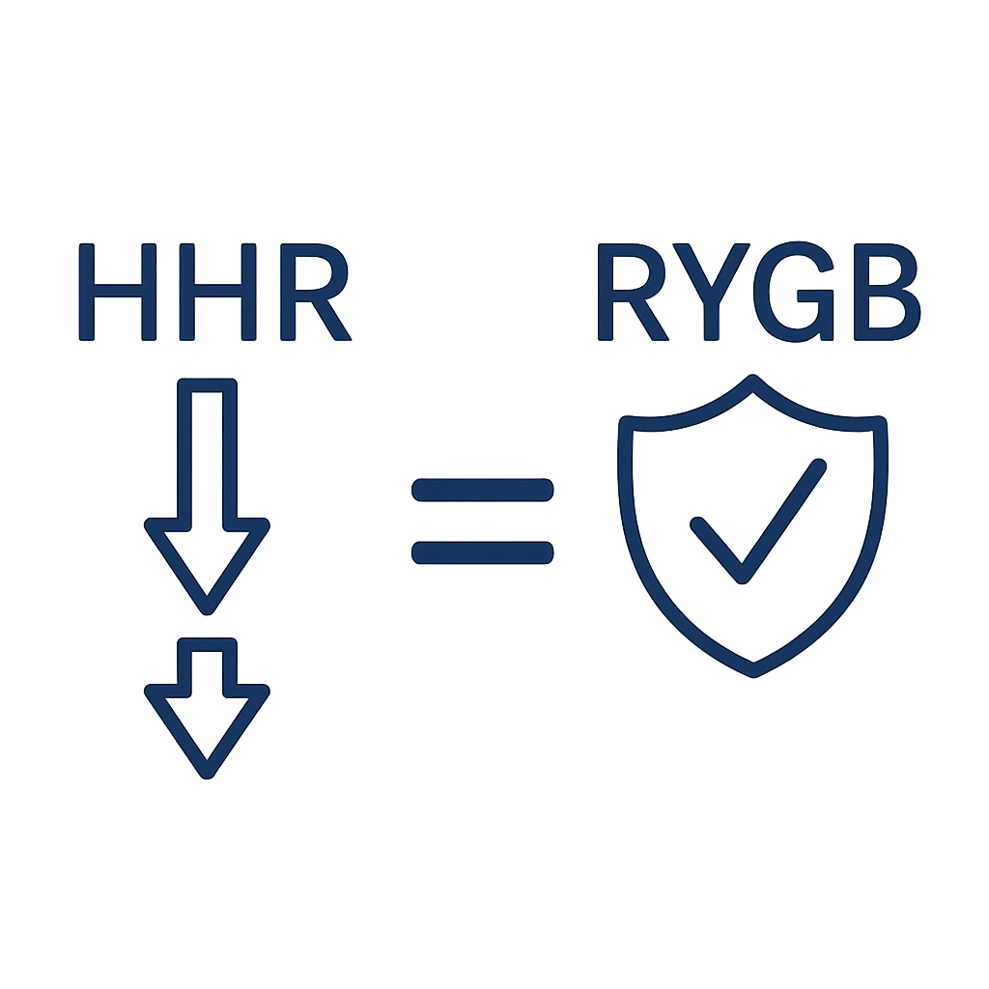


Hiatus Hernia Repair vs Gastric Bypass for Refractory GORD After Sleeve Gastrectomy
Conclusion
METHODs
RESULTS
CONCLUSION
Key Findings: Both HHR and RYGB significantly reduced GORD post LSG.
HHR a safe and effective option for refractory GORD after sleeve gastrectomy
Results comparable to RYGB
Key Findings: HHR = RYGB 6 months
*No statistical difference
Key Findings: HHR less complications = safter
HHR (N=25) RYGB (N=25)
Retrospective review of GORD post LSG pre and 6 months post anti-reflux procedure
HHR RYGB
(Please keep this space clear for review purposes)
Notes:
LU Biter, MMA Van Buuren, GHH Mannaerts
JA Apers, M Dunkelgrun, GHEJ Vikgen, May 2017

