Slide 1
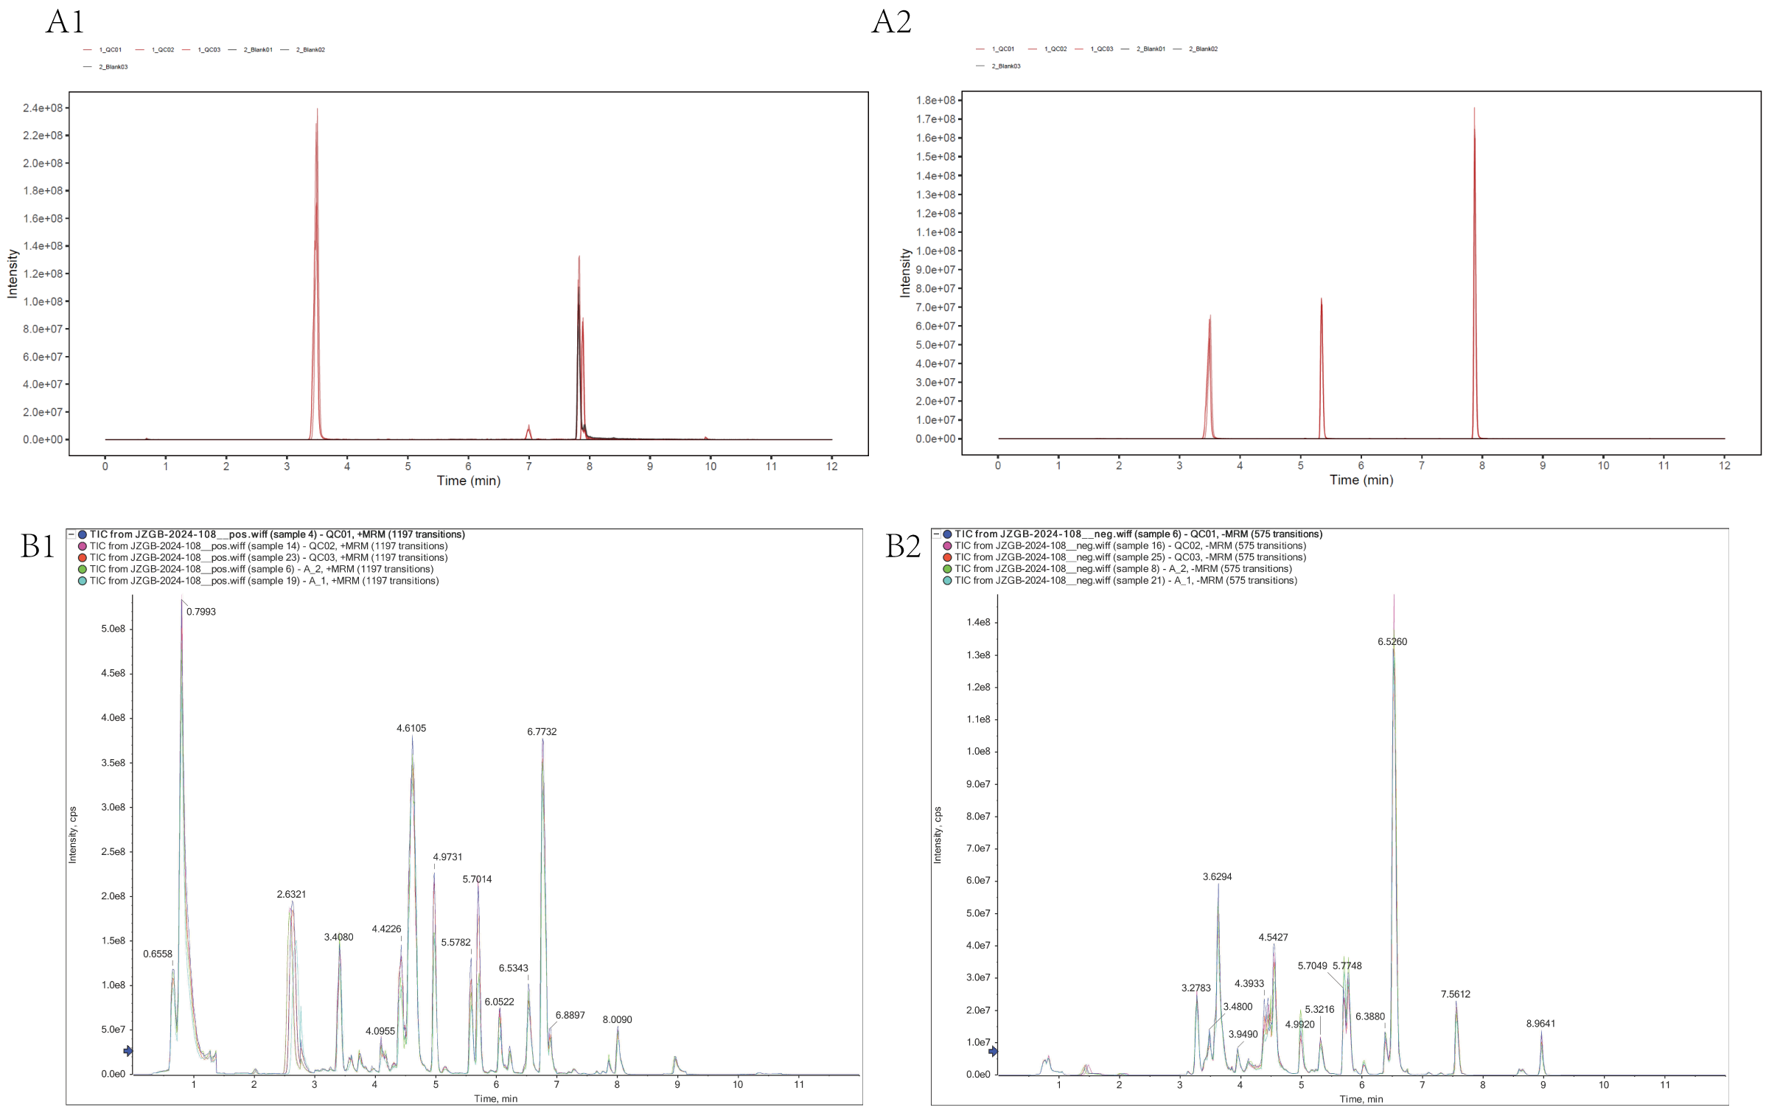
Figure S1:Non-targeted metabolomics and broad-targeted metabolomics blank samples and QC sample spectrum overlay .A1: Non-targeted positive ion mode extracted ion chromatogram; A2: Non-targeted metabolomics negative ion mode extracted ion chromatogram; A3: Broad-targeted metabolomics positive ion mode total ion current chromatogram; A4: Total ion current chromatogram of broad-targeted metabolomics in negative ion mode).

Slide 2
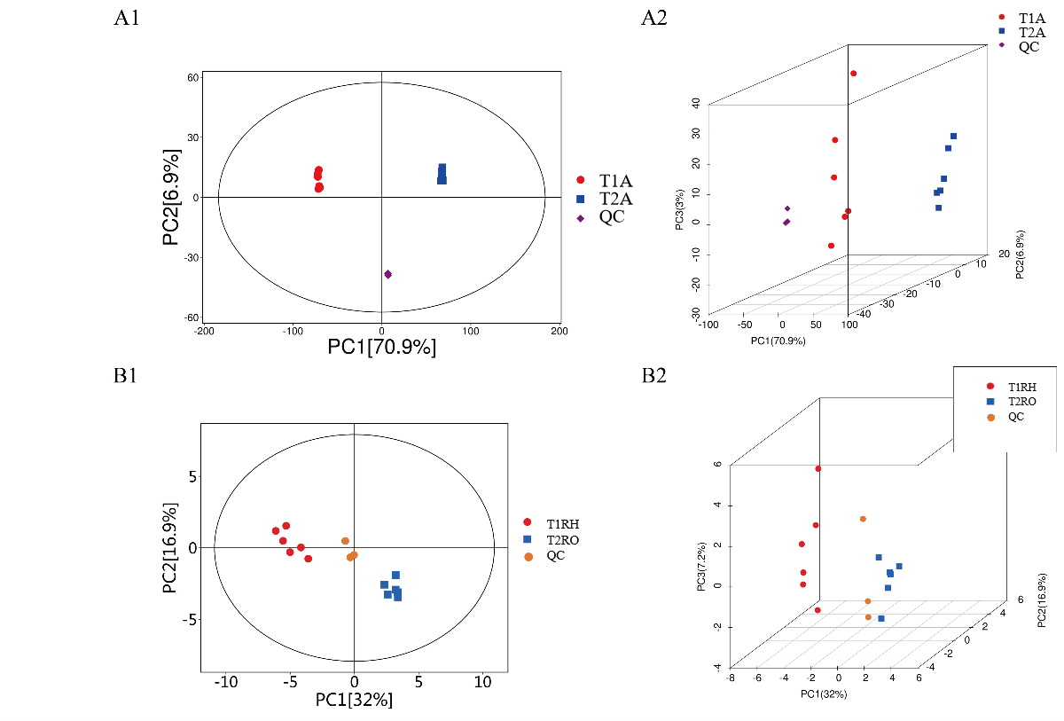
Figure S2:Metabolomics principal component analysis diagram. A1-A2: T1A vs T2A; B1-B2: T2RH vs T2RO.

Slide 3
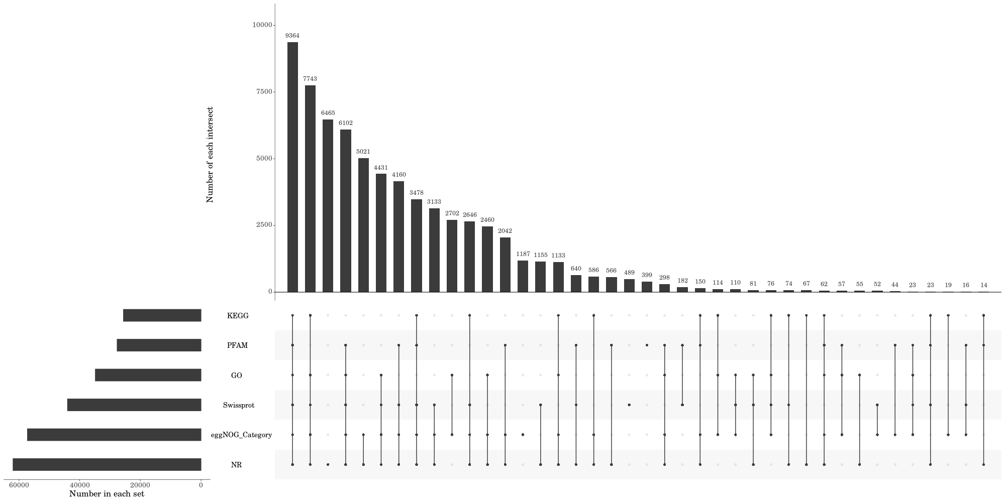
Figure S3:Unigene annotation statistical results Upset chart.

Slide 4
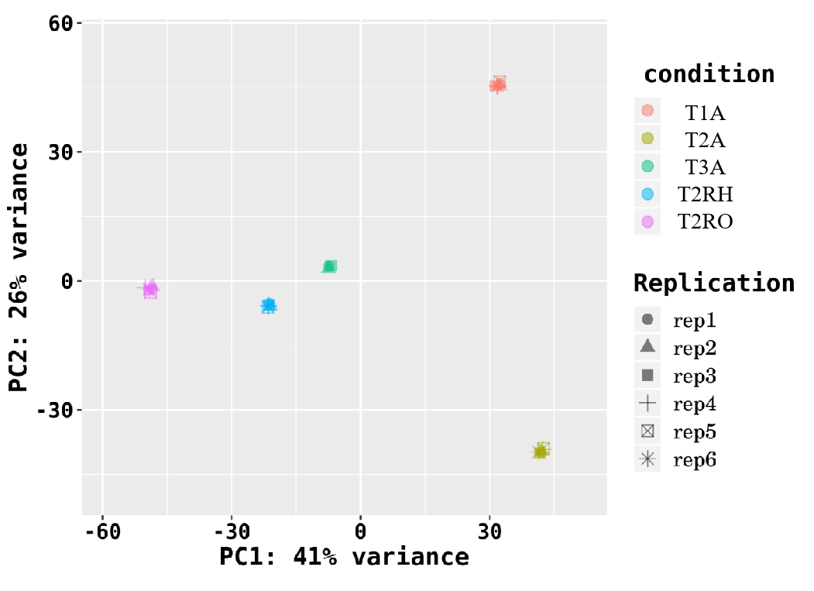
Figure S4: Principal component analysis of samples.

