Slide 1
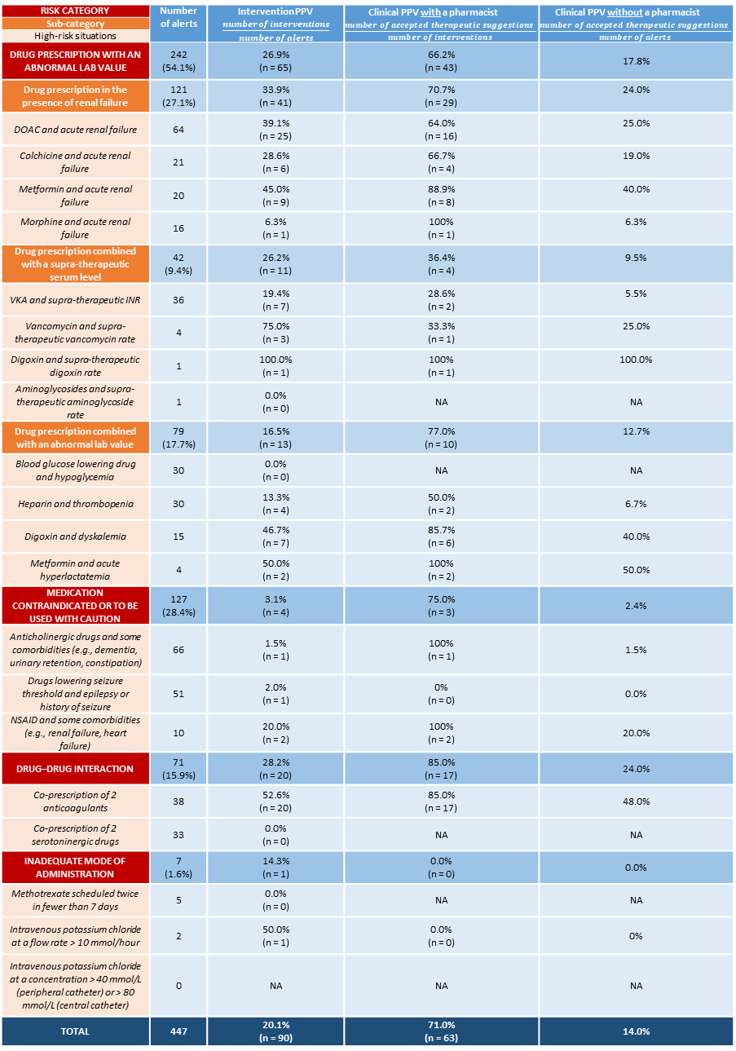
RISK CATEGORY | Number of alerts | Intervention PPV $\frac{number of interventions}{number of alerts}$ | Clinical PPV with a pharmacist $$\frac{number of accepted therapeutic suggestions }{number of interventions}$$ | Clinical PPV without a pharmacist $$\frac{number of accepted therapeutic suggestions }{number of alerts}$$
Sub-category
High-risk situations
DRUG PRESCRIPTION WITH AN ABNORMAL LAB VALUE | 242 (54.1%) | 26.9% (n = 65) | 66.2% (n = 43) | 17.8%
Drug prescription in the presence of renal failure | 121 (27.1%) | 33.9% (n = 41) | 70.7% (n = 29) | 24.0%
DOAC and acute renal failure | 64 | 39.1% (n = 25) | 64.0% (n = 16) | 25.0%
Colchicine and acute renal failure | 21 | 28.6% (n = 6) | 66.7% (n = 4) | 19.0%
Metformin and acute renal failure | 20 | 45.0% (n = 9) | 88.9% (n = 8) | 40.0%
Morphine and acute renal failure | 16 | 6.3% (n = 1) | 100% (n = 1) | 6.3%
Drug prescription combined with a supra-therapeutic serum level | 42 (9.4%) | 26.2% (n = 11) | 36.4% (n = 4) | 9.5%
VKA and supra-therapeutic INR | 36 | 19.4% (n = 7) | 28.6% (n = 2) | 5.5%
Vancomycin and supra-therapeutic vancomycin rate | 4 | 75.0% (n = 3) | 33.3% (n = 1) | 25.0%
Digoxin and supra-therapeutic digoxin rate | 1 | 100.0% (n = 1) | 100% (n = 1) | 100.0%
Aminoglycosides and supra-therapeutic aminoglycoside rate | 1 | 0.0% (n = 0) | NA | NA
Drug prescription combined with an abnormal lab value | 79 (17.7%) | 16.5% (n = 13) | 77.0% (n = 10) | 12.7%
Blood glucose lowering drug and hypoglycemia | 30 | 0.0% (n = 0) | NA | NA
Heparin and thrombopenia | 30 | 13.3% (n = 4) | 50.0% (n = 2) | 6.7%
Digoxin and dyskalemia | 15 | 46.7% (n = 7) | 85.7% (n = 6) | 40.0%
Metformin and acute hyperlactatemia | 4 | 50.0% (n = 2) | 100% (n = 2) | 50.0%
MEDICATION CONTRAINDICATED OR TO BE USED WITH CAUTION | 127 (28.4%) | 3.1% (n = 4) | 75.0% (n = 3) | 2.4%
Anticholinergic drugs and some comorbidities (e.g., dementia, urinary retention, constipation) | 66 | 1.5% (n = 1) | 100% (n = 1) | 1.5%
Drugs lowering seizure threshold and epilepsy or history of seizure | 51 | 2.0% (n = 1) | 0% (n = 0) | 0.0%
NSAID and some comorbidities (e.g., renal failure, heart failure) | 10 | 20.0% (n = 2) | 100% (n = 2) | 20.0%
DRUG–DRUG INTERACTION | 71 (15.9%) | 28.2% (n = 20) | 85.0% (n = 17) | 24.0%
Co-prescription of 2 anticoagulants | 38 | 52.6% (n = 20) | 85.0% (n = 17) | 48.0%
Co-prescription of 2 serotoninergic drugs | 33 | 0.0% (n = 0) | NA | NA
INADEQUATE MODE OF ADMINISTRATION | 7 (1.6%) | 14.3% (n = 1) | 0.0% (n = 0) | 0.0%
Methotrexate scheduled twice in fewer than 7 days | 5 | 0.0% (n = 0) | NA | NA
Intravenous potassium chloride at a flow rate > 10 mmol/hour | 2 | 50.0% (n = 1) | 0.0% (n = 0) | 0%
Intravenous potassium chloride at a concentration > 40 mmol/L (peripheral catheter) or > 80 mmol/L (central catheter) | 0 | NA | NA | NA
TOTAL | 447 | 20.1% (n = 90) | 71.0% (n = 63) | 14.0%

