Slide 1
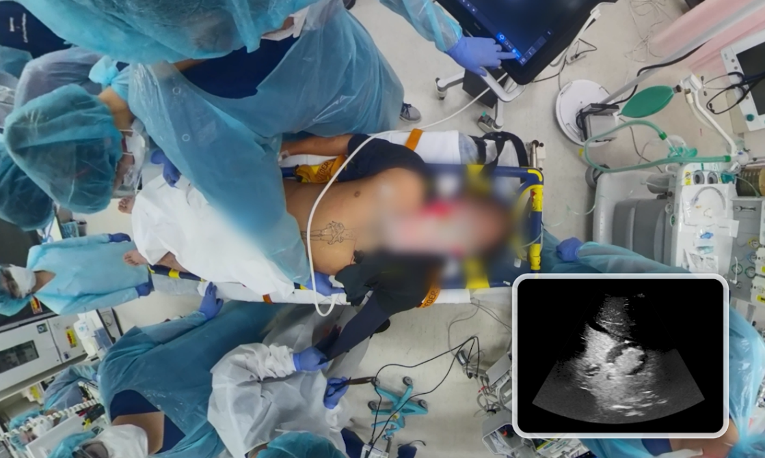
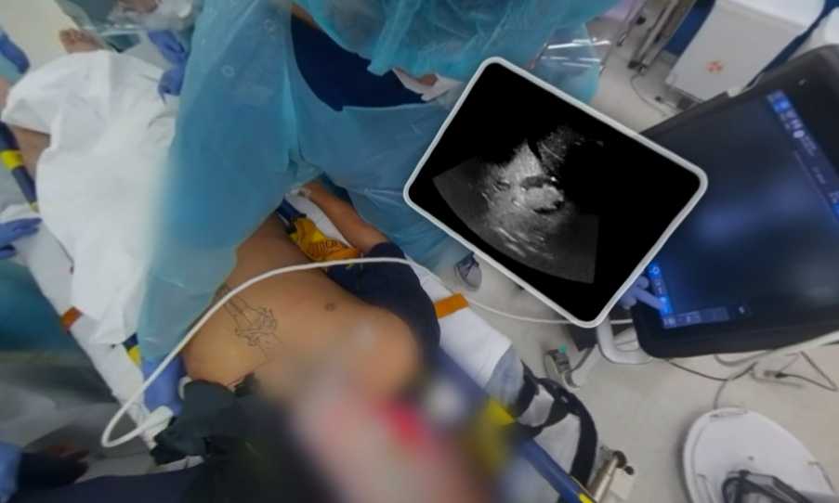
Supplementary figure 1. Overview of visual perspectives and viewing characteristics in 2D and VR
２D
VR

