Slide 1
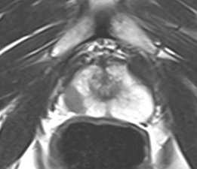
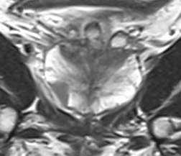
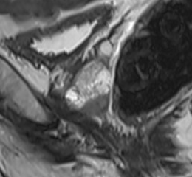
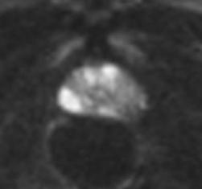
Predictive Value of Quantitative MRI Parameters for Clinically Significant Prostate Cancer: A Comparison Between PI-RADS v2.1 Category 4 and 5 Lesions on Biparametric MRI.
The maximum diameter, mean diameter, nodule area, and nodule volume of prostate nodules all demonstrate high diagnostic value in distinguishing benign from malignant lesions in PI-RADS v2.1 category 4-5 nodules, with nodule volume showing the optimal diagnostic efficacy.
Notes:
Figure 1

