Slide 1
Full uncropped western blots

Slide 2

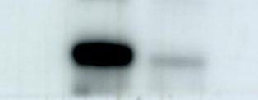










Fig 2
F
A549
H1975
Vector
+ -
Vector
+ -
A
A549
H1975
APOC3
- +
APOC3
- +
Vector
APOC3
Vector
APOC3
E-cadherin
E-cadherin
APOC3
N-cadherin
N-cadherin
GAPDH
Vimentin
Vimentin
β-Actin
β-Actin

Slide 3
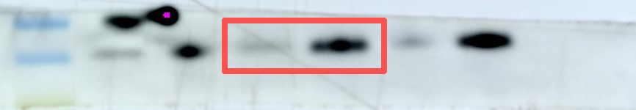
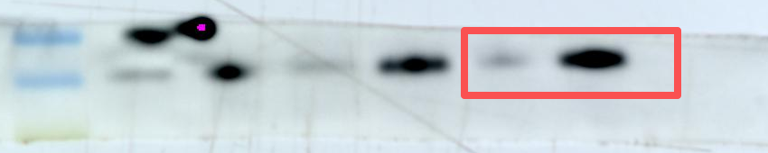
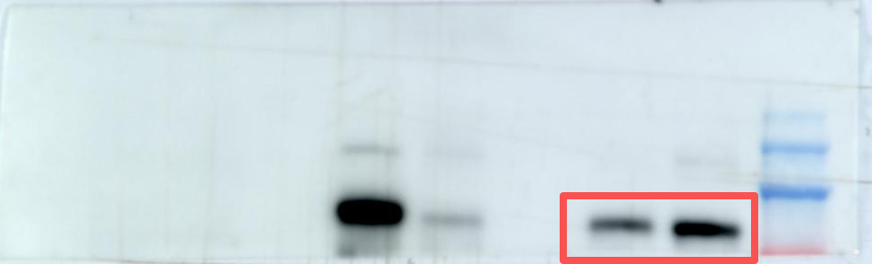
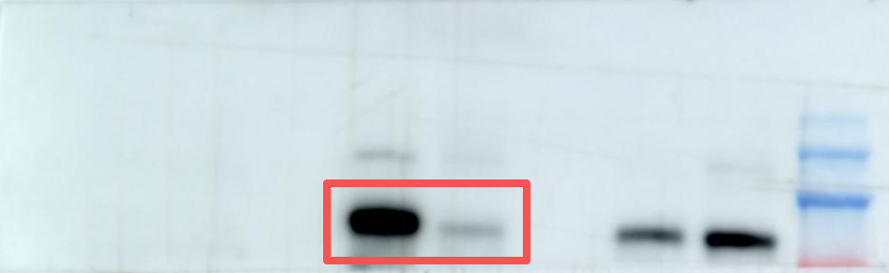
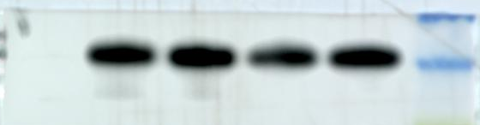
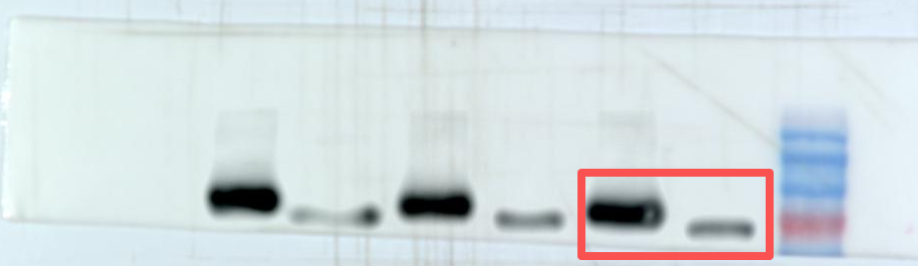

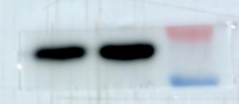
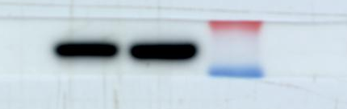
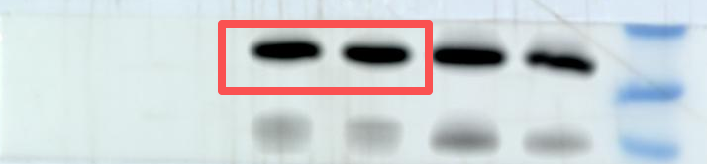
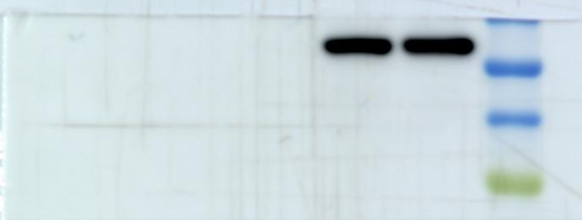
A549
H1975
A549
H1975
Vector
+ -
Vector
Vector
APOC3
Vector
APOC3
APOC3
- +
APOC3
APOC3
E-cadherin
E-cadherin
GAPDH
N-cadherin
N-cadherin
Vimentin
Vimentin
β-Actin
β-Actin

Slide 4
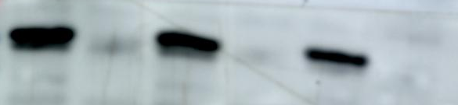




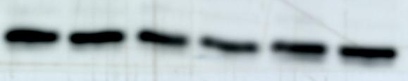
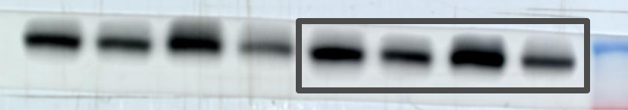
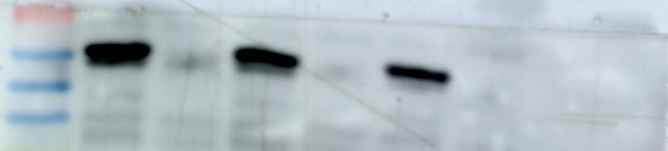
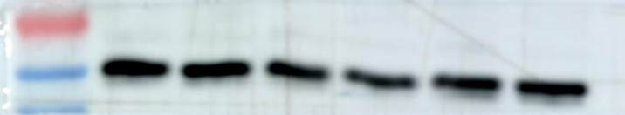
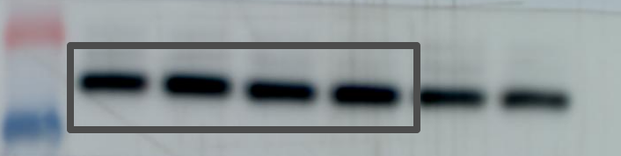
Fig 3
F
A549
H1975
K
+ - + - + -
Vector
Vector
APOC3
Vector
APOC3
- + - + - +
APOC3
CPT1A
CPT1A
GAPDH
GAPDH
A549
H1975
+ - + - + -
Vector
Vector
- + - + - +
APOC3
APOC3
Vector
APOC3
CPT1A
CPT1A
GAPDH
GAPDH

Slide 5











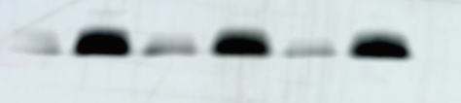






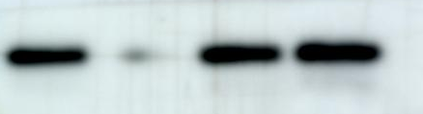


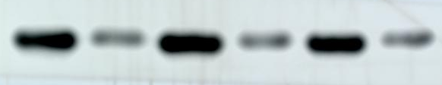





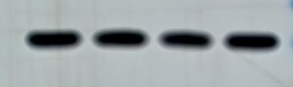

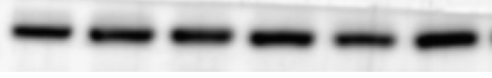

Fig 4
H
E
A549
G
PC-9
Vector
APOC3
p-PKA
A549
+ - -
NC
+ - - +
- + -
si-1
PKA
Vector
- + + -
APOC3
- - +
si-2
p-CREB
+ + +
SQ22536
- - + +
Forskolin
L
CREB
p-PKA
GAPDH
p-PKA
+ - + - + -
Vector
PKA
- + - + - +
PKA
APOC3
F
H1975
p-CREB
APOC3
p-CREB
Vector
APOC3
CREB
p-PKA
CREB
p-PKA
p-HSL
PKA
p-HSL
PKA
HSL
HSL
p-CREB
p-CREB
PGC-1α
PGC-1α
CREB
CREB
GAPDH
GAPDH
GAPDH
GAPDH

Slide 6
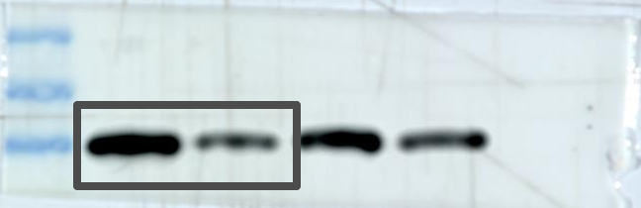
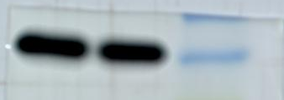
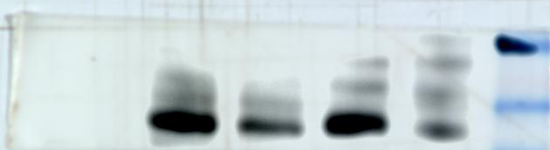


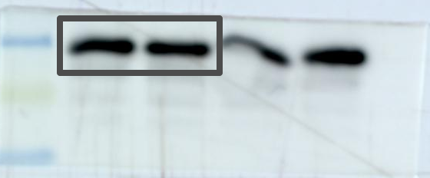
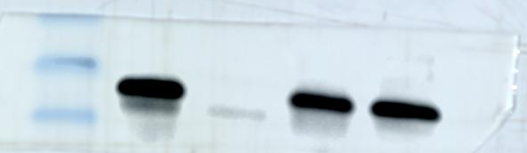

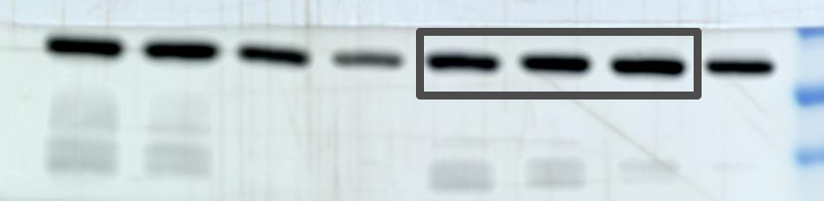
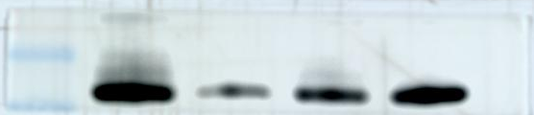
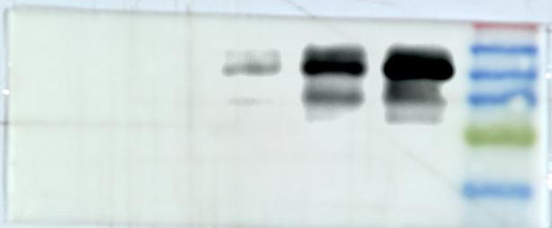

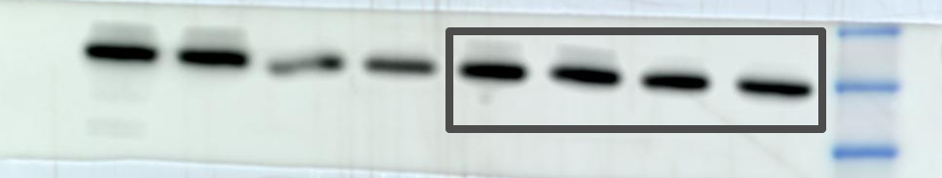
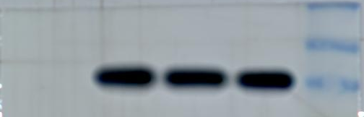
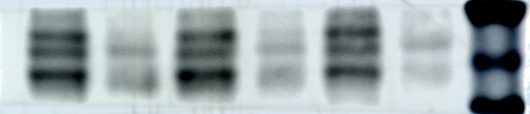
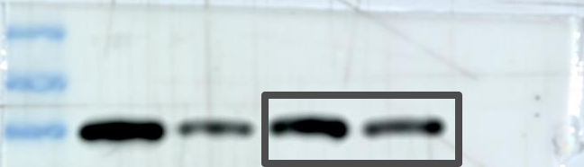
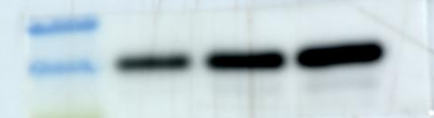
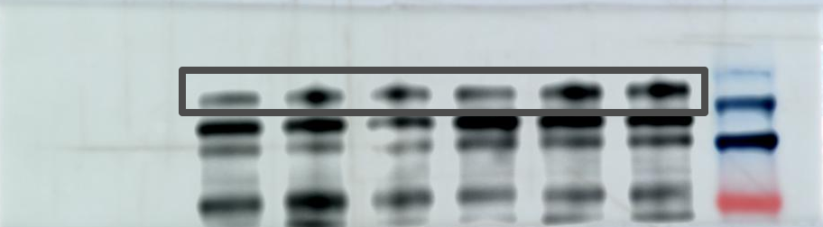
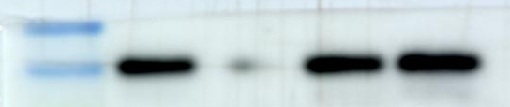
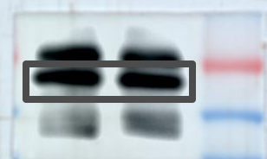
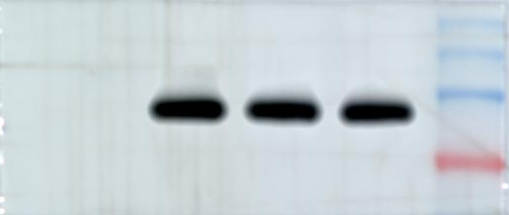
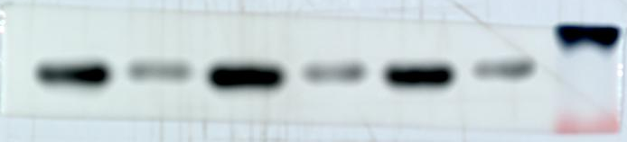
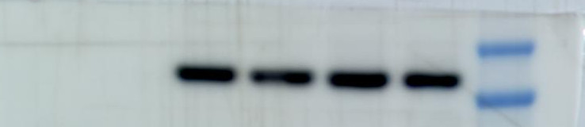

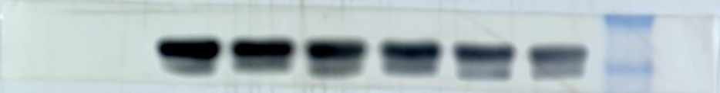
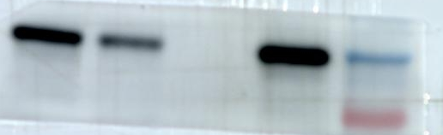

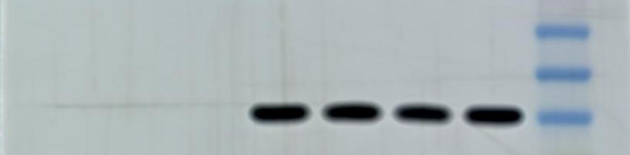
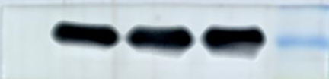
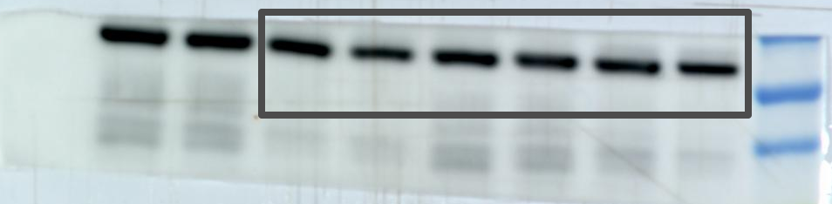
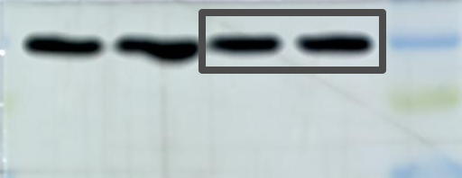
A549
PC-9
Vector
APOC3
p-PKA
A549
+ - -
NC
+ - - +
- + -
si-1
PKA
Vector
- + + -
- - +
si-2
p-CREB
APOC3
- - + +
+ + +
SQ22536
CREB
Forskolin
p-PKA
GAPDH
p-PKA
+ - + - + -
Vector
PKA
- + - + - +
PKA
APOC3
p-CREB
APOC3
H1975
p-CREB
CREB
p-PKA
Vector
APOC3
CREB
p-HSL
PKA
p-PKA
p-HSL
PKA
HSL
HSL
p-CREB
p-CREB
PGC-1α
PGC-1α
CREB
CREB
GAPDH
GAPDH
GAPDH
GAPDH

Slide 7




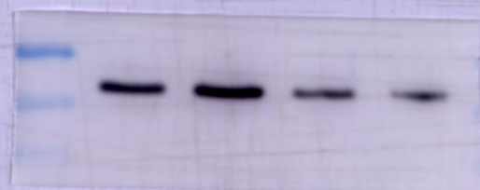
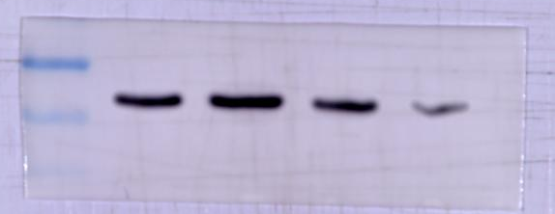
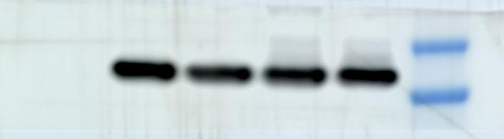

Fig 5
NC
+ - - -
NC
+ - - -
siAPOC3
- + - -
siAPOC3
- + - -
siAPOC3+
siHSL#1
siAPOC3+
siPGC-1α#1
- - + -
- - + -
siAPOC3+
siHSL#3
- - - +
siAPOC3+
siPGC-1α#3
- - - +
p-HSL
PGC-1α
GAPDH
GAPDH
NC
+ - - -
NC
+ - - -
siAPOC3
- + - -
siAPOC3
- + - -
siAPOC3+
siPGC-1α#1
siAPOC3+
siHSL#1
- - + -
- - + -
siAPOC3+
siPGC-1α#3
- - - +
siAPOC3+
siHSL#3
- - - +
PGC-1α
p-HSL
GAPDH
GAPDH

Slide 8








Fig 6
Input
+ - -
Input
+ - -
IgG
- + -
IgG
- + -
IP:Flag
- - +
IP:GNAI3
- - +
Flag
GNAI3
IB
IB
GNAI3
Flag
Flag
GNAI3
IB
IB
Flag
GNAI3

Slide 9







Fig S2
A
A549
PC-9
H1299
CALU-3
H358
H1975
B2B
K
PC-9
APOC3
NC
+ - -
GAPDH
si-1
- + -
si-2
- - +
E-cadherin
B
PC-9
N-cadherin
NC
si-1
si-2
APOC3
Vimentin
GAPDH
β-Actin

Slide 10







A
A549
PC-9
H1299
CALU-3
H358
H1975
B2B
PC-9
APOC3
NC
+ - -
GAPDH
si-1
- + -
si-2
- - +
E-cadherin
PC-9
N-cadherin
NC
si-1
si-2
APOC3
Vimentin
GAPDH
β-Actin

Slide 11




Fig S3
PC-9
PC-9
NC
si-1
si-2
NC
si-1
si-2
CPT1A
CPT1A
GAPDH
GAPDH

Slide 12










Fig S4
PC9
PC9
si-2
NC
si-1
NC
si-1
si-2
p-PKA
p-PKA
PKA
PKA
p-CREB
p-CREB
CREB
CREB
GAPDH
GAPDH

