Slide 1
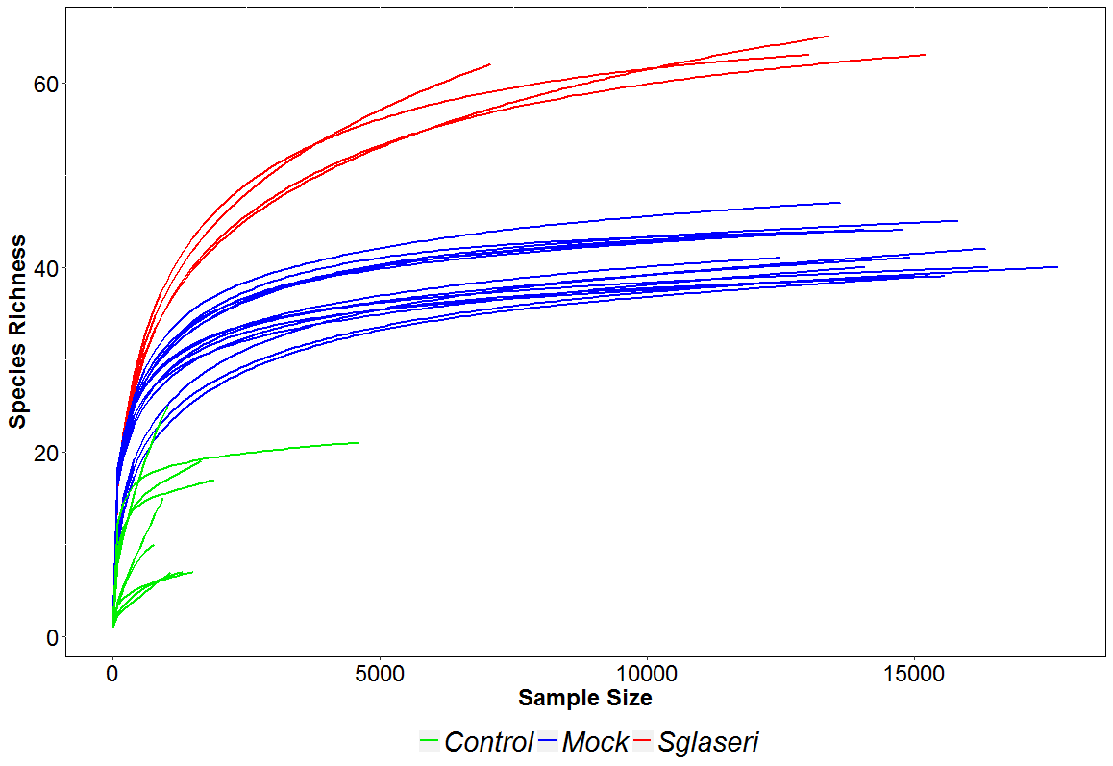
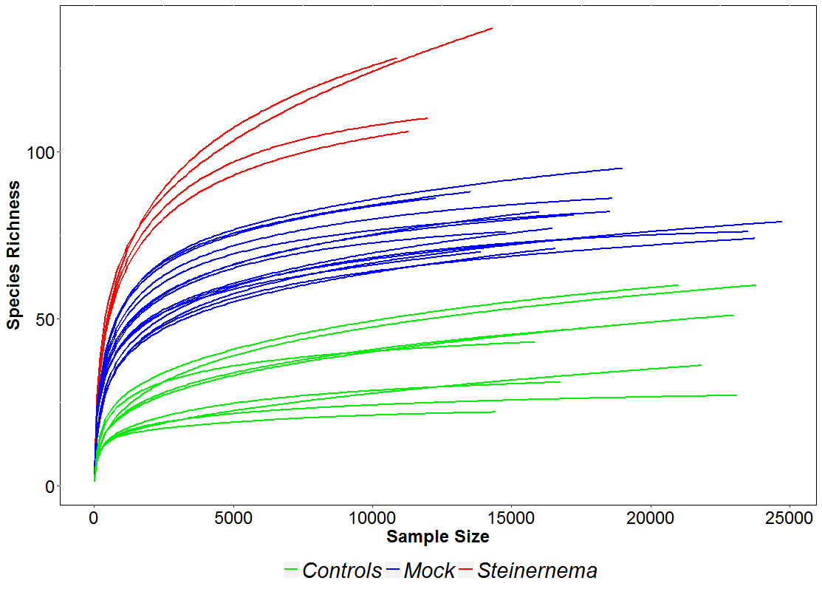
Additional file 2
A. rpoB marker
B. V3V4 marker

