Slide 1
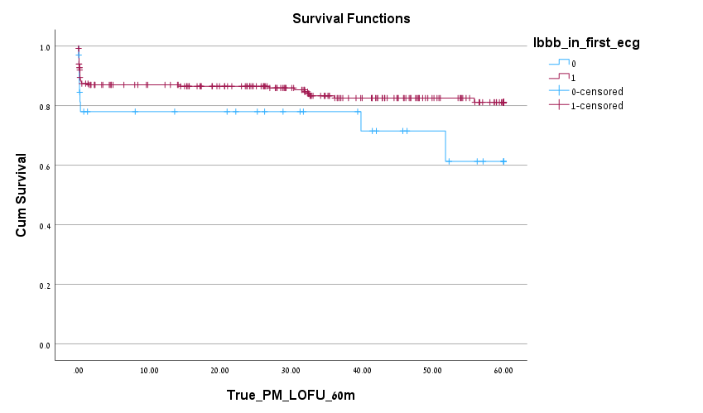
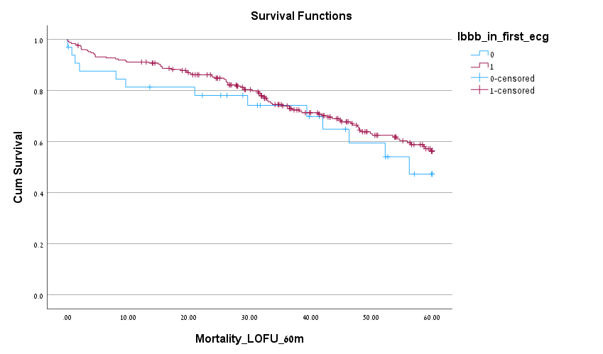
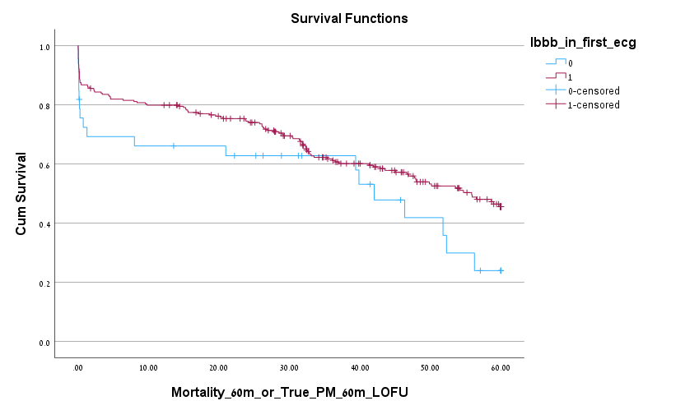
A
B
C
PPI free survival
Mortality free survival
PPI or mortality free survival
P=0.086
P=0.37
P=0.063
Months
Months
Months
Kaplan-Meier curves for A-permanent pacemaker implantation, B-Mortality, C-combined endpoint of
PPI and mortality during 5-years follow-up. A nonsignificant worst outcome is shown in all curves for patients
with delayed (blue line) compared to immediate (red line) post TAVR LBBB.

