Slide 1
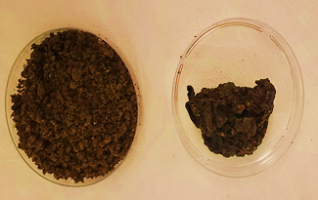
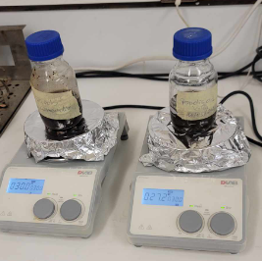
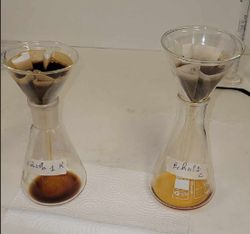
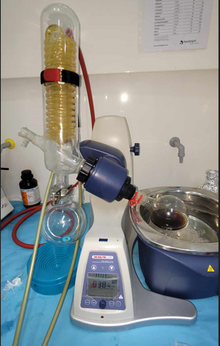
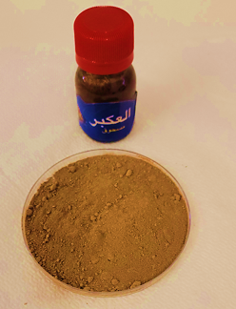
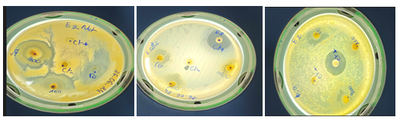
Physicochemical and biological characterization of propolis extracts
Algerian propolis sample
Phenolic compounds extraction:
70% EtOH (1:10 w/v), ≤45 °C, 24 h
Commercial propolis sample
Antimicrobial activity
Antioxydant activity
(DPPH• method)
FTIR, NMR, ATG/DSC and X-ray Diffraction analyses
LC–MS/MS analyses
Algerian propolis:
IC₅₀ = 0.20 mg/mL
Flavonoids
(apigenin, myricetin, luteolin, quercetin-3-glucoside);
Phenolic acids
(caffeic, p-coumaric, salicylic)
Algerian propolis:
highly crystalline,
thermally less stable, and enriched in bioactive compounds and mineral content
Staphylococcus aureus
IZ= 30 mm

