Slide 1
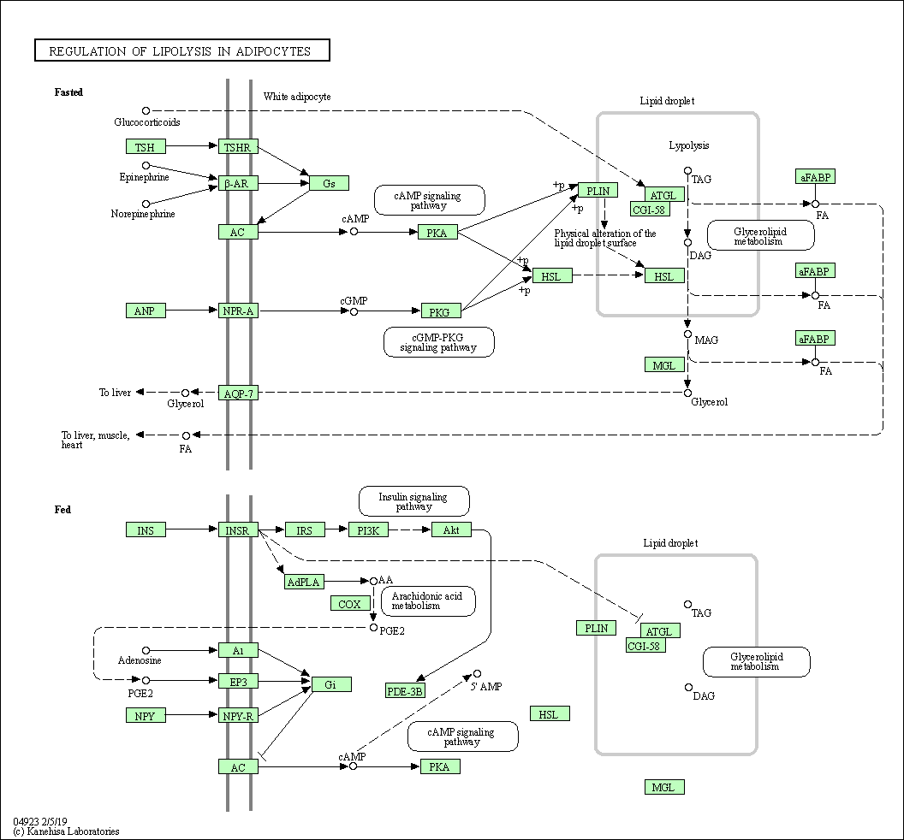
Supplemental figure 3
PNPLA3

