Slide 1
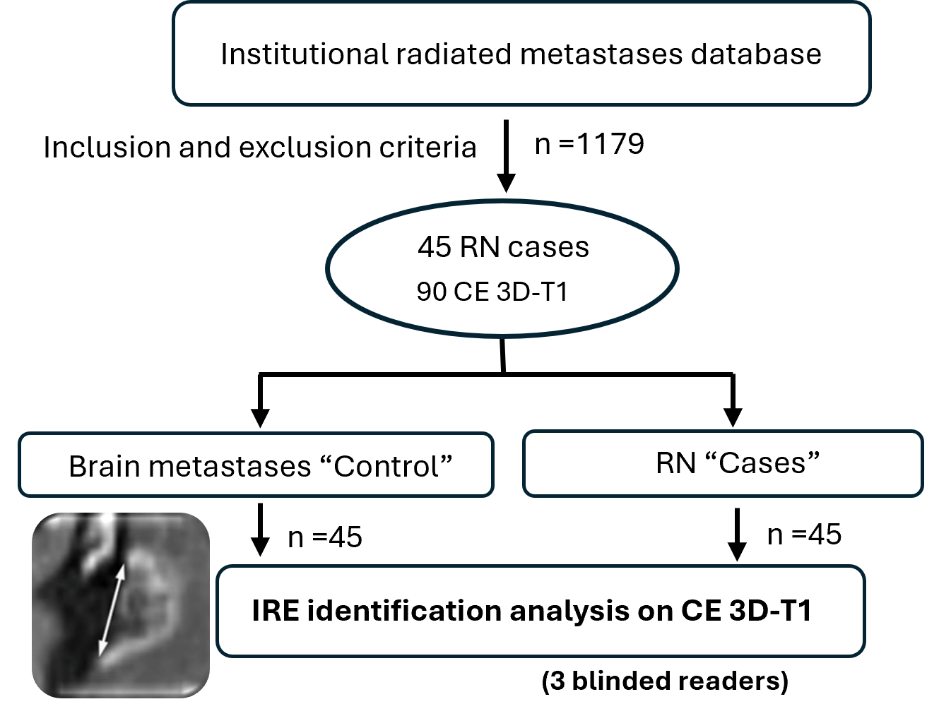
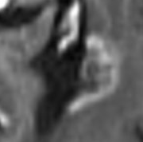
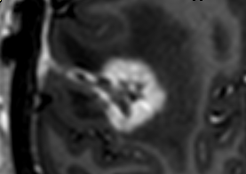



Imaging MRI Biomarkers for Diagnosing Brain Radionecrosis: Focus on Incomplete Ring Enhancement Sign
Does the incomplete ring enhancement (IRE) sign reliably identify brain radionecrosis on MRI?
Enlarging lesion following stereotactic radiotherapy
Additional features of RN
Fragmentation
Satellite lesion
Watershed distribution
INCOMPLETE RING ENHANCEMENT
±
+
-
Tumor
MRI
Brain
Single
RADIONECROSIS
The incomplete ring enhancement sign is an early, reliable imaging biomarker of brain radionecrosis, visible on contrast-enhanced 3D-T1 weighted MRI.
Eur Radiol (2025) Ortiz de Mendivil A., Santana-Suarez E., Pérez-Beteta J., Ciérvide R., Diamantopoulos J. et al.

Slide 2
Imaging MRI Biomarkers for Diagnosing Brain Radionecrosis: Focus on Incomplete Ring Enhancement Sign
Incomplete ring enhancement (IRE) sign reliably identify brain radionecrosis on CE 3DT1 GRE sequence
Enlarging lesion following stereotactic radiotherapy
Additional features of RN
Fragmentation
Satellite lesion
Watershed distribution
INCOMPLETE RING ENHANCEMENT
±
+
-
Tumor
MRI
Brain
Single
RADIONECROSIS
The incomplete ring enhancement sign is an early, reliable imaging biomarker of brain radionecrosis, visible on contrast-enhanced 3D-T1 weighted gradiente echo-sequence.
Ortiz de Mendivil A., Santana-Suarez E., Pérez-Beteta J., Ciérvide R., Diamantopoulos J. et al.

