Slide 1
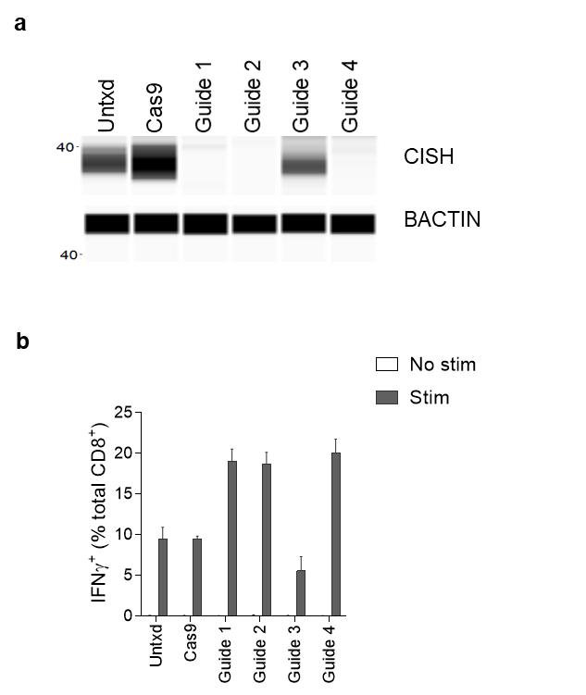
Extended Data Figure 1
Notes:
NY-ESO transduced cells, lymphocytes, live, CD8⁺ gated
6 hour coculture with plate-bound OKT3 (stim)
Wes performed with 2e6 cells without resting and without stimulation

Slide 2
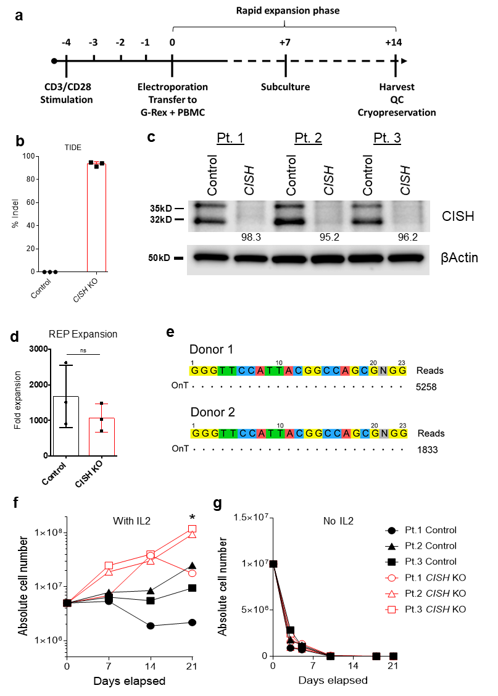
Extended Data Figure 2

Slide 3
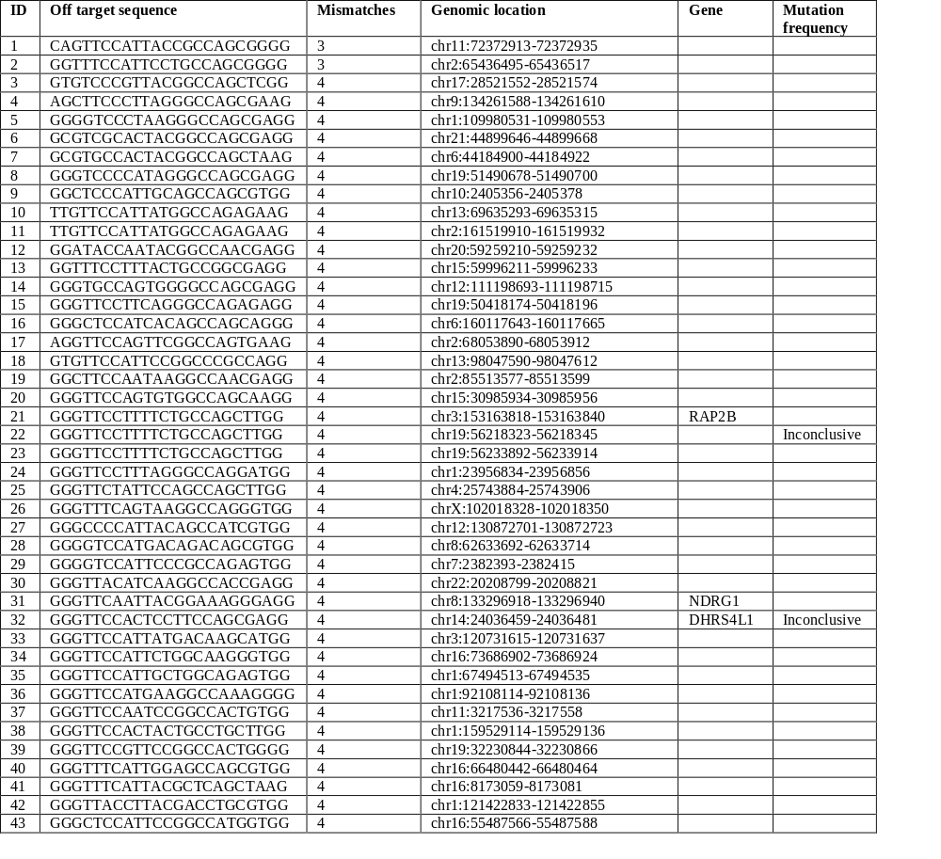
Extended Data Table 1

Slide 4
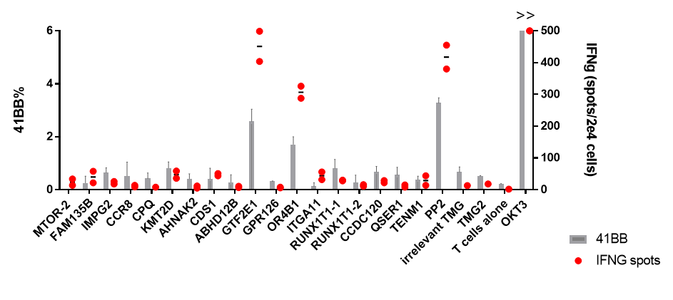
Extended Data Figure 3

Slide 5
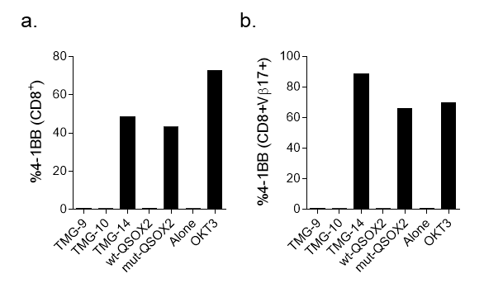
Extended Data Figure 4
Notes:
(A) 4-1BB upregulation of reactive TIL fragment (Pt. 4071) and antigen loaded autologous B cells after an overnight coculture. (B) 4-1BB upregulation in reactive CD8⁺ and CD8⁺ bearing the clonotypic Vβ17 TCR TIL. (C) Composition of CD4⁺, CD8⁺ and CD8⁺ T cells bearing the clonotypic Vβ17 TCR in the treatment TIL.

Slide 6
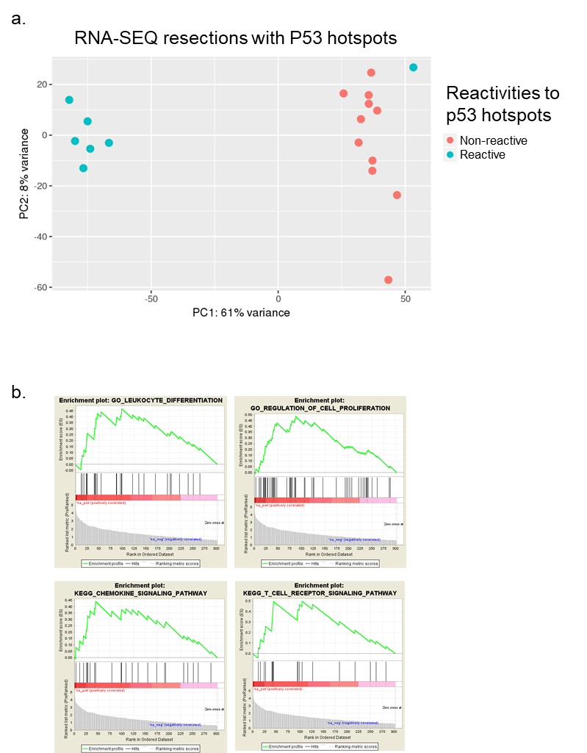
Extended Data Figure 5

Slide 7
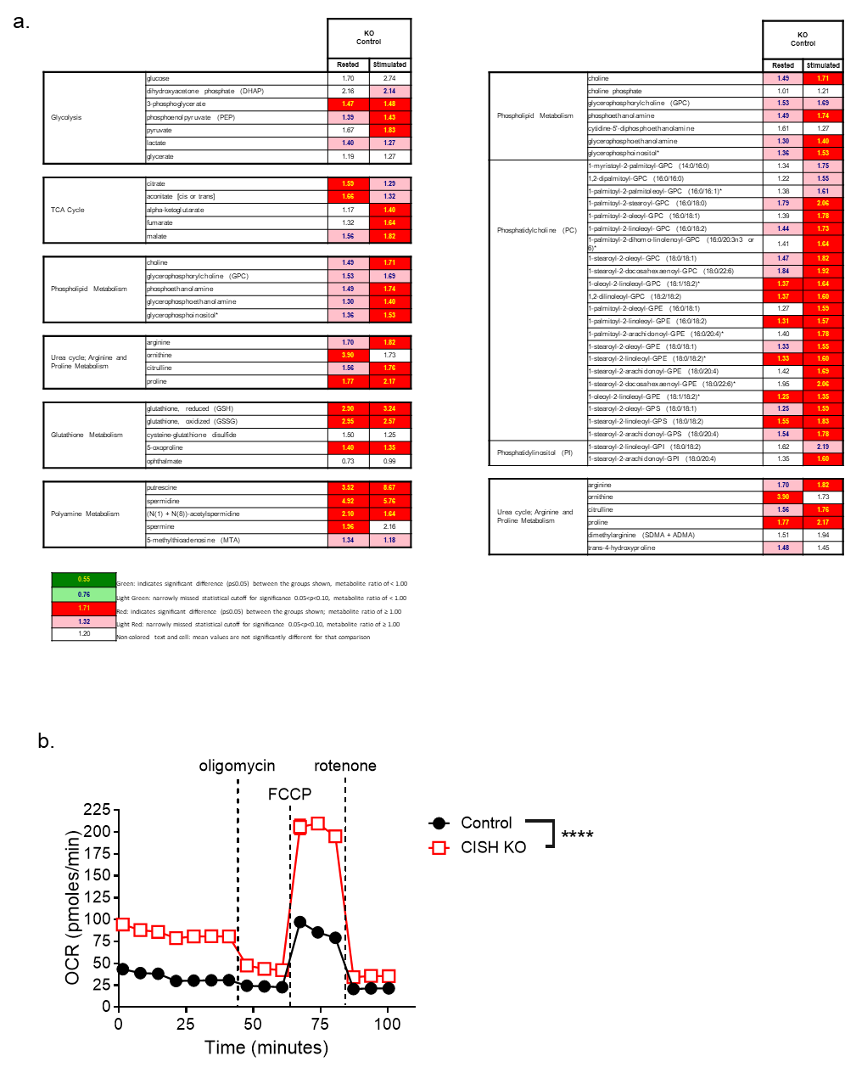
Extended Data Figure 6

