Slide 1
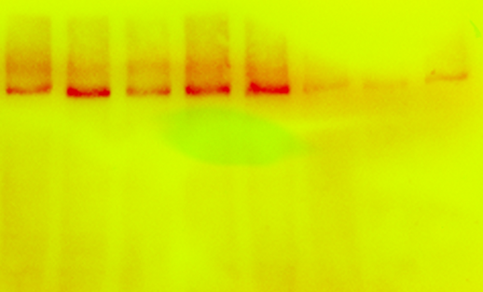
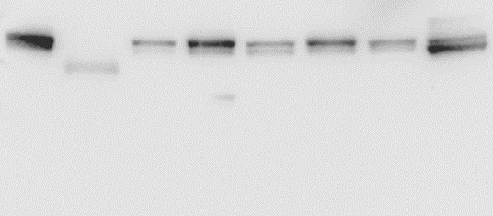
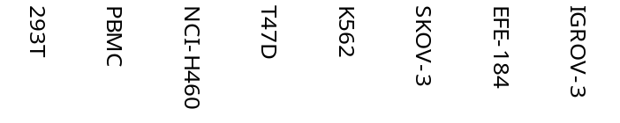
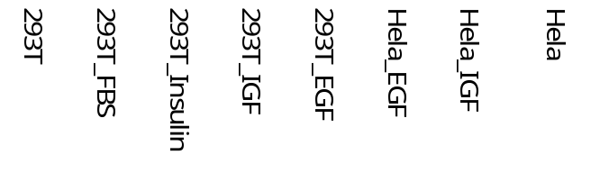
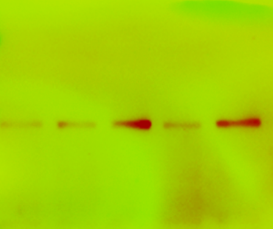
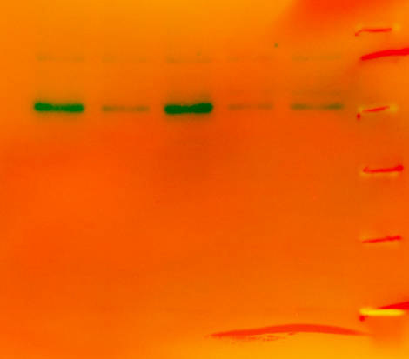
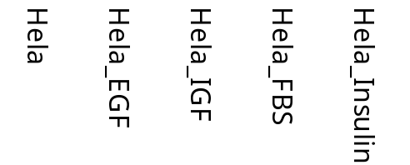
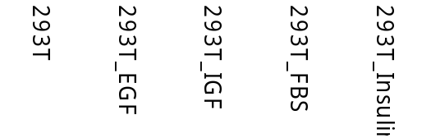
kDa
Akt
68 kDa
kDa
ACC_pS79
280 kDa
75
245
63
180
48
135
35
100
kDa
kDa
135
75
100
Akt _pT308
60kDa
Akt _pS473
60 kDa
75
63
63
48
48
35

Slide 2
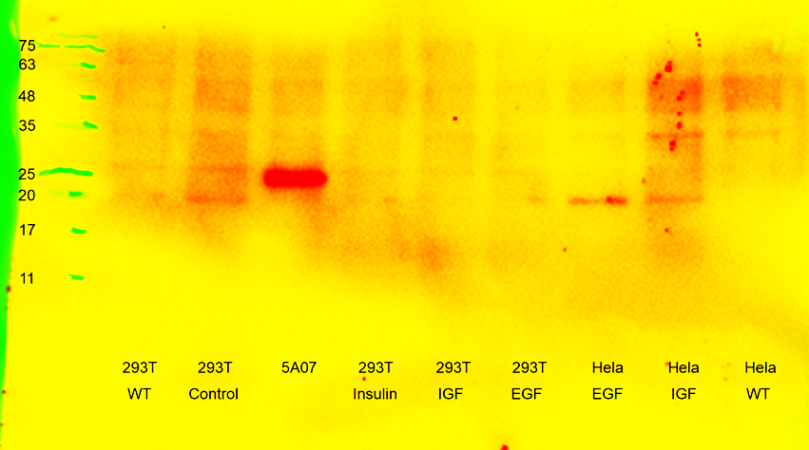
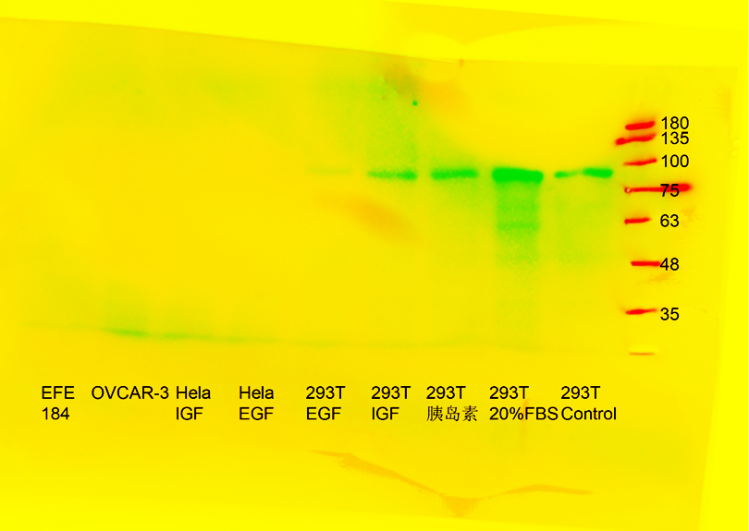
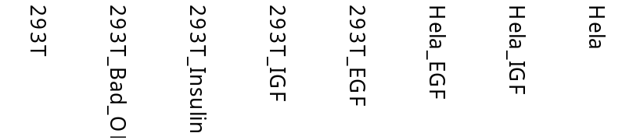
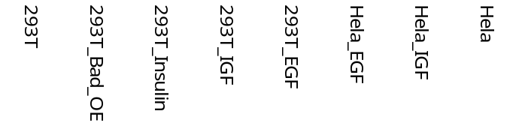
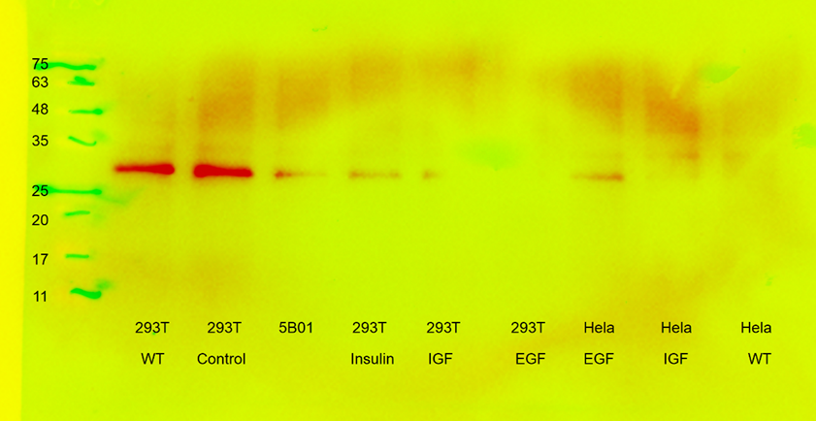
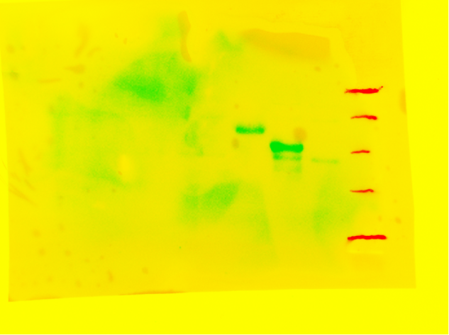
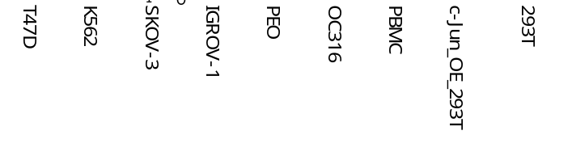
kDa
kDa
B-Raf_pS445
86 kDa
135
48
100
35
75
Bad _pS112
23 kDa
25
63
20
45
17
35
kDa
48
kDa
cdc2 _pY15
30 kDa
35
63
c-Jun_pS73
48 kDa
25
48
20
35
17
25
11

Slide 3
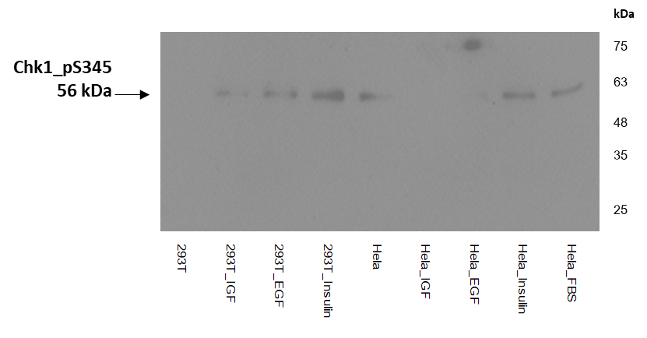
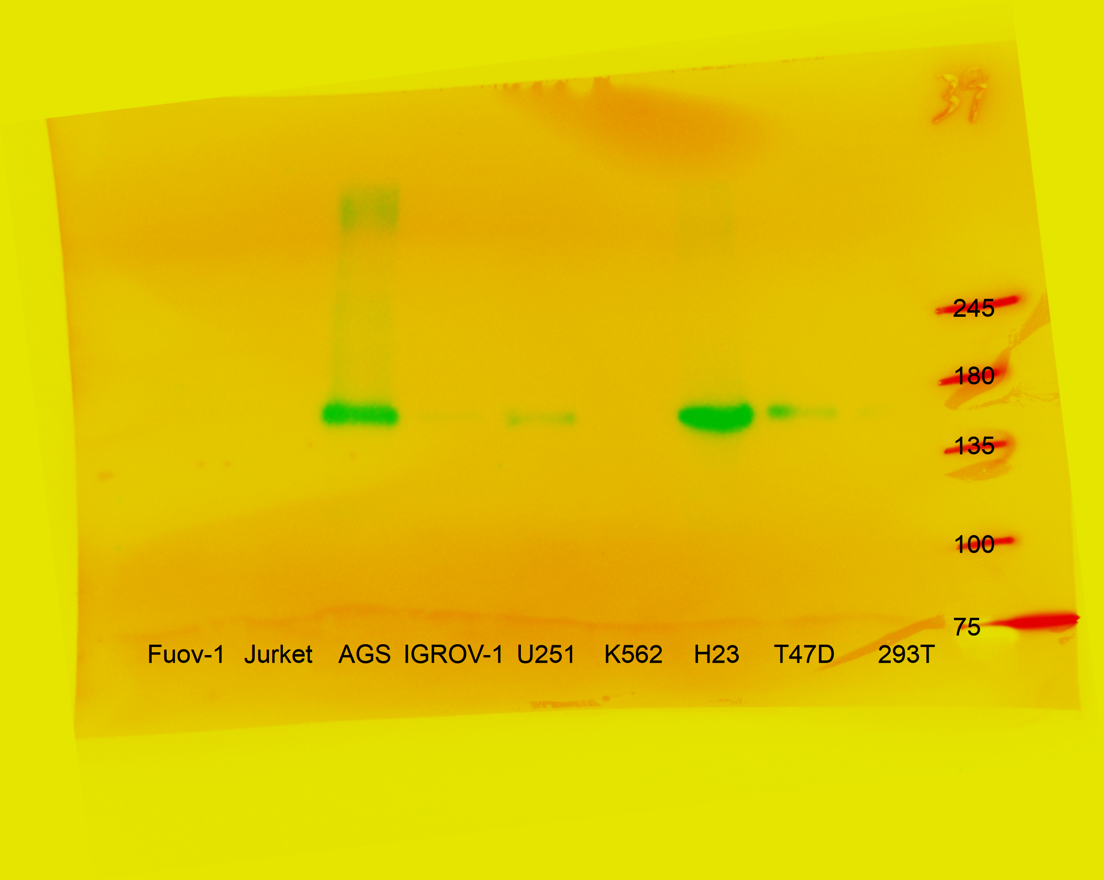
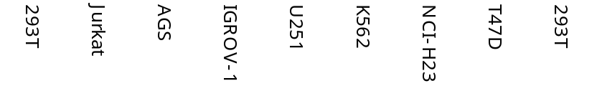
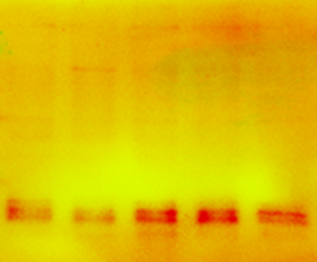
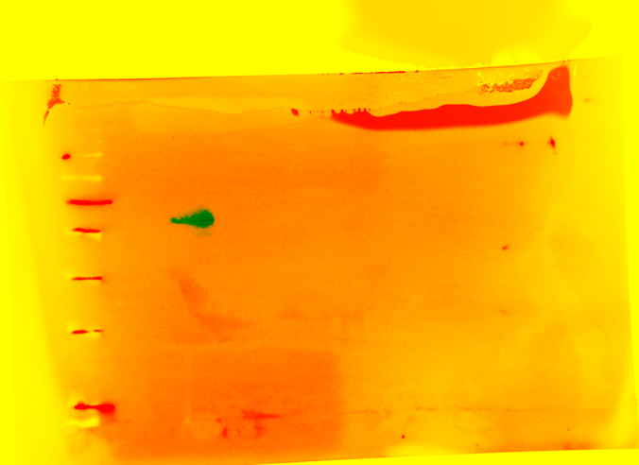
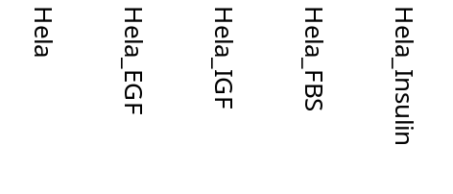
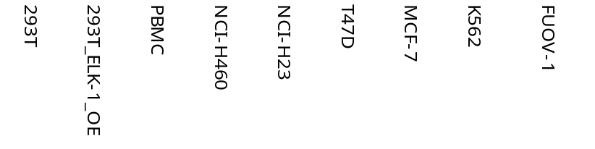
kDa
245
c-Met_pY1234/1235
155 kDa
180
135
100
75
kDa
kDa
135
63
100
Elk-1_pS383
47 kDa
75
48
63
35
48
4E-BP1 (Thr37/46)
17-20 kDa
25
20
35
17

Slide 4
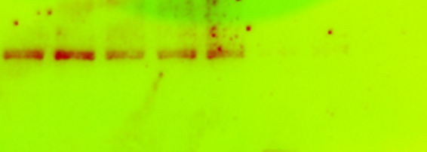
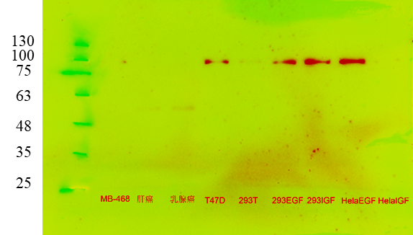
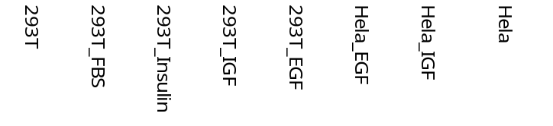
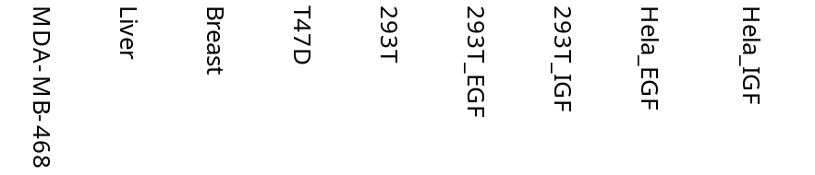
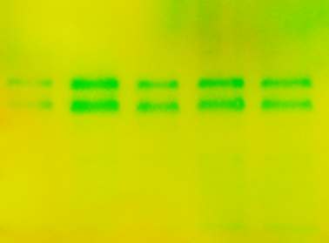
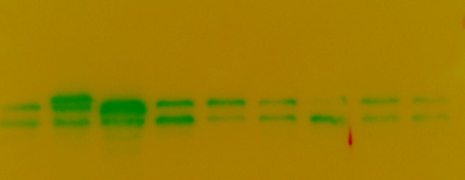
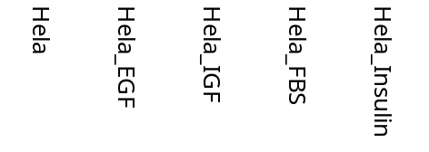
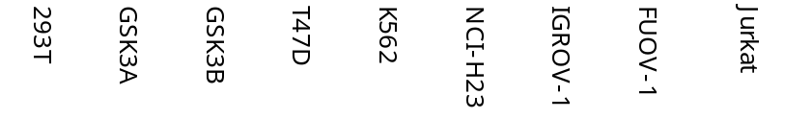
kDa
Erk5_pT218/Y220
115 kDa
180
FoxO3a_pS318/321
97 kDa
kDa
135
100
100
75
75
63
63
48
48
35
kDa
75
kDa
GSK-3α/β_S21/9
53 kDa
63
100
48 kDa
48
75
GSK-3alpha/beta
51 kDa
63
35
47 kDa
48
25
35

Slide 5
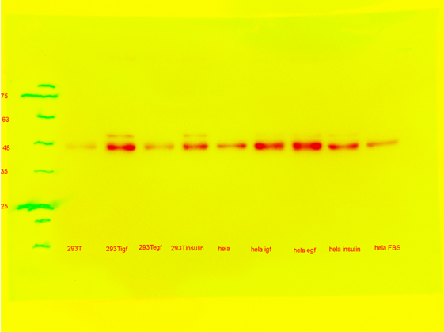
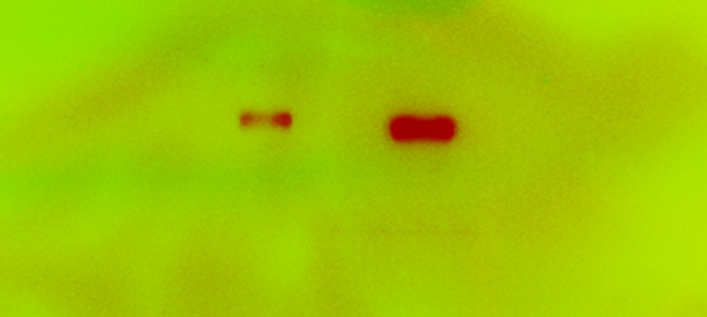
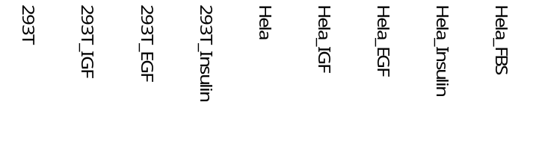
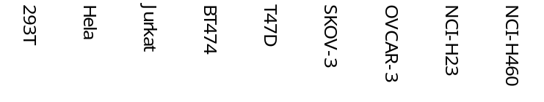
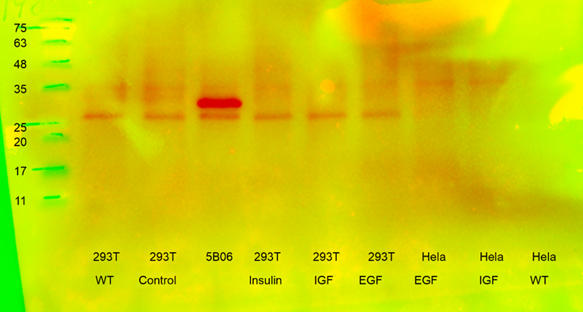
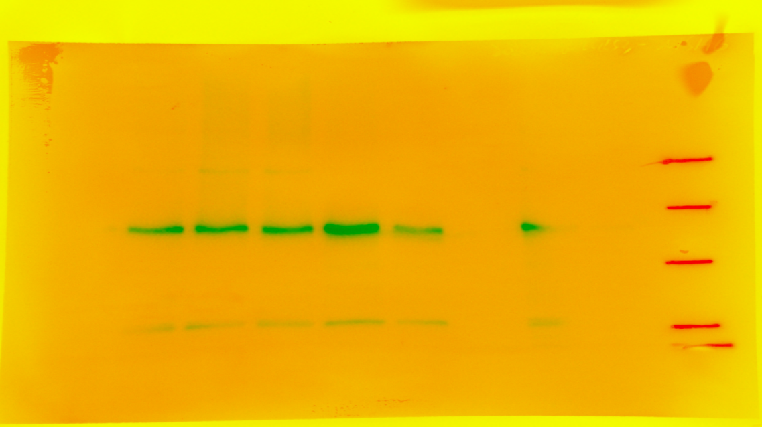
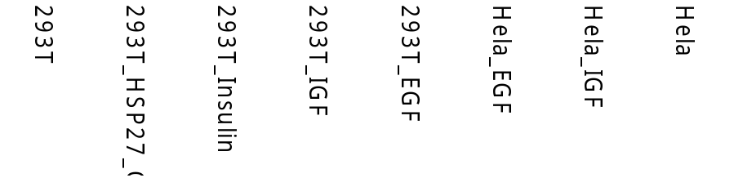
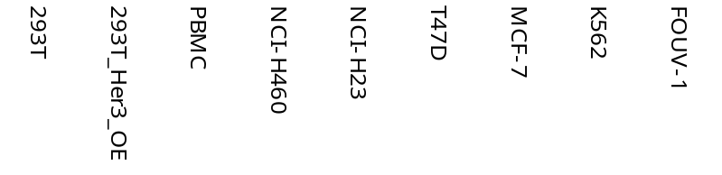
kDa
kDa
100
245
75
Her2_pY1196
137 kDa
GSK-3beta_pS9
46 kDa
63
180
48
135
35
100
25
75
kDa
kDa
245
HSP27_pS82
27 kDa
35
Her3_pY1289
148 kDa
180
25
135
20
17
100
11
75

Slide 6
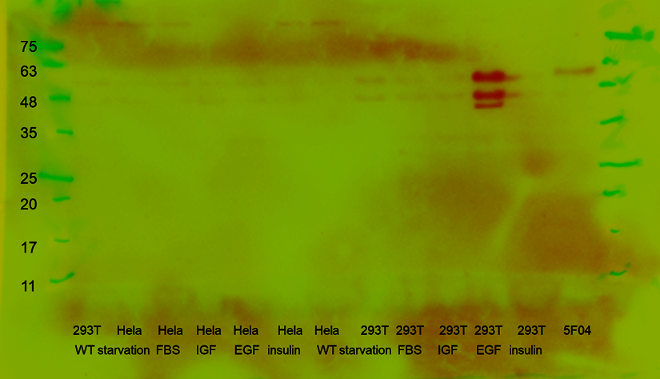
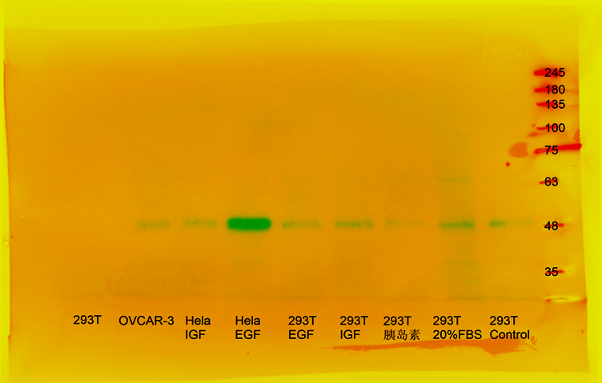
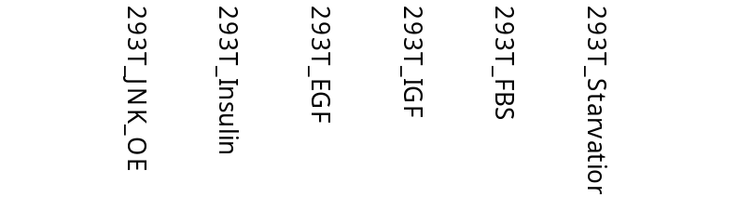
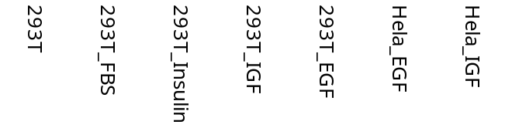
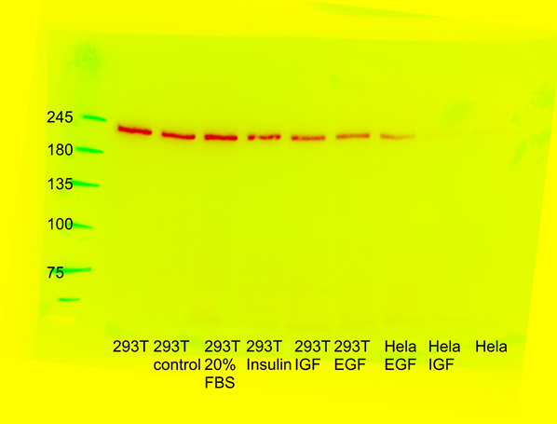
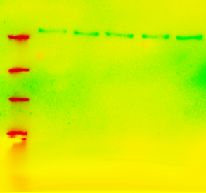
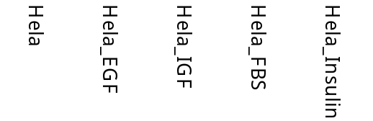
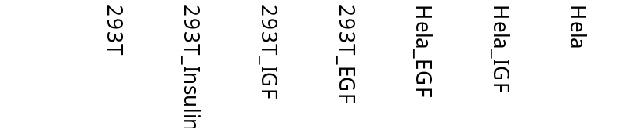
JNK_pT183/Y185
54 kDa
kDa
kDa
63
135
46 kDa
48
100
75
35
MEK1/2_pS217/221
45 kDa
63
25
48
20
35
kDa
kDa
Myosin IIa_pS1943
226 kDa
245
mTOR _pS2448
289 kDa
245
180
135
180
100
135
75
100

Slide 7
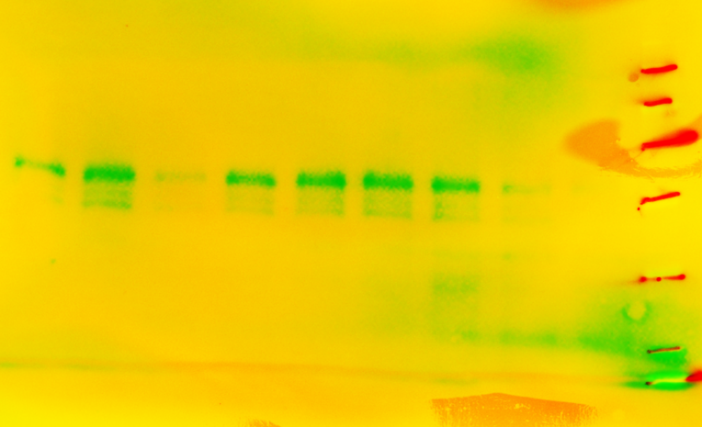
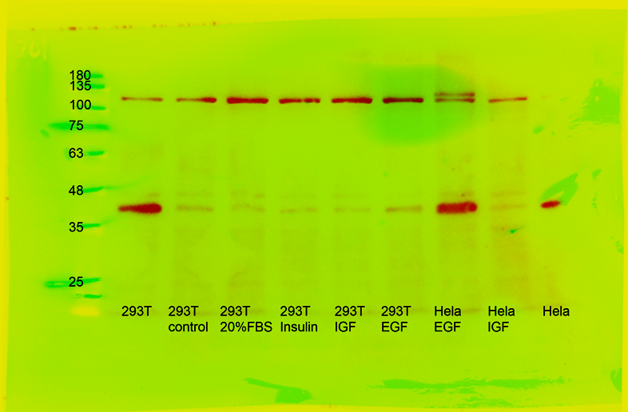
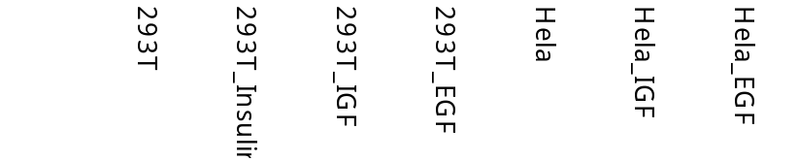
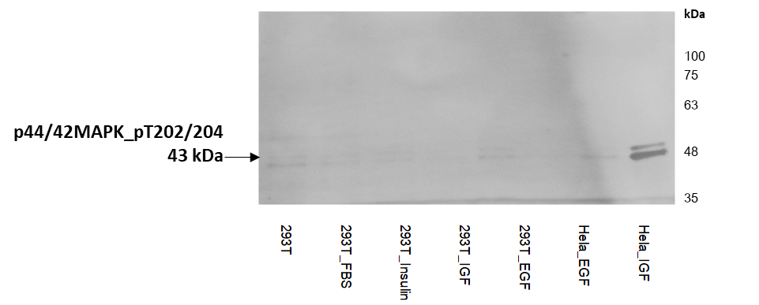

kDa
kDa
75
135
63
100
p38 MAPK _pT180/Y182
43 kDa
PDK1_pS241
58-68 kDa
75
48
63
35
48
25
kDa
100
75
63
P44/42 MAPK _pT202/Y204
44 kDa
48
42 kDa
35

Slide 8








kDa
kDa
PKC Beta II_pS660
85 kDa
135
PKCd_pS664
78 kDa
100
100
75
75
63
63
48
48
35
kDa
kDa
Raf1_pS296
73 kDa
100
75
63
245
48
35
180
Rb_pS807/811
110 kDa
135
100

Slide 9








kDa
75
kDa
S6_pS240/244
32 kDa
75
48
S6_pS235/236
32 kDa
48
35
35
25
25
17
17
kDa
kDa
100
135
Src_pY416
60 kDa
75
100
63
75
Src_pY527
60 kDa
48
63
35
48

Slide 10








kDa
kDa
135
EGFR_pY1173
170 kDa
180
100
135
Syk
72 kDa
75
100
63
75
48
63
kDa
kDa
135
135
100
ER alpha
66 kDa
100
75
75
alpha-Tubulin
50 kDa
63
63
48
48
35

Slide 11










kDa
kDa
75
100
63
75
GAPDH
35 kDa
48
β-Actin
45 kDa
63
35
48
35
25
kDa
kDa
75
75
GSK3 beta
46 kDa
63
p53
53 kDa
63
48
48
35
35
25
25
kDa
Nrf2
66 kDa
100
75
63
48
35

Slide 12








kDa
kDa
LAG3
57 kDa
63
63
48
PD-L1
40-50 kDa
48
35
35
25
25
17
17
11
11
kDa
kDa
63
63
TTF1
38kDa
48
48
35
35
25
25
S100B
11 kDa
17
11
17
11

Slide 13








kDa
kDa
ROS1
263 kDa
245
Topoisomerase II α
174 kDa
180
180
135
135
100
100
75
75
VEGFR3
195 kDa
kDa
kDa
245
75
PD-1
47-55 kDa
63
180
48
135
100
35
75
25
17

Slide 14








kDa
kDa
75
75
63
VEGF
40 kDa
63
NAPSIN-A
35 kDa
48
48
35
35
25
25
17
17
kDa
135
kDa
p40
77kDa
100
75
Beta-tubulinIII
50kDa
63
75
48
63
35
48
35
25
25
17

Slide 15







kDa
kDa
100
Cytokeratin7
51 kDa
75
EGFR
175 kDa
245
63
180
48
135
35
100
25
75
kDa
EGFR
175 kDa
kDa
180
p40
77 kDa
100
135
75
100
63
75
63
48
35

Slide 16










kDa
kDa
Replicate 1
63
63
48
48
35
35
25
25
MelanA
13-20 kDa
20
MelanA
13-20 kDa
20
17
17
11
11
kDa
kDa
63
48
63
35
48
25
35
MelanA
13-20 kDa
20
MelanA
13-20 kDa
17
25
20
11
17
11
kDa
63
48
35
25
20
MelanA
13-20 kDa
17
11

Slide 17









kDa
kDa
Replicate 2
63
63
48
48
35
35
MelanA
13-20 kDa
25
25
20
MelanA
13-20 kDa
20
17
17
11
11
kDa
kDa
63
48
48
35
35
MelanA
13-20 kDa
25
25
20
MelanA
13-20 kDa
20
17
17
11
11
5
kDa
48
35
MelanA
13-20 kDa
25
20
17
11
5

Slide 18









kDa
kDa
Replicate 3
63
63
48
48
35
35
MelanA
13-20 kDa
25
MelanA
13-20 kDa
25
20
20
17
17
11
11
kDa
kDa
63
48
48
35
35
MelanA
13-20 kDa
25
25
20
20
MelanA
13-20 kDa
17
17
11
11
5
kDa
48
35
25
MelanA
13-20 kDa
20
17
11
5

